Slide 1
Cholesterol Screening in Children and Young Adults. Where are we going?
Don P. Wilson, M.D., FNLA
Fellow, American Board of Clinical Lipidology
Pediatric Endocrinology
Cook Children’s Medical Center
Fort Worth, Texas

Slide 2
Disclosures
Osler Institute - Speaker
Insulet - Speaker
Aegerion Pharmaceuticals - Advisory Board
Alexion Pharmaceuticals - Advisory Board
Merck Sharp & Dohme - Research Funding
Novo Nordisk Inc.- Research Funding
Notes:
Speaker notes
THIS IS A TEMPLATE SLIDE
Please insert relevant details of your job role, career history, and current responsibilities

Slide 3
Rationale for
Cholesterol Screening
Abnormal lipid values are highly prevalent.
Well documented relationship between total and LDL-C levels and CHD risk.
Treatment decreases the risk of CVD events.
Early knowledge of a lipid disorder creates the best opportunity for early intervention.

Slide 4

Principles of Screening
Congenital Hypothyroidism
Serious Morbidity and Mortality
Reliable Testing
Effective Treatment
Willing
to
Treat
Affects 1:4000 newborns
Shared Decision
Physician
Parent
Increased Risk
Developmental Delay
Mental Retardation
Treatment
Thyroid Hormone
10-15 mcg/kg/d
Reliable monitoring
Testing - TSH
Reliable
Specific

Slide 5
Newborn Screening

Slide 6

Question
Which of the following is the key goal of cholesterol screening?
Familial hypercholesterolemia.
All genetic disorders associated with increased atherogenic cholesterol.
All acquired conditions associated with increased atherogenic cholesterol.
a and b.
b and c.

Slide 7
Cholesterol Screening
World Health Organization
9 Key Principles of Screening
Wilson JMG, Jungner G. PRINCIPLES AND PRACTICE OF SCREENING FOR DISEASE. In: Organization WH, editor. Geneva: World Health Organization; 1968.

Slide 8

An important health problem.
#1
CVD is the leading cause of morbidity and mortality worldwide.
In the U.S. more than 600,000 ( ̴̴ 1 in 4) die of heart disease each year.
Of those with heart disease, coronary heart disease is the most common, killing > 370,000 people annually.
Abnormalities in lipoprotein metabolism represent approximately 50% of the population attributable risk of CVD.
^{CDC, 2015; Mozaffarian D, 2015}

Slide 9
An important health problem.
#1
Cholesterol screening has the potential to identify a wide variety of primary and secondary conditions, including:
Genetic mutations in lipid and lipoprotein metabolism.
Acquired dyslipidemia, especially related to unhealthy lifestyles, obesity, medications, etc.
It is, therefore, critical to identify the primary goal of cholesterol screening.

Slide 10
An important health problem.
#1
Many believe familial hypercholesterolemia (FH) should be the primary goal of cholesterol screening. Why FH?
Mortality rates from CHD in FH:
  100x greater in those age 20-39
  4x greater in those age 40-59
Children with untreated HeFH have a dramatic increase in risk of premature CHD after 20 years of age.
Youssef AA, Srinivasan SR, Elkasabany A, Chen W, Berenson GS. Trends of lipoprotein variables from childhood to adulthood in offspring of parents with coronary heart disease: the Bogalusa Heart Study. Metabolism. 2001; 50:1441–6.

Slide 11
Question
In the U.S. how frequently, on average, is a child born with familial hypercholesterolemia (FH)?
Every 1 minute
Every 5 minutes
Every 10 minutes
Every 60 minutes
Familial hypercholesterolemia 1:250

Slide 12
An important health problem.
#1
Current diagnosis and treatment of FH is:
  Very inadequate (<1% indentified)
  Often delayed
  Despite effective interventions, late treatment often results in significant residual risk and poor outcomes.

Slide 13
An important health problem.
#1
Cholesterol screening – What are the cons?
Some argue that screening young adults w/out other risk factors for CVD should be delayed until > 40 yrs of age, since absolute risk reduction in CVD events will be small.
There are no studies showing a positive effect of screening in young adults (e.g., ages 18-35)

Slide 14
An important health problem.
#1
Cholesterol screening – What are the cons?
Screening the entire population:
  Can be costly
  May result in the use of unnecessary medication in lower-risk individuals.
Therefore for some, the benefits of screening individuals < 40 yrs of age is uncertain.

Slide 15
#2
Accepted treatment for
patients with recognized disease.
A variety of effective lipid lowering medications are available for the treatment of FH:
Children 6 yrs of age and older: rosuvastatin*
Children 8 yrs of age and older: pravastatin
Children 10 yrs of age and older:
  All statins (except pitavastatin)
  Ezetimibe
  Colesevelam
*Europe

Slide 16
2011 NHLBI’s Expert Panel
#2
Accepted treatment for
patients with recognized disease.
“What was said…”
All children should undergo lipid screening and interventions for genetic and acquired risk factors and conditions.
What was heard…”
All children who are obese should undergo lipid screening and treated with statins.

Slide 17
#3
Recognizable latent or early symptomatic stage.
Children and young adults with FH are rarely symptomatic.
While CVD typically manifests in adulthood, the process begins in childhood.
Identifying children is critical to reducing the burden of disease in adulthood.
Some, but not all, guidelines underscore the value of noninvasive imaging of atherosclerosis (e.g. cIMT) in assessing and managing asymptomatic FH subjects.

Slide 18
#4
Suitable test or examination.
The majority of FH children and young adults have no physical signs/symptoms of hypercholesterolemia.
Blood testing
  Cholesterol - quick, easy, inexpensive and generally reliable.
  Genetic Testing - costs are high, but improving.

Slide 19
#4
Suitable test or examination.
Question: True or False?
The US Preventative Task Force recommended against cholesterol screening in children and adolescents?
“The USPTF concludes that the current evidence is insufficient to assess the balance of benefits and harms of screening for lipid disorders in children and adolescents 20 years or younger.”
Therefore, the USPTF statement is neither for or against.
Screening for Lipid Disorders in Children and Adolescents: US Preventive Services Task Force Recommendation Statement. JAMA. 2016; 316(6):625-33.

Slide 20
#4
Suitable test or examination.
Summary of USPTF Screening Recommendations
 | Men | Recommendation |  | Criteria
 | 20-35 | Recommended |  | If at increased risk for CHD
 | 35 and Older | Strongly recommended |  | None
 | Women | Recommendation | Criteria
 | 20-45 | Recommended | If at increased risk for CHD
 | 45 and Older | Strongly recommended | If at increased risk for CHD
Final Recommendation Statement: Lipid Disorders in Adults (Cholesterol, Dyslipidemia): Screening. U.S. Preventive Services Task Force. December 2014.

Slide 21
#4
Suitable test or examination.
USPTF preferred screening tests: TC and HDL-C on non-fasting or fasting samples.
Measuring TC alone is acceptable.
Optimal interval for screening is uncertain; reasonable options include every 5 years, or sooner if clinically indicated.
An age to stop screening has not been established.
Screening for Lipid Disorders in Children and Adolescents: US Preventive Services Task Force Recommendation Statement. JAMA. 2016; 316(6):625-33.

Slide 22
What age to screen?
Cholesterol Screening
Age | Type | Criteria
> 2 yrs of age | Selective | 1 or both biologic parents known to have hypercholesterolemia or are receiving LLM; or Family history of premature CVD (i.e. men < 55 yrs; women < 65 yrs); or Whose family history is unknown (e.g. children who were adopted).
> 10 yrs of age* | Universal | Regardless of general health or the presence/absence of CVD risk factors. If normal, repeat every 5 yrs.
*Selective screening if clinically indicated. LLM = lipid-lowering medications; CVD = cardiovascular disease National Lipid Association Annual Summary of Clinical Lipidology 2017. J of Clinical Lipidology (2016) , S1-S50

Slide 23
European Atherosclerosis Society
Children suspected of FH should be screened from the age of 5 years.
Cascade screening of families is recommended using a combined phenotypic and genotypic strategy.
Universal screening of children may be another option, depending on practical and cost considerations.

Slide 24
What age to screen?
The literature suggests that the optimal age range for screening is between 1 - 9 years, as determined by optimal discrimination using cholesterol measurement between children with and without FH.
Wald David S, Bestwick Jonathan P, Wald Nicholas J. Child-parent screening for familial hypercholesterolaemia: screening strategy based on a meta-analysis BMJ 2007; 335 :599

Slide 25
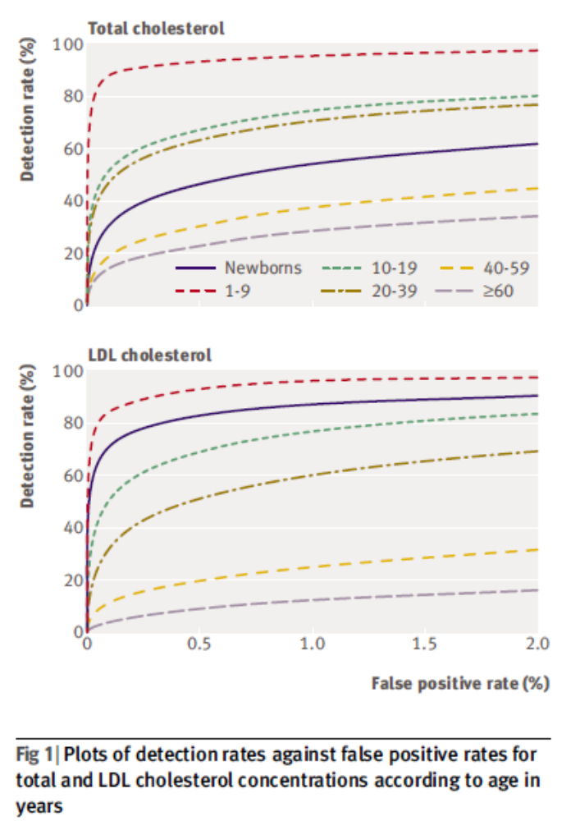
Detection rate plotted against the false positive rate for total and LDL-C measured at different ages.
This illustrates the maximum
discrimination at 1-9 yrs and shows that there is little
additional increase in the detection rate as the false
positive rate increases above 1%.
Detection Rate (%)
At a false positive rate of 0.1%, the detection rate in the 1-9 yr age group was:
Total Cholesterol 88%
LDL Cholesterol 85%
Detection Rate (%)
Wald David S, Bestwick Jonathan P, Wald Nicholas J. Child-parent screening for familial hypercholesterolaemia: screening strategy based on a meta-analysis BMJ 2007; 335 :599

Slide 26
#5
Test should be acceptable
to the population.
Cholesterol Screening – Patient/Family Concerns
Testing methods
  Finger prick vs. venipuncture
  Fasting vs. non-fasting
  POC vs. Lab
Psychological issues (e.g. “fatalism”)
Practical issues
  Cost of testing/insurance coverage
  Increased life insurance premiums

Slide 27
A systematic review and meta-analysis on screening lipid disorders in the pediatric age group.
Aim: Assess the effectiveness of lipid screening in youth (2 to 20 yr) according to the existence of positive family history of CVD risk factors.
Study cohort: 37,304 assessed for dyslipidemia.
Results:
Sensitivity = 42.65% / Specificity = 59%
Predictive value = 20.7%
Kelishadi R, Haghdoost AA, Moosazadeh M, Keikha M, Aliramezany M. A systematic review and meta-analysis on screening lipid disorders in the pediatric age group. J Res Med Sci 2015;20:1191-9.

Slide 28
Family History
Reliance on family history alone as a basis for lipid screening fails to identify as many as 30-60% of children and adolescents with elevated levels of cholesterol.
Dennison 1989, Griffin 1989, Freedman 1992

Slide 29
Natural history of the condition
should be adequately understood.
#6
Ischemic Heart
Disease
Cerebrovascular
Disease
Peripheral Vascular
Disease
Lesion: Initiation
→ Progression
→ + Stable
No Symptoms
+ Symptoms
Symptoms
Reversible
+ Reversible
Non - Reversible
Years

Slide 30
#7
Agreed policy on
whom to treat.
Guidelines and Recommendations are available from a variety of professional organizations and societies:
National lipid Association
ACC/AHA
NHLBI/NIH
USPSTF
American Academy Pediatrics
American Academy of Clinical Endocrinologist
American Diabetes Association
… and others, including European guidelines

Slide 31
#7
Agreed policy on
whom to treat.
Application of pediatric vs adult guidelines for lipid levels, which consider additional CVD risk factors beyond age and LDL-C, might result in statin treatment for more than 400,000 additional adolescents and young adults
JAMA Pediatr. 2015 Jun;169(6):569-74. doi: 10.1001/jamapediatrics.2015.0168. Application of Pediatric and Adult Guidelines for Treatment of Lipid Levels Among US Adolescents Transitioning to Young Adulthood. Gooding HC1, et. al.

Slide 32
#8
Cost of case-finding should
be economically balanced.
Cost effectiveness of screening for FH is dependent upon 3 factors:
Cost effectiveness of treatment, once FH is identified.
The underlying prevalence of FH among the screened population.
The accuracy (validity) of the screening test.
A systematic review of economic evaluations of the detection and treatment of familial hypercholesterolemia. Ademi, et al. International Journal of Cardiology 167 (2013) 2391–2396.

Slide 33
#8
Cost of case-finding should
be economically balanced.
For the vast majority of children with FH, there is 1 affected parent.
Child-parent screening strategies have the potential to prevent medical consequences of FH in 2 generation simultaneously.
Wald David S, Bestwick Jonathan P, Wald Nicholas J. Child-parent screening for familial hypercholesterolaemia: screening strategy based on a meta-analysis BMJ 2007; 335 :599

Slide 34
#8
Cost of case-finding should
be economically balanced.
Conclusion:
Cascade screening is more cost effective than any other screening strategy currently available.
However, cost of genetic testing has dramatically decreased in recent years, and may become more acceptable and feasible in the future.
Ademi, et al. International Journal of Cardiology 167 (2013) 2391–2396.
Marks D, Wonderling D, et al. BMJ. 2002;324(7349):1303. National Institute for Health and Clinical Excellence (NICE). Familial Hypercholesterolaemia – Costing Report: Implementing NICE guidance. 2009. pp.1–42. https://www.nice.org.uk/guidance/cg71/resources/familialhypercholesterolaemia-costing-report2.

Slide 35
Question
On average, how long does it take for evidence from RCTs to be incorporated into clinical practice?
3 years
9 years
17 years
>20 years

Slide 36
Why Don’t Physicians Follow
Clinical Practice Guidelines?
Physician adherence is critical in improving outcomes.
Historically, guidelines have had limited effect on changing physician behavior.
M. Cabana, et al. JAMA. 1999;282:1458-1465

Slide 37
Clinical Practice Guidelines -
Barriers that undermine the process.
Physician knowledge: Lack of awareness and familiarity.
Physician attitudes: Lack of agreement, outcome expectancy, and the inertia of previous practices.
M. Cabana, et al. JAMA. 1999;282:1458-1465

Slide 38
Clinical Practice Guidelines -
Barriers that undermine the process.
External barriers:
  Guideline related - not easy to use, not convenient, confusing.
  Patient related - lack of acceptance, not covered by insurance.
  Environmental - lack of time, insufficient staff, lack of consultative support.
M. Cabana, et al. JAMA. 1999;282:1458-1465

Slide 39
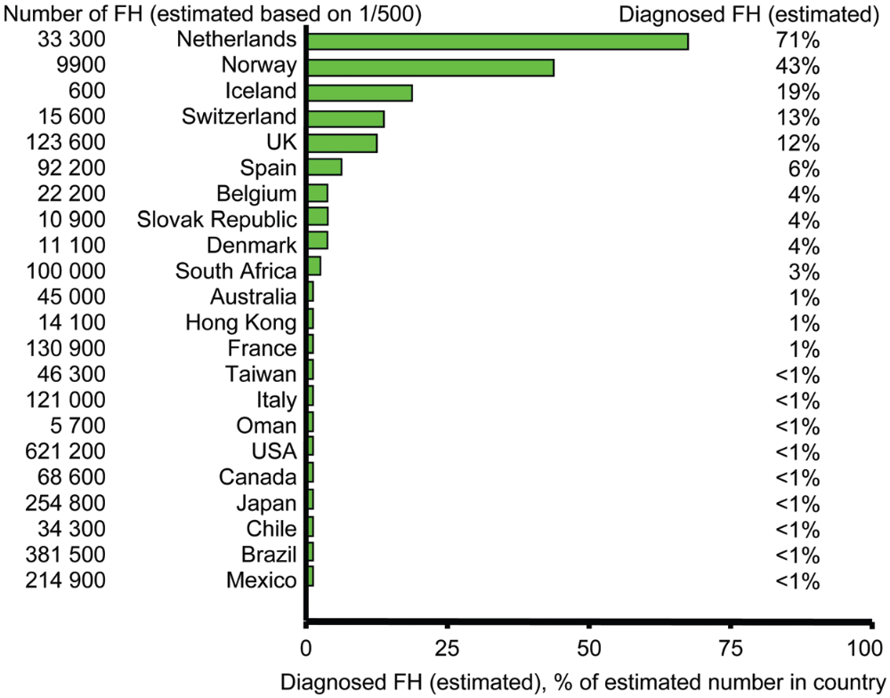
#9
Case-finding should be a continuing process.
B.G. Nordestgaard et al. European Heart Journal. doi:10.1093/eurheartj/eht273

Slide 40
Principles of Screening
Familial hypercholesterolemia
FH
Serious Morbidity and Mortality
Reliable Testing
Effective Treatment
Willing
to
Treat
Affects 1:250
Shared Decision
Physician
Parent
Premature CVD
MI
CVA
Death
LLMs
Statins
Ezetimibe
BAS
New agents*
* Not FDA approved <18 yr
Tests - Cholesterol
+ Genetic Testing
Reliable
Accurate
Accessible
Inexpensive

Slide 41
Cholesterol Screening Guidelines
 | ¹NHLBI | NLA | ACC/AHA
Who to Screen?
Selective Screening | Yes | Yes | Yes
Universal Screening | Yes | Yes | Yes
Age at First Screening?
Selective Screening | >2 yrs | >20 yrs | >20 yrs
Universally Screening | 9-11 yrs | >20 yrs | >20 yrs
²Repeat Screening | 17-20 yrs | ³Every 5 yrs | ---
What to Order?
Fasting or non-fasting lipid panel | Yes | Yes | Yes
Calculate non HDL-C | Yes | Yes | Yes
Risk Factors Assessment? | Yes | Yes | Yes
ASCVD Risk 10 Year Estimate? | ⁴N/A | ⁴Yes | ⁴Yes
¹ These recommendations have been endorsed by the American Academy Pediatrics, National lipid Association and American Heart Association. ² If initial levels of artherogenic cholesterol (non-HDL-C and LDL-C) are in the desirable range. ³ Or sooner based upon clinical judgement. ⁴ Risk calculators are not applicable to children and adolescents, and may either over- or under estimate risk in those < 40 years of age. ⁵Every 4-6 yrs NLA = National Lipid Association. J Clin Lipidol. 2014 Sep-Oct; 8 (5):473-88. Part 2. J Clin Lipidol. 2015 Nov-Dec; 9 (6 Suppl):S1-122. ACC/AHA = American College of Cardiology/American Heart Association. Circulation. 2014;129 [suppl 2]:S1-S45). NHLBI = National Heart, Lung, and Blood Institute: Summary Report. Pediatrics 2011; 128(Suppl 5):S1-S44.

Slide 42
Final thoughts…
There is no generally accepted screening program for children, adolescents, and young adults.
Universal screening, started at age 10 and continued every 5 years thereafter, may help simplify the process for busy clinicians.
Wiegman A, Gidding SS, et al. Familial hypercholesterolaemia in children and adolescents: gaining decades of life by optimizing detection and treatment. Eur Heart J. 2015;36(36):2425–37.

Slide 43
Final thoughts…
Many feel FH should be the primary goal of cholesterol screening.
Early recognition of a child or young adult with FH, coupled with therapy from a young age, will impede, if not arrest, the onset of atherosclerosis.
Wiegman A, Gidding SS, et al. Familial hypercholesterolaemia in children and adolescents: gaining decades of life by optimizing detection and treatment. Eur Heart J. 2015;36(36):2425–37.

Slide 44
Final thoughts…
Statin therapy alone could potentially avert 96-98% of FH-related CHD deaths in individuals < 40 years of age.
Austin MA, Zimmern RL, Humphries SE. High “population attributable
fraction” for coronary heart disease mortality among relatives in monogenic
familial hypercholesterolemia. Genet Med. 2002;4(4):275–8.

Slide 45
Final thoughts…
Identification of a child with FH combined with effective screening of 1st and 2nd degree relatives (i.e. reverse cascade screening):
  Combines the benefits of universal + cascade screening.
  Has the potential, within 1 generation, of detecting all cases of FH.
Morris JK, Wald DS, Wald NJ. The evaluation of cascade testing for familial hypercholesterolemia. Am J Med Genet A. 2012;158(1):78–84.

Slide 46
Time Course of Human Atherogenesis
Years
Events
Ischemic Heart
Disease
Cerebrovascular
Disease
Peripheral Vascular
Disease
Lesion: Initiation
→ Progression
→ + Stable
No Symptoms
+ Symptoms
Symptoms
Reversible
+ Reversible
Non - Reversible
Intervention
Notes:
Schematic time course of human atherogenesis
In this timeline of atherosclerosis, note the compensatory enlargement as intimal thickening progresses, until later in the disease when luminal obstruction occurs.

Slide 47

Time Course of Human Atherogenesis
Years
No Events
Early Detection/ Early Intervention
Lifelong Heart Healthy Living
Lesion: prevention
No Symptoms
Reversible
Intervention
Notes:
Schematic time course of human atherogenesis
In this timeline of atherosclerosis, note the compensatory enlargement as intimal thickening progresses, until later in the disease when luminal obstruction occurs.

Slide 48
Cholesterol Screening in Children and Young Adults. Where are we going?
Don P. Wilson, M.D., FNLA
Fellow, American Board of Clinical Lipidology
Pediatric Endocrinology
Cook Children’s Medical Center
Fort Worth, Texas

