Slide 1
Women's HRT

Slide 2



US Women's Health: Menopause
75M
90%
70%
US women currently in pre, peri, or menopause¹
Experience symptoms (yet only 20% seek treatment)²
Gain weight & lose 3 - 8% muscle mass³
($9B US Market, 6% CAGR)
1 Let's Talk Menopause 501c3 org research (US Census data by age range) 2024
2 The Economic Impact of Menopause: A survey of Women 35+ and Employers. Washington, DC: AARP Research, January 2024
3 Various sources: uclahealth.org and British Menopause Society
Notes:
Pre, Perimenopause and Menopause:
65% of our female customer base is 35 or older; pre, perimenopause and menopause are top of mind (50M women in the US are currently in menopause)
The market addressing menopause-related symptoms could increase eightfold, to more than $40 billion
90% of perimenopausal or menopausal women have some symptoms, yet only 20% seek treatment currently
70% who seek treatment do not receive the care they need
Only 30% of U.S. residency programs offer a formal menopause curriculum, and 80% of OB-GYN residents admit to being ill-prepared to discuss menopause
70% of women gain weight during menopause, and lose and average of 3-8% of their muscle mass

Slide 3
Patient View

Slide 4
HRT Patient Journey
Online Health Questionnaire
Symptom history
Goals
First Telehealth Provider Visit
On-camera, confirm ID
Discuss health history & goals
Discuss medication preferences
Cancer history
Link to Pay for Medication
User creates an account
Can select medications, durations, & add-ons
Medication & Labs Delivered
Medications paid for and shipped
Medication Refill
No symptoms or med change = online chat with provider for fast refill
Can meet with provider via video call or chat at any time about symptoms, med changes, etc.
Provider requests lab kits for baseline and regular monitoring (not required to receive new RX)
User considered "Member" once they've paid for membership
Labs will be on invoice (no additional charge)

Slide 5
HRT Membership Overview
Monthly Membership Cost Covers:
All provider-prescribed HRT medications:
  Options for women: Estradiol, Progesterone
Recommended lab work
Add-Ons for Additional Cost
  Sexual Health Medications
  DHEA

Slide 6

HRT Labs
How lab tests work:
It is recommended that patients have their hormone levels checked prior to and during treatment for monitoring of progress, but it is NOT a requirement to receive medication
Ivim providers must order lab kits for patients – at the time of initial consult and every 2-4 months after
Patients are shipped at-home lab kits which can automatically collect samples. Watch a general instruction video HERE

Slide 7
Pathophysiology

Slide 8
Hormonal Shifts
Estrogen declines
Progesterone declines
FSH increases
Testosterone declines

Slide 9
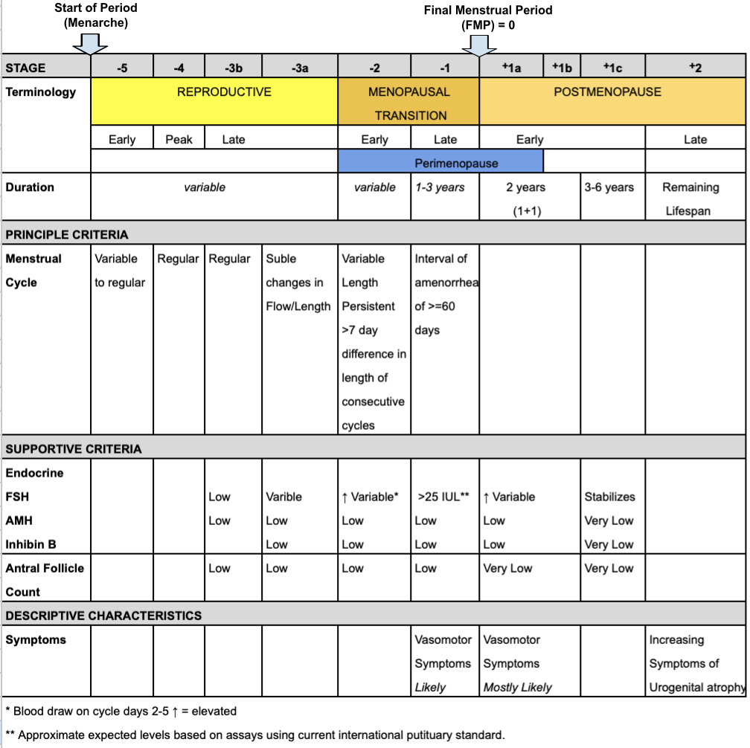
Physiology of Perimenopause and Menopause

Slide 10
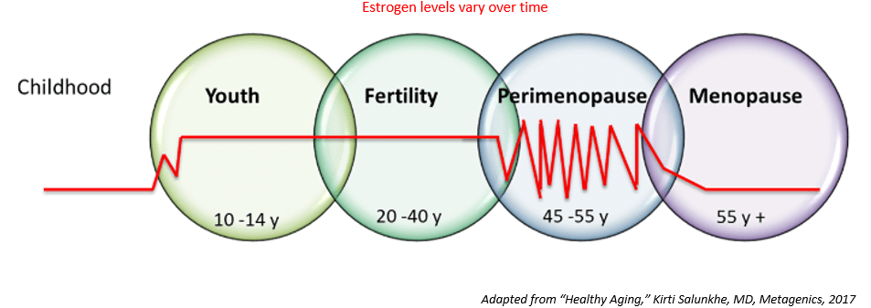
Hormonal Shifts – whats happening day to day

Slide 11
FDA Criteria For Systemic HRT
    FDA Criteria for MHT:
      1. Vasomotor Symptoms/Climacteric Symptoms
      2. Prevention of bone loss
      3. Premature hypoestrogenism (Bilateral Oophorectomy/Premature Ovarian Insufficiency)
      4. Genitourinary Syndrome of Menopause

Slide 12
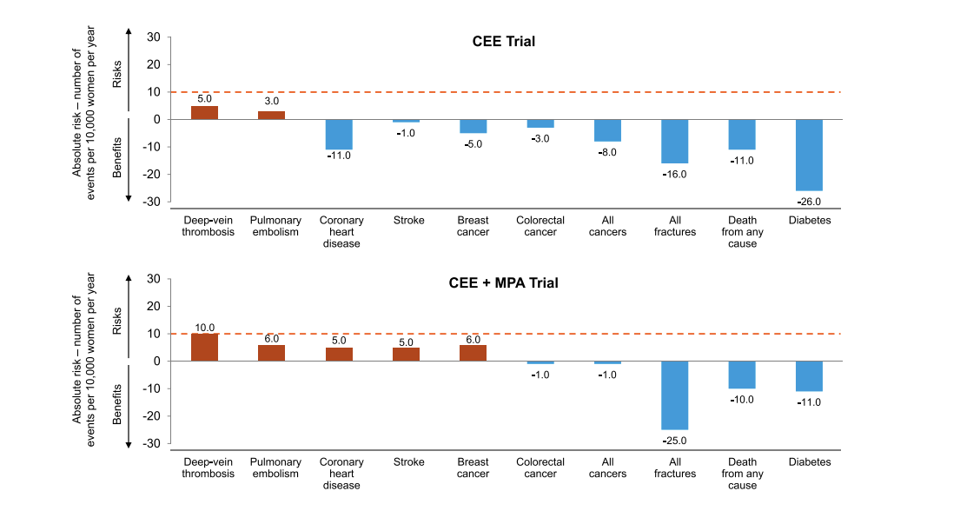
WHI
2022 hormone therapy position statement of The North American Menopause Society

Slide 13
Tis but a scratch – Avrum Z. Bluming, MD
Definite failure to acknowledge its reporting of nonsignificant results as if they were meaningful, misinterpretation of its own data and misleading assertion that its findings have reduces the incidence of breast cancer in the US
CEE alone reduces the risk of breast cancer by 23% and reduces the risk of breast cancer death by 40%
CEE+MPA, when initiated in HT naïve women, does not increase breast cancer risk and does not increase breast cancer mortality, even for women with a family history of breast cancer.

Slide 14

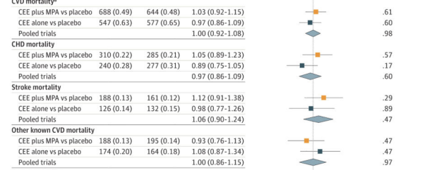
WHI Results
Notes:
Menopausal Hormone Therapy and Long-term All-Cause and Cause-Specific Mortality: The Women's Health Initiative Randomized Trials

Slide 15
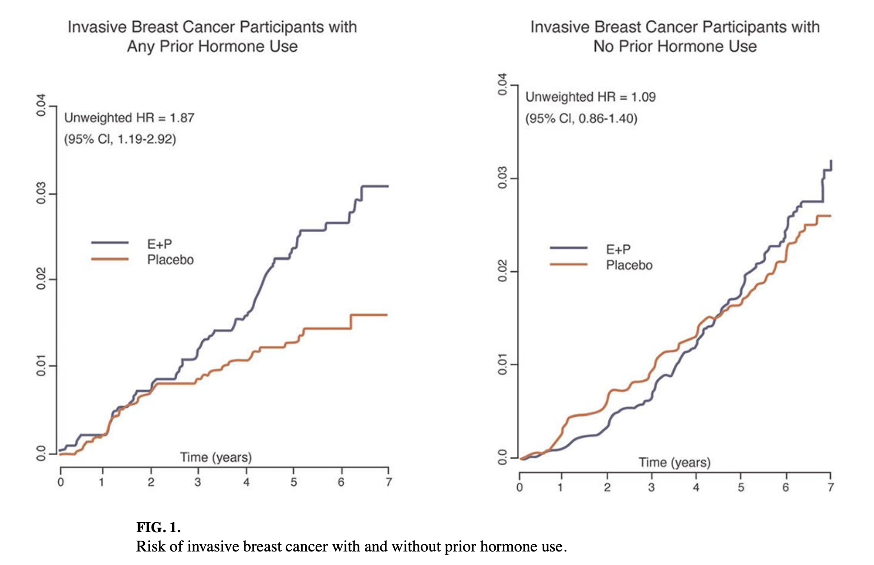
Breast Cancer risk
Notes:
Tis but a scratch

Slide 16
Symptoms – Predominantly Estrogen
Vasomotor symptoms
Mood changes (depression)
Irritability
Sexual health changes
Genitourinary symptoms of menopause
Trouble staying asleep

Slide 17
Symptoms – Predominantly Progesterone
Insomnia (sleep onset)
Anxiety
Heavy bleeding (although HRT dosing of progesterone may not be sufficient to treat)

Slide 18
Symptoms – Predominantly Testosterone
Low libido
Fatigue
Muscle fatigue or loss

Slide 19
Terminology
HRT = hormone replacement therapy
MHT = menopause hormone treatment/therapy
Stacking
  The concept of starting one medication, assessing efficacy, tolerability, AE prior to adding another
  Typically start with the hormone that will target the symptoms causing the most problems for the individual

Slide 20
Routes for Systemic Use
Estrogen
  Oral tablets
  Topical patch
  Topical gel
  Vaginal ring
  Topical spray
  Sublingual film
Progesterone
  Oral capsule
  IUD
  Sublingual film

Slide 21
Types of Estrogens
Human estrogens
  Estrone, 17b Estradiol, Estriol
  Estradiol most biologically active
Animal-derived estrogens
  Conjugated equine estrogens (Premarin)
Synthetic estrogens
  Esterified estrogens and synthetic conjugated estrogens
  Mostly contain estrone.
Synthetic estrogens + steroid molecular structure
  Ethinyl Estradiol
Plant based estrogens
  Phytoestrogens – not a prescription

Slide 22
Topical Local Estrogen
Often needed in conjunction with systemic therapies
Creams/gels easy to use but are messy
Rapid dissolvable tablets allow for local treatment without the mess

Slide 23
Types of Progestogens
Progesterone – the steroid hormone produced by the ovary
  Micronized progesterone allows improved oral absorption
Progestin
  Synthetic products that have progesterone-like activity but are not identical to the progesterone produced in the human body.
    MPA, megestrol, norethindrone, LNG, norgestimate, drospirenone

Slide 24
Medication Information
Estradiol
  Reduces the release of GnRH and LHrH from hypothalamus, reduces gonadotropin release from pituitary, increases synthesis of DNA, RNA and various proteins in target tissues.
Micronized Progesterone
  Natural progestin hormone that promotes mammary gland development, induces changes to the endometrium, relaxes uterine smooth muscles, blocks follicular ovulation and maintains a pregnancy
  Has the same molecular structure as the progesterone circulating in the body
  Micronized versions allow for better GI absorption. Progesterone is not absorbed well through the skin
  Progesterones are often taken at night as they promote sleep and may cause drowsiness during the daytime
  FDA approved for prevention of endometrial hyperplasia in HRT, secondary amenorrhea and contraception.

Slide 25
Medication Information: Intravaginal Estrogen and DHEA
Estrogen
Commonly used for vaginal dryness or atrophy.
Low dose vaginal estrogen is most effective treatment for moderate to severe symptoms of vaginal atrophy not responsive to nonhormonal intervention (gel/lubricants)
While prescribing information includes the same boxed warnings as systemic estrogen therapy, vaginal preparations have not been associated with the adverse effects associated with systemic therapy, and most patients are candidates for treatment. Unlike systemic therapy, a progestogen is generally not indicated.
Estrogen can restore normal vaginal acidic pH and microflora, thicken the epithelium, increase vaginal sections and decrease vaginal dryness and dyspareunia, and is associated with urinary tract benefits
Improvement of symptoms usually seen within 2-4 weeks
Low dose vaginal therapy can be used indefinitely with clinical judgement
DHEA
DHEA is a precursor for both estrogen and testosterone. DHEA can provide similar effects to vaginal estrogen (noted above). Because of its ability to convert to testosterone, DHEA can also help improve libido and improve comfort during sexual intercourse

Slide 26
Choosing Route
Patient preference should be considered
Patch = set and forget, lower risk VTE due to no first pass metabolism
  Recommended first line
Gel = nice if want topical but patch doesn't stick
Oral = simple, easy if already taking other meds
Sublingual film = would allow for mucosal absorption reducing VTE risk, but gives the benefit of taking orally

Slide 27
IVIM offerings
Estrogen
  Estradiol/Estriol (human estrogens)– most biologically similar without complicated sourcing of CEE
    Oral
    Patch
    Sublingual strip
  Estradiol Vaginal RDT 5mcg
  Estradiol Vaginal cream
Progesterone
  Micronized capsule
  Most biologically similar molecule with good evidence on dosing required to remove risk of unopposed E use

Slide 28
Estrogen Offerings
Estradiol tablets/capsules – commercially available and compounded
  Estradiol 0.5 mg
  Estradiol 1 mg
  Estradiol 2 mg
Estradiol/Progesterone tablets/capsules – compounded:
  Estradiol .5mg / Progesterone 100mg
  Estradiol 1mg / Progesterone 100mg
  Estradiol 2mg / Progesterone 200mg
Estradiol patch – commercially available and compounded
  Estradiol .025mg / day
  Estradiol .0375mg / day
  Estradiol .05mg / day
  Estradiol .075mg / day
  Estradiol 0.1mg / day
Estradiol topical cream – commercially available and compounded
  Estradiol 0.01% vaginal cream

Slide 29
Progestogen Offerings
Micronized Progesterone capsules - commercially available or compounded
  Progesterone SR 100mg Capsule
  Progesterone SR 200mg Capsule
Estradiol/Progesterone tablets/capsules – compounded:
  Estradiol .5mg / Progesterone 100mg
  Estradiol 1mg / Progesterone 100mg
  Estradiol 2mg / Progesterone 200mg

Slide 30
Intravaginal Estrogen and DHEA Contraindications
Estrogen
  Absolute Contraindications
    Not prescribing for secondary conditions:
      Prior a planned vulvar surgery
      Urinary incontinence
      Anatomic malformations
    Same as Menopause patients
  Relative Contraindications
    History of Endometriosis
    Fibroids
    History of Endometrial Cancer if have had a hysterectomy
DHEA
  Contraindications:
    Undiagnosed vaginal bleeding
    Breast Cancer
    Pregnancy
    Breastfeeding
  Relative Contraindications:
    Endometrial Cancer post hysterectomy

Slide 31
Absolute Contraindications
(SEE P&P for Details)
    Age <45 with menopause/perimenopause with amenorrhea not evaluated
    Primary Ovarian Insufficiency
    Actively pregnant or breastfeeding
    Personal history of venous thromboembolism (DVT or PE)
    Personal history of a clotting disorder
    Acute or End Stage Liver Failure
    Unexplained vaginal bleeding
    Initiation of therapy >/=10 years from FMP
    Personal history of breast cancer
    Personal hx of BRCA mutation
    High Risk For Breast Cancer
    Patients on endocrine therapy for estrogen positive breast cancer are not candidates for any hormonal treatment (including local therapy)
    Personal history of cardiovascular disease
      History of coronary artery disease, prior myocardial infarction (heart attack), prior cerebrovascular accident (stroke), and documented peripheral arterial disease
      If someone is undergoing a workup for possible CVD (stress testing, catheterization) they are not a candidate for treatment until workup is complete and results are available for review.

Slide 32
Relative Contraindications (SEE P&P for Details)
    Primary family history of breast or uterine cancer
    Personal history of cardiovascular disease
    High Risk for Endometrial Cancer
    Autoimmune Disease(s) that increase risk of clotting
    Age>60
    Family history of VTE
    Current Smoker
    Migraine with aura

Slide 33
Dosing Guidelines
 | Mild symptoms | Moderate symptoms | Severe symptoms
Route
Transdermal patch | 0.025mg/d | 0.05mg/d | 0.1mg/d
Gel | 0.25-0.5mg/d | 0.5-0.75mg/d | 1-1.25mg/d
PO | 0.5mg/d | 1mg/d | 2mg/d
Amt Prog needed for uterine protection | 100 | 100 | 200
*its safe to wait to add Progesterone for 3-4m, esp in perimenopause since still ovulating
*usually dose progesterone continuous, but if they'd like to they can do cyclic 1-12d

Slide 34
When do symptoms improve?
Can be as soon as 2 days, most notice improvement by 2 weeks and should be by 2 months
Follow-up at 2-month mark with goal of 80% improvement in symptoms without Adverse Effects

Slide 35
Patients with a Uterus
Endometriosis Patients
MUST use progesterone if a woman has a uterus
  Need progesterone to prevents unopposed estrogen stimulation leading to potential endometrial thickening and cancer risk
    Note- it is okay to use only estrogen for 3-4 months, especially in the perimenopausal period
  OK to use local progesterone (IUD) if in place but need to document its presence, date of placement and date requiring change
Endometriosis with or without a hysterectomy
  Endometrial tissue can be outside of the uterus and despite hysterectomy, would be at risk for any tissue left behind to have malignant transformation

Slide 36
Side Effects
Headaches
Mood changes
Breast tenderness
Acne
Hair changes
Weight gain
Trouble sleeping
Vaginal bleeding
Irritability

Slide 37
Add-ons
Bremelanotide

Slide 38
Bremelanotide
Activates melanocortin receptors in the brain involved in sexual arousal pathways.
Work centrally to enhance sexual motivation in the absence of physical or psychological barriers.
FDA Approved Indications:
  Hypoactive Sexual Desire Disorder (HSDD) in premenopausal women
Off-label Uses:
  Female Sexual Interest/Arousal Disorder
  Libido enhancement in postmenopausal women
  Hormonal optimization and vitality
  Libido support in men (potential)

Slide 39
Bremelanotide
Doses & Formulations
  Injection (commercially available as Vyleesi) 1.75mg
  Nasal spray (1.75mg/spray)
  Sublingual tab (0.5-2mg)
  Patients should not use more than one dose in 24 hours, nor more than 8 doses in a span of one month

Slide 40
Bremelanotide Contraindications
Hypersensitivity to the medication
Uncontrolled hypertension
Cardiovascular disease
Pregnancy
Breastfeeding

Slide 41
Bremelanotide Side Effects
Nausea (40% of patients)
Flushing (second most common)
Injection site reaction
Headache
Vomiting
Paresthesia (tingling or prickling sensation)
Focal hyperpigmentation (rare, but could be permanent)

Slide 42
Ivím Supplements
to complement HRT

Slide 43
Krill
Bioavailable omega-3s support inflammation balance during menopause
May ease joint discomfort often reported with estrogen decline
Supports cognitive clarity and memory during hormonal transition
Aids mood stability and emotional regulation in midlife
Helps maintain muscle strength and physical function with aging
Phospholipid form enhances omega-3 absorption
Complements HRT by supporting brain, joints, and physical resilience

Slide 44
Collagen Peptides
Improves skin hydration, elasticity, and structure affected by aging
Supports bone density and strength, especially in postmenopausal women
Aids connective tissue flexibility, including pelvic floor and joints
May support urogenital tissue integrity linked to collagen decline
Helps maintain lean muscle mass when paired with activity
Complements HRT by addressing visible and structural aging

Slide 45
Magnesium
Supports mood regulation and reduces anxiety-like symptoms
Promotes deeper, more restful sleep
May help lessen hot flashes and night sweats
Aids mental clarity and focus during hormonal shifts
Contributes to healthy bone metabolism and density
Complements HRT by reinforcing emotional, neurologic, and skeletal support

Slide 46
Vitamin D3 + K2
Promotes bone strength and mineralization
Helps regulate calcium placement—into bones, not arteries
Supports cardiovascular health and arterial flexibility
Aids in mood stability and emotional wellness
May support muscle strength and physical performance
Complements HRT by supporting bones, mood, and metabolic balance

Slide 47

Side Effect Protocols

Slide 48
Side Effects Protocol for HRT and Sexual Health
Headaches
Mood changes
Breast tenderness/pain
Acne
Hair changes
Weight gain
Trouble sleeping
Vaginal bleeding
Irritability
Nausea (40% of patients)
Vomiting
Bremelanotide Specific
  Flushing (second most common)
  Paresthesia (tingling or prickling sensation)
  Focal hyperpigmentation (rare, but could be permanent)

Slide 49
Urgent and Emergent Complaints
Have a low threshold for notifying a patient to go to an emergency department. If you have any suspicion, do not hesitate to direct to an urgent care or ED.
Urgent/Emergent Complaints
Workflow Standing Order
Definition
Any medical complaint that can potentially results in death, bodily harm, permanent disability including but not limited to, or if you are unsure of how to direct the patient:
  Chest pain
  Signs and Symptoms of a stroke (one sided weakness, slurred speech, balance disturbance, visual changes)
  Shortness of breath
  Airway swelling or oral swelling
  Vomiting/diarrhea leading to dehydration/ hypotension
Urgent Responses
If the patient states they are having chest pain, shortness of breath, difficulty breathing or swelling in your throat/mouth, signs and symptoms of a stroke, or having very severe side effects thought to be related to their medication, tell them to dial 911/seek emergent attention and they are to notify their PCP; Inform patient to stop medications. Let the patient know you will notify and Ivim Health medical provider, however, it is highly recommended to seek immediate medical evaluation at a local urgent care or emergency department and not to wait for a provider’s response.
  Make a patient inquiry in the chart
  Send the State Lead a direct message or the Clinical Supervisors if the State Lead is unavailable
  Lead NP will attempt to reach out to the patient, but this should NOT delay attempts to seek urgent medical attention
Non-Urgent Responses
NA

Slide 50
Headache
Headache
Workflow Standing Order
Definition
Very common and most people will experience this in their lifetime. This is when there is pain in the head or face. Often described as a throbbing pressure. There are several types of headaches, and tension headaches are the most common. While most headaches aren’t dangerous, certain types can be a sign of a serious underlying condition.
Questions to Ask:
When did the headache start?
Is it the worst headache of your life?
Do you have any other symptoms: numbness or tingling, chest pain, weakness, slurred speech, changes in vision, confusion?
Where is the pain located?
Any recent sinus infection/virus?
What have you tried OTC and has it helped?
Urgent Responses
If the patient reports numbness or tingling, chest pain, weakness, slurred speech, changes in vision, confusion, or asserts this is the "worst headache of their life", refer for emergent evaluation and they are to notify their PCP; Inform patient to stop medications
  Make a patient inquiry in the chart
  Send the state lead a direct message or notify a Clinical Supervisor if the state lead is unavailable.
Non-Urgent Responses
  Make sure you have a sleep routine with good/adequate sleep hours at night
  Stay hydrated and drink plenty fluids
  Limit fasting—make sure have enough protein in your diet (50% of body weight)
  OTC meds: Ibuprofen/Motrin/Advil/Aleve/Tylenol per package instructions
  Avoid caffeine, alcohol, smoking
  Can set up a video visit to discuss with provider too

Slide 51
Hair Loss
Workflow Standing Order
Hair Loss
Urgent Responses
Not Urgent
If the patient states hair loss in one localized spot, irritation, rash, itching refer to their PCP; Okay to continue medication.
  Make a patient inquiry in the chart
  Send the Lead NP a direct message or the Clinical Supervisors if the State Lead is unavailable
Non-Urgent Responses
It can take 6 months to see hair growth changes
Eat a healthy diet and ensure getting 50% of body weight in grams of protein
Over-the-Counter vitamin for hair/skin/nails, or topical Minoxidil
Limit stress
Avoid hairstyles that pull hair tightly. Be gentle with your hair and use a detangler if needed
Avoid harsh chemical treatments
Stop smoking
Protect from sunlight
Supplement Suggestions: Collagen, Cyano, Lipo, multiV,
Definition
It is normal to have hair loss daily as part of our regular hair growth cycle. Illness, hormonal changes, aging, medical conditions, nutritional changes can interfere with the growth cycle where more hair falls out, but new strands don't always grow back.
Questions to Ask:
When did you first notice the hair loss
Is this on your head in one localized area
Is it generalized hair loss on the scalp
Any itching or irritation or rash on the head

Slide 52
Weight Gain: Menopause
Plateau in Weight Gain: Menopause
Workflow Standing Order
Definition
In females, weight gain and increased central fat distribution often occur in the early postmenopausal years. The increased levels of follicle-stimulating hormone (FSH) that occur with menopause may be involved in this weight gain independent of the fall in estrogen. However, estrogen therapy does not prevent weight gain in postmenopausal females, although it may minimize fat redistribution
Questions to Ask:
Are you taking your medication as prescribed
Have you been doing a high protein and fiber diet
    50% of your body weight in grams of protein a day
    25 G fiber (female) 35 G (male) per day
Are you exercising 30 minutes straight 3 days a week
How many calories are you taking in
  Have you reviewed the number of calories you need to lose weight or to be in calorie deficit
Urgent Responses
NA
Non-Urgent Responses
Make sure you are getting enough cellular hydration with low sugar electrolyte drinks
Practice good sleep hygiene
    Try to bed before 11pm to avoid a cortisol spike
    Try getting to bed around the same time
Patient can add Lipotropic
Patient can add Sermorelin
Review diet and calories
Review exercise recommendations
Alter GLP-1 medication
Schedule a video consultation to speak with a provider
Supplement Suggestions: Berberine, akkermansia

Slide 53
Nausea & Vomiting
Nausea and Vomiting
Workflow Standing Order
Urgent Responses
If the patient states bloody vomit, vomiting several times or all day, chest, abdominal, or back pain, fever, chills, or if you are concerned for dehydration/hypotension refer for emergent evaluation and they are to notify the PCP; Inform patient to stop medications
  Make a patient inquiry in the chart
  Send the Lead NP a direct message or the Clinical Supervisors if the State Lead is unavailable
Non-Urgent Responses and Standing Orders
OTC Medication Suggestions
  Ginger, Vitamin B12, Peppermint, Vitamin B6
Natural Suggestions
  Avoid big meals, fatty meals, high carb meals
Prescription Medication: Zofran can be ordered prn if needed
    Add an Async Visit to Care team lead with information gathered and need for Zofran
    NOTE—Patients on Apomorphine cant not take zofran
  Supplement Suggestions: B6
Stay hydrated
    Take small sips every 15 to 30 minutes. Water, sports drinks
Definition
Nausea, the unpleasant sensation of being about to vomit, can occur alone or can accompany vomiting (the forceful expulsion of gastric contents), dyspepsia, or other gastrointestinal symptoms. Nausea can occur without vomiting and, less commonly, vomiting occurs without nausea. Nausea is often more bothersome and disabling than vomiting.
Questions to Ask:
Are you vomiting
  If yes, how often and how many days
  Any blood in the vomit
Did this first occur when you initiated or titrated your GLP
Do you feel weak/dizzy? Do you feel lightheaded upon standing
Are you fatigued
Have you tried any medications
Any sick contacts—fever

Slide 54
Side Effect: Mood Changes/Irritability
Mood Changes/Irritability
Workflow Standing Order
Urgent Responses
Anyone that has severe symptoms or reports SI/HI needs to follow the workflow for these. Inform patient to stop medications
  Make a patient inquiry in the chart
  Send the Lead NP a direct message or the Clinical Supervisors if the State Lead is unavailable
Non-Urgent Responses
Schedule a video consultation to speak with a provider
Exercise
Balanced Diet
Supplement Suggestions: Magnesium, Krill, D+K2,
Definition:
Mood changes are common with hormonal changes with menopause and/or medication use. Most common changes are depression and/or anxiety
Questions to Ask:
When did the symptoms start?
Is it associated with your current medications?
Do you feel the symptoms are severe?
Can you provide specific details of changes in mood?

Slide 55
Side Effect: Breast Tenderness/Pain
Breast Tenderness/Pain
Workflow Standing Order
Urgent Responses
Any patient with a noted lump or localized erythema should be referred for in person care. Inform patient to stop medications
  Make a patient inquiry in the chart
  Send the Lead NP a direct message or the Clinical Supervisors if the State Lead is unavailable
Non-Urgent Responses
Good support garments
Low-fat diet
Eliminate and/or decrease caffeine intake
OTC recommendations
  Vitamin E, Agnus castus (fruit extract), chamomile extract, NSAIDs
Schedule a video consultation to speak with a provider
Definition:
Breast tenderness or pain can be due to normal physiological changes related to hormonal fluctuation or to a pathologic process. Postmenopausal hormone therapy that causes breast tenderness/pain. Progestogens also improve breast pain symptoms in some women
Questions to Ask:
Where is the pain
Is it in one localized spot
Is there any lumps/bumps
Is it on one or both breast?
Any nipple discharge?
Localized redness?
When was your last mammogram? Was it normal?

Slide 56
Side Effect: Acne
Acne
Workflow Standing Order
Urgent Responses
Any concern for skin infection should be referred to in-person care for evaluation. Generally, patients do not need to stop medications for urgent reasons for acne.
    Make a patient inquiry in the chart
    Send the Lead NP a direct message or the Clinical Supervisors if the State Lead is unavailable
Non-Urgent Responses
Schedule a video consultation to speak with a provider
Supplement Recommendations: Cu Cream
OTC Recommendations:
  Multivitamin with vitamin A
Develop a skin care cleaning regimen
  Don't scrub too hard
  Don't squeeze blemishes
  Benzoyl peroxide
Decrease stress
Healthy diet
Avoid environmental irritants
Definition:
Common cutaneous disorder that can be related to A common cutaneous disorder that can be related to different things, including hormonal changes and es under the skin become clogged. Can happen on face, back, chest, shoulders.
Questions to Ask:
When do you feel like the acne started
Have you tried anything over the counter
Do you have any cleansing steps
Do you feel you might have a skin infection

Slide 57
Side Effect: Sleep Disturbances and/or Hormonal Treatment
Difficulty Sleeping
Workflow Standing Order
Urgent Responses
Any sleep concerns are generally not urgent and can use dose adjustments in therapy. Generally, patients do not need to stop medications for urgent reasons for sleep disturbances.
    Make a patient inquiry in the chart
    Send the Lead NP a direct message or the Clinical Supervisors if the State Lead is unavailable
Non-Urgent Responses
Keep a sleep diary to attempt to identify triggers
Establish a bedtime routine
Exercise with walking in the day
Avoid high stimulation before bedtime
Avoid caffeine and cigarettes
Sleep Environment: turn down lights, sleep activities such as reading, avoid electronics 30 minutes before bedtime
Avoid napping in the day
Supplement Suggestions: Magnesium, Glycine
Definition:
When the patient has difficulty staying or falling asleep. Menopause and hormonal treatment can have side effects of sleep disturbances
Questions to Ask:
When did this start
Do you have problems falling asleep or staying asleep
Do you feel it is related to hot flashes and or mood changes
Have you tried anything over the counter or prescribed medication

Slide 58
Menstrual Cycle Changes
Menstrual Cycle Changes
Workflow Standing Order
Definition
Any change from the patient's regular menses.
Vaginal bleeding occurs in almost all women receiving cyclic estrogen-progestin regimens and is common in the early months of a continuous estrogen-progestin regimen.
Questions to Ask:
Do you feel you are having significant/heavy/severe bleeding
Have you seen your provider
When did this start
Do you feel weak/lightheaded/dizzy
Urgent Responses
If the patient states they feel they have heavy/severe/significant bleeding with or without symptoms refer for urgent evaluation, they are to notify their PCP; Inform patient to stop medications
  Make a patient inquiry in the chart
  Send the Lead NP a direct message or the Clinical Supervisors if the State Lead is unavailable
Non-Urgent Responses
Schedule a video consultation to speak with a provider
Menstrual cycle changes can happen with hormone therapy but should not be severe.
  Note bleeding after menopause is NEV ER considered normal even with calorie/weight changes
Recommend follow-up with GYN if heavy and/or not within 2 months of dose change/initiation

Slide 59
  Side Effect: Flushing and Paresthesia side effects with Bremelanotide
Workflow Standing Order
Flushing and Paresthesia
Definition:
Flushing is a sensation of warmth accompanied by transient erythema that most commonly occurs on the face but may also involve the neck, ears, chest, epigastrium, and arms or other areas
Paresthesia is an abnormal sensation, tingling or pricking feeling on the skin
Questions to Ask:
Did this start when you started taking Bremelanotide
Any recent fever/infections
How frequently are you having flushing or changes in skin sensation
Urgent Responses
If the patient states they feel they have flushing or paresthesia when taking Bremelanotide it is generally a known side effect and should not warrant urgent referral. Patients that have continued flu flushing or paresthesia and/or associated with dizziness or syncope should be sent for urgent evaluations and notify their PCP; Inform the patient to stop medications
  Make a patient inquiry in the chart
  Send the Lead NP a direct message or the Clinical Supervisors if the State Lead is unavailable
Non-Urgent Responses
This should be temporary and usually resolves without treatment within a few hours
If bothersome, can change to light fitting clothing, cool environment

Slide 60
Side Effect: Focal Hyperpigmentation—Bremelanotide (rare but could be permanent)
Focal Hyperpigmentation
Workflow Standing Order
Urgent Responses
Any patient with noted pigment changes does not require urgent evaluation. Patients can continue or hold medications until they speak with a provide
  Make a patient inquiry in the chart
  Send the Lead NP a direct message or the Clinical Supervisors if the State Lead is unavailable
Non-Urgent Responses
Schedule a video consultation to speak with a provider
Definition:
Darkening of the skin in a specific area rather than all over the body. Generally related to injury. Bremelanotide is a melanocortin receptor agonist and stimulates melanocytes (pigment making cells) and can lead to increased pigmentation
Questions to Ask:
Is the area localized or all over
Do you have any redness or concern for skin infection
Have you had any pigment disorders in the past
Has the site changed

Slide 61
Side Effect: Template
Side Effect
Workflow Standing Order
Urgent Responses
Non-Urgent Responses
Definition:
Questions to Ask:

