Slide 1


Slide 2


ABOUT
PATRICK STEVENS DO DABOM
Family and Obesity Medicine Physician
pstevens@hughchatham.org
Disclaimer: For internal use only

Slide 3
DISCLAIMER
The information presented in this presentation is for educational purposes only and should not be taken as medical advice. Any medical decisions or treatments should be made in consultation with a qualified healthcare professional.
I have no financial conflicts of interest to disclose in relation to the content of this presentation. All material shared is based on my professional knowledge and publicly available evidence, with no external financial influence.
The resources and materials cited in this presentation are publicly available information and remain the sole property of their respective creators and copyright holders. This presentation is intended for educational/informational purposes only, and no ownership or endorsement is implied.
Disclaimer: For internal use only

Slide 4
OBESITY MEDICINE
Disclaimer: For internal use only

Slide 5
BACKGROUND
Disclaimer: For internal use only

Slide 6

Disclaimer: For internal use only

Slide 7
THE WHY
There comes a point where we need to stop just pulling people out of the river. We need to go upstream and find out why they’re falling in.
–Bishop Desmond Tutu
Disclaimer: For internal use only

Slide 8
THE WHY
Type 2 Diabetes Mellitus (T2DM) and Metabolic Dysfunction
Atherosclerotic Cardiovascular Disease (ASCVD
Neurodegenerative Disease^{1,2}
Cancer (breast, endometrial, ovarian, prostate, thyroid, colorectal, esophageal, gall bladder, hepatic, pancreatic, gastric, renal, meningioma, multiple myeloma) ^{3,4,5}
Disclaimer: For internal use only

Slide 9
THE WHY
Insulin Resistance
Metabolic Syndrome
Hypertension
Dyslipidemia
Metabolic-associated Fatty Liver Disease (MASLD previously NAFLD)
Non-alcoholic Steatohepatitis (NASH)
Obstructive Sleep Apnea (OSA)
Osteoarthritis (OA)
Depression
Anxiety
Polycystic Ovarian Disease (PCOS)
Menstrual Irregularities
Infertility
Atrial Fibrillation
Gallbladder Disease
Cellulitis
Intertrigo
Disclaimer: For internal use only

Slide 10
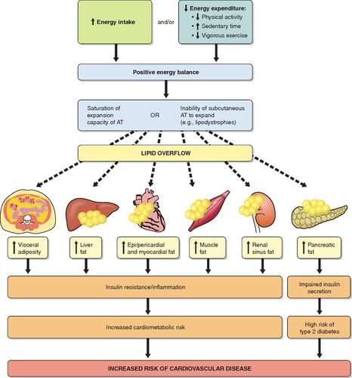
Disclaimer: For internal use only
Source: Tchernof and Depres (2013)

Slide 11
MORTALITY
At BMI of 30-35 kg/m², median survival is reduced by 2-4 years
At BMI of 40-45kg/m², median survival is reduced by 8-10 years (comparable to the effects of smoking)
Obesity & tobacco products, median survival is reduced by 13-14 years compared to normal weight patients who do not use tobacco products.
Disclaimer: For internal use only

Slide 12
THE WHY
5-10% decrease in body weight improves:
  Blood pressure
  Blood glucose
  Lipid profile
Joint pain and functional status in OA
Weight loss of 10-15% body weight improves
  Sleep apnea
  MASLD
Disclaimer: For internal use only

Slide 13
PREVALENCE
As of the latest data from the National Health and Nutrition Examination Survey (NHANES) covering August 2021 to August 2023, the prevalence of obesity among U.S. adults aged 20 and over was 40.3%⁶
Men: 39.2%​
Women: 41.3%
Although previously rates were increasing during this time rates were determined to be stable likely due to adoption of novel methods of treatment
Disclaimer: For internal use only

Slide 14
PREVALENCE
Regarding severe obesity (defined as a Body Mass Index [BMI] of 40 or higher), the overall prevalence was 9.4% during the same period.
Men: 6.7%
Women: 12.1%
The prevalence of severe obesity has shown a significant increase, rising from 7.7% in 2013–2014.
Disclaimer: For internal use only

Slide 15
DEFINITION
Obesity is defined as a chronic, relapsing, multi-factorial, neurobehavioral disease, wherein an increase in body fat promotes adipose tissue dysfunction and abnormal fat mass physical forces, resulting in adverse metabolic, biomechanical, and psychosocial health consequences.
-Obesity Medical Association (OMA)
Disclaimer: For internal use only

Slide 16
OBESITY AS A DISEASE
Obesity is not caused by insufficient willpower, lack of discipline and/or bad choices.
The outlook on this transformed after 2013 when the American Medical Association (AMA) labeled it as a disease.
Patients have impaired metabolic pathways along with disordered signaling for hunger, satiety and fullness.
There is not just one cause or type of obesity.
Disclaimer: For internal use only

Slide 17
IMPACTS OF STIGMA
Weight-based stigma has negative consequences
Those who experienced weight-based stigma are more likely to
  Avoid physical activity
  Engage in unhealthy diets
  Have sedentary behavior
Fear of prejudice and internalized weight bias make patients with obesity less likely to seek/receive treatment for obesity and other conditions
Disclaimer: For internal use only

Slide 18
TERMINOLOGY
Use people-first language
  Patient with obesity
  Not obese patient
Focus on health not weight alone
Use weight-friendly language
  Overweight, unhealthy weight instead of fat, obese
  Eating habits instead of diet
  Physical activity instead of exercise
Disclaimer: For internal use only

Slide 19
ECONOMIC IMPACT
Obesity-related medical expenses are substantial, with estimates ranging from $147 billion to nearly $210 billion per year.⁷
Individuals with obesity incur significantly higher medical costs than individuals without obesity, both overall and for most major categories of health expenditures.
Because obesity is associated with several co-morbid diseases and conditions that require treatment, the rising rates of obesity have resulted in significant increases in direct medical spending for individuals with obesity.
Other individual costs are also associated with obesity, including lost wages, short-term and long-term disability and insurance claims, and higher work-related costs such as presenteeism and absenteeism.¹
Disclaimer: For internal use only

Slide 20
PATHOPHYSIOLOGY
Disclaimer: For internal use only

Slide 21
REGULATION OF APPETITE
    Outside the brain
      Stomach: ghrelin
      Small intestine: CCK, GLP1, OXM, PYY
      Large intestine: GLP1, OXM, PYY
      Pancreas: pancreatic polypeptide, insulin, amylin
      Adipocytes: leptin, adiponectin
Disclaimer: For internal use only

Slide 22
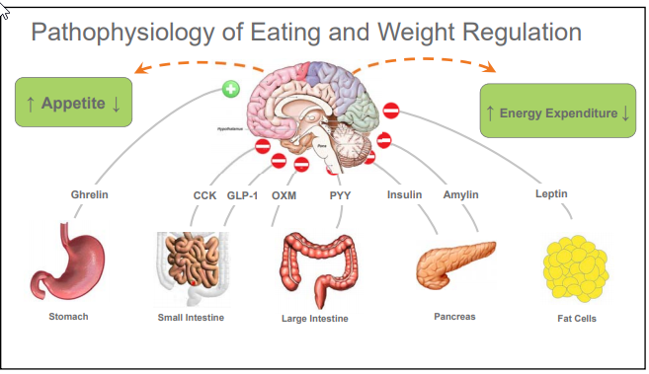
REGULATION OF APPETITE
Disclaimer: For internal use only

Slide 23
STOMACH
Ghrelin
  Hunger hormone
  Secreted by the gastric fundus and body
  When stomach is empty ghrelin is secreted. Levels surge and peak prior to meals.
  When stomach is stretched secretion is inhibited, levels drop after meal and nutrient ingestion (less of a drop in patients with obesity)
  Stimulates NPY/AgRP in CNS
  Vagotomy inhibits ghrelin
  Significant decrease with a sleeve gastrectomy
Disclaimer: For internal use only

Slide 24
SMALL & LARGE INTESTINE
CCK
  I cells of proximal small bowel
  Secreted in response to fat and protein ingestion
  Short acting
  Slows gastric emptying and reduces appetite
Glucagon-like Peptide-1 (GLP-1)
  L cells of distal small bowel and colon
  Secreted in response to carbs
  Glucose dependent insulin secretion, reduced gluconeogenesis, delayed gastric emptying and reduced appetite
Oxyntomodulin (OXM)
  L cells of distal small bowel
  Co-secreted with GLP-1
  Decreased appetite/feeding
  Less gastrointestinal symptoms than GLP-1 when given exogenously
Peptide YY
  L cells distal small bowel, colon, rectum
  Elevated within 1 hour post feeding.
  Binds to the Y2 receptor
  Potent appetite
  suppression
Disclaimer: For internal use only

Slide 25
PANCREAS
Pancreatic polypeptide
  F cells in response to caloric load
  Binds to Y4 receptor in gut decreasing gastric emptying. Y4 is also present in hypothalamus inhibiting NPY and reducing hunger
Insulin
  B cells
  In the hypothalamus it inhibits AgRP/NPY neurons and centrally deactivates the feeding response
Amylin
  B cells
  Reduces food intake, slows gastric emptying, suppresses glucagon production
  Similar effect to GLP1
Disclaimer: For internal use only

Slide 26
ADIPOCYTES
Leptin
  Secreted by white adipose tissue
  Promotes weight loss, fullness, satiety
  Levels decline with weight loss
  Stimulates POMC pathway and inhibits NPY/AgRP
Adiponectin
  Made in white adipose tissue
  Improves insulin sensitivity.
  Enhances insulin sensitivity in the liver, stimulates glucose use in the muscle, works in vascular endothelium to increase Nitric Oxide (NO) which reduces inflammation
Disclaimer: For internal use only

Slide 27
REGULATION OF APPETITE
    Inside the brain
      Arcuate nucleus is part of the hypothalamus near the base and located near the blood brain barrier so it can take in peripheral circulating signals and relay them to the Central Nervous System (CNS)
        First order neurons are in the arcuate nucleus
        Second order neurons are deeper in hypothalamus
Disclaimer: For internal use only

Slide 28
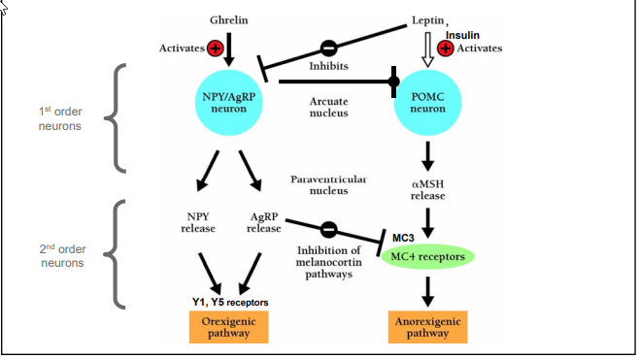
REGULATION OF APPETITE
Disclaimer: For internal use only

Slide 29
FIRST ORDER NEURONS
Two neuron systems
  Weight gaining (NPY/AgRP)
  Weight losing (POMC/CART)
Receives the peripheral signals and activates either of the 1st order neuron systems
Disclaimer: For internal use only

Slide 30
FIRST ORDER NEURONS
Neuropeptide Y (NPY)/ Agouti-related peptide (AgRP)
Activated by ghrelin
Inhibited by leptin
When neuron activated, releases NPY/AgRP that proceed to second order neurons
Proopiomelanocortin (POMC)/ Cocaine and amphetamine-regulated transcript (CART)
Activated by leptin and insulin
Inhibited by NPY/AgRP neurons
Causes alpha-MSH release that proceed to second order neurons
Disclaimer: For internal use only

Slide 31
SECOND ORDER NEURONS
Y1 and Y5 receptors
Activated by NPY and AgRP
AgRP also inhibits MC4 pathway
Y1 causes MCH release→ sensory processing, anxiety, aggression, feeding, pleasure, reward, learning
Y2 causes Orexin A&B release→ increased arousal, hunt for food
MC3 & MC4 receptors
Activated by alpha-MSH
Causes decreased appetite, increased energy expenditure
Disclaimer: For internal use only

Slide 32
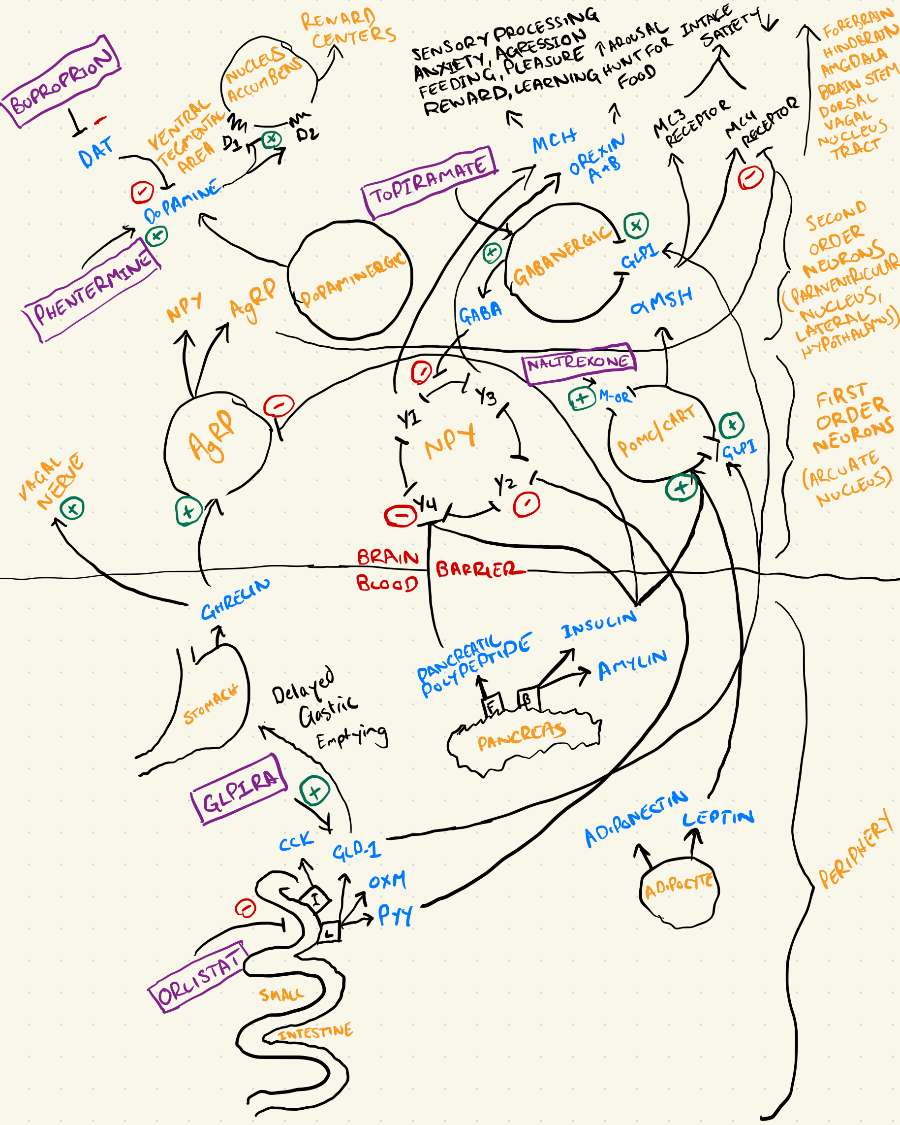
Disclaimer: For internal use only

Slide 33
EVALUATION
Disclaimer: For internal use only

Slide 34
PURPOSE
Overnourished vs undernourished
Adequately muscled vs inadequately muscled
Risk stratification
  Cardiovascular
  Metabolic
  Eating Disorders
Active disease processes
Assessment for comorbidities
Current therapies which contribute to weight gain or difficulty with weight loss.
Disclaimer: For internal use only

Slide 35
MEDICATION-ASSOCIATED
WEIGHT GAIN
COMMON CLASSES | ASSOCIATED WITH WEIGHT GAIN | ALTERNATIVE(S)
Antidepressants | Tricyclics, mirtazapine, Many SSRIs | Bupropion, Fluoxetine, SNRIs
Anticonvulsants | Gabapentin, carbmazepine, valproate | Topiramate, zonisamide
Antipsychotics | Clozapine, risperdone, olanzapine, quetiapine | Ziprasidone, aripiprazole
Antihyperglycemics | Insulin, Sulfonylureas, TZDs, metaglinides | Metformin, acarbose, GLP-1s, SGLT-2s
Gynecologic medications | Depo-provera, Many estrogen containing contraceptives, Lupron | Paragard, Barrier methods, progesterone only pill, IUD, or implant
Antihypertensives | Beta-blockers, alpha-blockers | ACEi, ARB, CCB
Antihistamines | Diphenhydramine, Cetirizine, Cyproheptadine | Loratadine, Fexofenadine
*Not an exhaustive list of medications associated with weight gain
Disclaimer: For internal use only

Slide 36
BIOMETRICS
Disclaimer: For internal use only

Slide 37
BODY MASS INDEX (BMI)
Normal weight 18.5-24.9
Overweight 25.0-29.9
Class 1 obesity 30.0-34.9
Class 2 obesity 35.0-39.9
Class 3 obesity >40.0
Disclaimer: For internal use only

Slide 38
PEDIATRIC BMI
Normal weight <85th percentile
Overweight 85th to <95th percentile
Obesity ≥95th percentile
Severe Obesity ≥99th percentile
Disclaimer: For internal use only

Slide 39
ETHNIC CRITERIA
International Diabetes Federation (IDF)
  China – overweight >23-24, obesity >27-29
  Japan – overweight >24, obesity >29
  India – overweight >23, obesity >27
  Singapore – overweight>22, obesity >27
  Ethnic south and central Americans similar to South Asians
Disclaimer: For internal use only

Slide 40
WAIST CIRCUMFERENCE
Men
  ≥40in
  South Asian, Chinese, Japanese ≥90cm=35.4in
  European ≥94 cm=37in
Women
  ≥35in
  S. Asian, Chinese, Japanese ≥80cm=31.5in
  European ≥80cm=31.5in
Disclaimer: For internal use only

Slide 41
BODY COMPOSITION
Method | Accuracy | Measures Bone? | Notes
DEXA Scan | Highest | Yes | Gold Standard
Bioelectrical Impedance (BIA) | Moderate | No | Inexpensive, but affected by hydration
Skinfold Calipers | Moderate-low | No | User skill-dependant
Bod Pod (Air Displacement) | High | No | Accurate, but less accessible
Hydrostatic Weighing | High | No | Was the previous gold standard
Dual-Energy X-Ray Absorptiometry (DEXA Scan) considered the gold standard for body composition analysis in clinical and research settings
Highly precise
Low radiation exposure (about as much as background radiation in a typical flight)
Costs $99-$250 depending upon location
Disclaimer: For internal use only

Slide 42
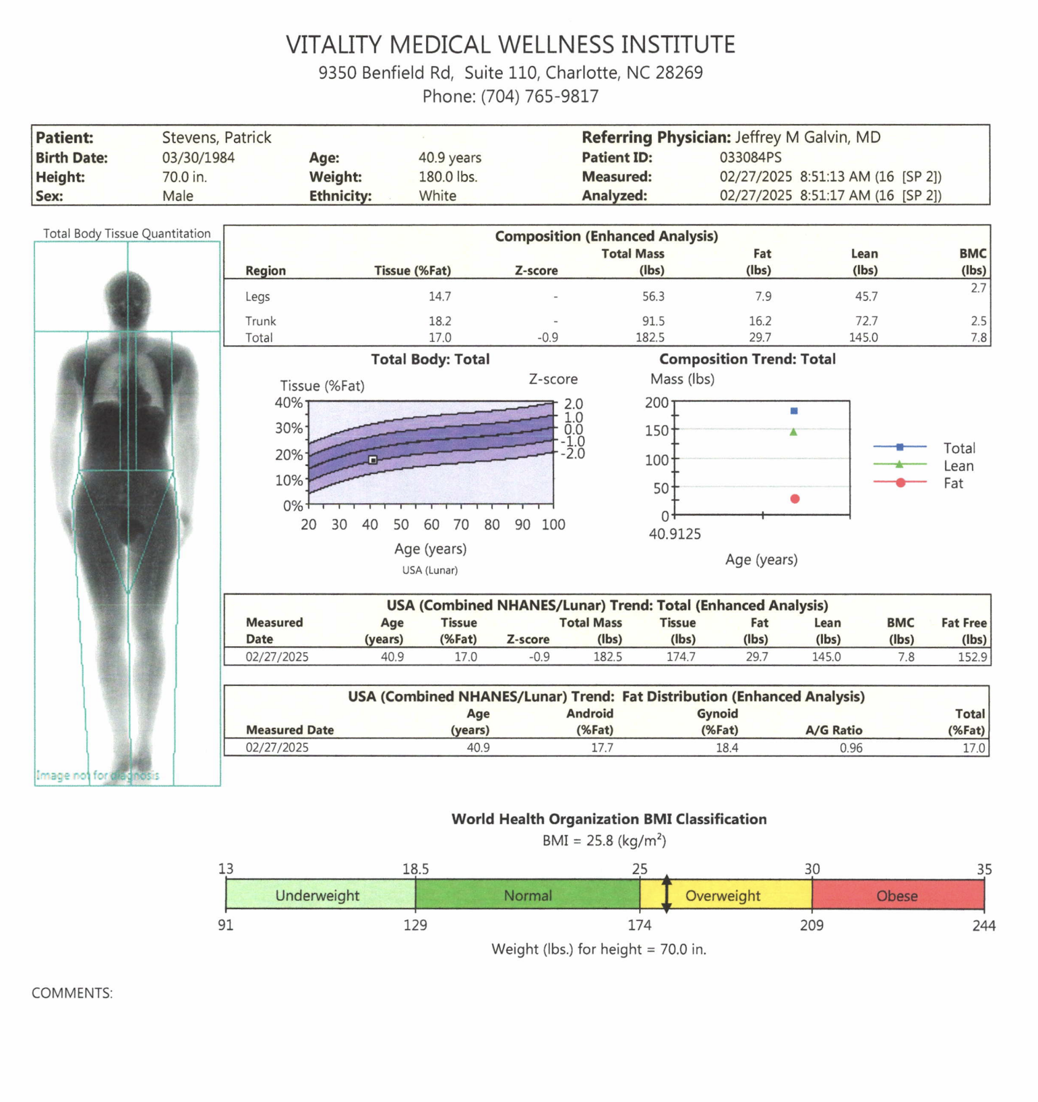
DEXASCAN REPORT
Fat mass including android/gynoid distribution
Lean body mass
Bone mineral content including applicable z-score and t-score
Disclaimer: For internal use only

Slide 43
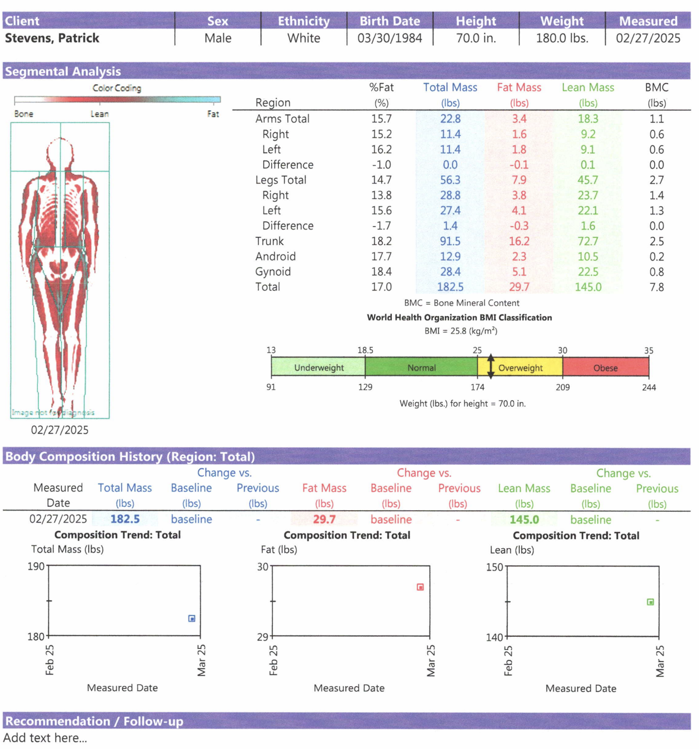
DEXASCAN REPORT
Regional distribution of fat mass and lean mass
Great for tracking progress over time in response to nutrition, training, or medical conditions.
Disclaimer: For internal use only

Slide 44
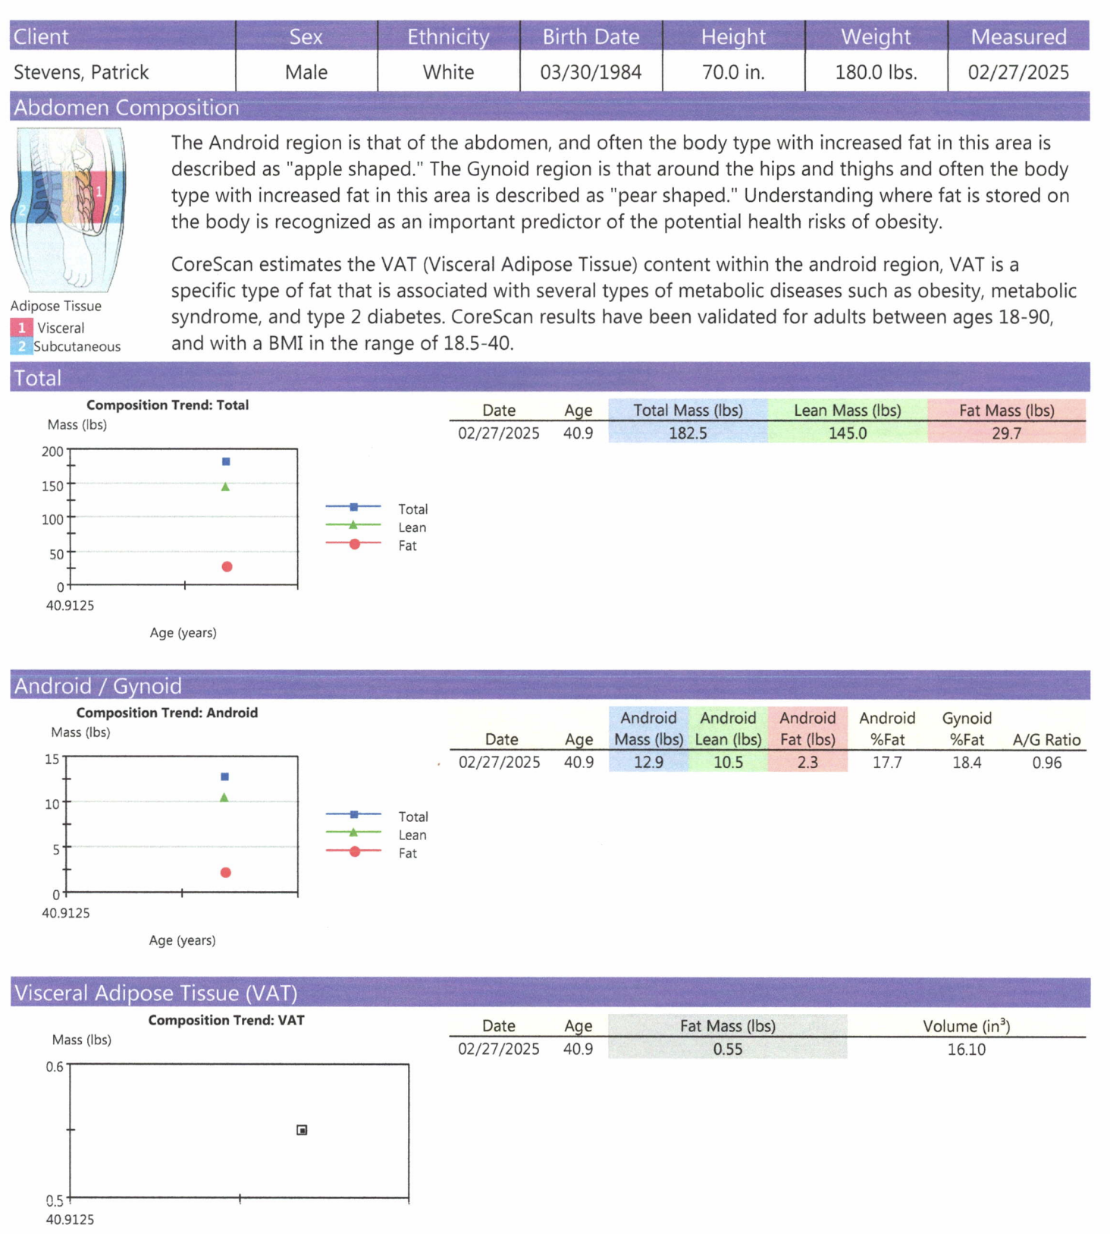
DEXASCAN REPORT
Can detect regional fat distribution such as visceral vs subcutaneous not just total body fat
Disclaimer: For internal use only

Slide 45
BIOMARKERS
Disclaimer: For internal use only

Slide 46
EVALUATION
≥ 10 and obese
≥ 10 and overweight with positive family history of comorbidities
≥ 2 and severely obese -> genetics
Fasting for 8-10 hours before
Repeat biomarkers every 2 years if no abnormalities
Repeat biomarkers every year if abnormal
Disclaimer: For internal use only

Slide 47
ORDERS
Complete Blood Count (CBC) with Differential
Lipid panel with calculated LDL
Lipoprotein (a) (if not previously screened)
Thyroid stimulating hormone (TSH)
Complete metabolic panel (CMP) with glucose
Fasting insulin level
Hemoglobin A1c
High-sensitivity C-reactive protein (hs-CRP)
Fasting morning cortisol
If considering Metformin: B-12 level
For females evaluating for PCOS: add Free and Total Testosterone, DHEA-S, LH/FSH ratio (In PCOS usually 2:1),17-hydroxyprogesterone, prolactin ± Ovarian Ultrasound
Disclaimer: For internal use only

Slide 48
CARDIOVASCULAR SCREENING
Risk factors for Cardiovascular Disease (CVD)
  Modifiable
    Tobacco use
    High blood pressure
    High bad cholesterol (LDL)
    Low good cholesterol (HDL)
    Lipoprotein (a)
    Diabetes mellitus
    High body fat or body weight
    Physical Inactivity
    Mental stress & depression
  Non-modifiable
    Age ( >45 in men, >55in women)
    Family history of early heart disease (<55 for father, <65 for mother)
    Ethnicity (CVD death rate higher in African-Americans and South Asians, HDL lower in Asians)
Disclaimer: For internal use only

Slide 49
DYSLIPIDEMIA SCREENING
Screening for genetic dyslipidemia⁸
  Non-fasting Total Cholesterol and HDL
  Abnormal if non-HDL cholesterol >145
    Ages 9-11 once
    Ages 17-21 once
Screening for Lipoprotein(a)⁹
  Non-fasting
  Abnormal if > 30 mg/dL
    Ages 18+ once
Disclaimer: For internal use only

Slide 50
METABOLIC SYNDROME SCREENING
3 out of 5 of the following:
  Abdominal obesity (waist circumference in men =102 cm (40 in) and in women =88 cm (35 in)
  Serum triglycerides =150 mg/dL (1.7 mmol/L) or treatment for elevated triglycerides
  Serum high-density lipoprotein (HDL) cholesterol <40 mg/dL (1 mmol/L) in men and <50 mg/dL (1.3 mmol/L) in women or treatment for low HDL cholesterol
  Blood pressure >=130/85 mmHg or treatment for elevated blood pressure
  Fasting plasma glucose (FPG) > or =100 mg/dL (5.6 mmol/L) or treatment for elevated blood glucose
Disclaimer: For internal use only

Slide 51
POLYCYSTIC OVARIAN SYNDROME (PCOS) SCREENING
Rotterdam Criteria (2003): 2 out of the following 3 criteria must be met after ruling out other causes (e.g., thyroid dysfunction, hyperprolactinemia, Congenital Adrenal Hypeplasia, etc)
Oligo or Anovulation
  Infrequent or absent ovulation
  Irregular menstrual cycles (e.g., cycles >35 days or <8 cycles/year)
  Clinical and/or lab-confirmed Hyperandrogenism
  Clinical signs: hirsutism, acne, androgenic alopecia
  Biochemical evidence: elevated serum androgens (e.g., total or free testosterone, DHEA-S)
Polycystic Ovarian Morphology on Ultrasound
  ≥12 follicles in either ovary (2–9 mm in size) OR
  Ovarian volume >10 mL
Of note, in adolescents and perimenopausal women, diagnosis is more nuanced because ultrasound is less reliable. Emphasis is placed on clinical features and hormone labs.
Disclaimer: For internal use only

Slide 52
POLYCYSTIC OVARIAN SYNDROME (PCOS) SCREENING
Important Exclusions Before Diagnosing PCOS:
  Thyroid disorders (TSH)
  Hyperprolactinemia (Prolactin)
  Congenital adrenal hyperplasia (17-hydroxyprogesterone)
  Androgen-secreting tumors (Markedly elevated androgens defined as rapid onset of androgenic characteristics, total testosterone >200 ng/dL, DHEA-S >700 µg/dL)
    Pelvic ultrasound (to look for ovarian tumors)
    Adrenal CT or MRI (if DHEA-S is high or adrenal mass suspected)
Disclaimer: For internal use only

Slide 53
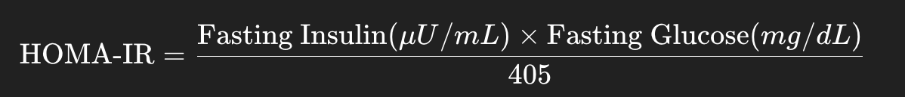
INSULIN RESISTANCE SCREENING
Normal: HOMA-IR < 1.0 (indicates normal insulin sensitivity)
Insulin Resistance: HOMA-IR ≥ 1.0 (indicates varying degrees of insulin resistance, with higher values suggesting more severe resistance)
Cutoff for metabolic syndrome: Some guidelines suggest a threshold of ≥ 2.5 to 3.0 as an indicator of significant insulin resistance, though this can vary depending on population and study.
Disclaimer: For internal use only

Slide 54
TREATMENT
Disclaimer: For internal use only

Slide 55
MONITORING
Several issues can arise during weight loss.
During the initial appointment patients risk for these should be determined.
During each follow-up there should be ongoing monitoring for:
  Lean Muscle Loss/Sarcopenia
  Gall stones/biliary colic
  Fatigue
  Mood changes
Disclaimer: For internal use only

Slide 56
SARCOPENIA
European Working Group on Sarcopenia in Older People EWGSOP (2019) Diagnostic Criteria
Probable Sarcopenia
  Low muscle strength (most reliable measure for initial suspicion)
    Handgrip strength (<27 kg (men), <16 kg (women))
    Chair stand test (≥15 seconds to complete 5 rises from a chair without using arms)
Confirmed Sarcopenia
  Low muscle strength AND
  Low muscle quantity or quality
    DXA (Dual-energy X-ray absorptiometry) <7.0 kg/m² (men), <5.5 kg/m² (women)
    BIA (Bioelectrical impedance analysis)
Severe Sarcopenia
  All the above AND
  Low physical performance
    Gait speed (≤0.8 m/s)
      Short Physical Performance Battery (SPPB)
      Timed Up and Go (TUG) test
      400-meter walk test
***Patients >65 tend to be at increased risk of poor outcomes at lower to mid-range BMIs. I suggest a modified target BMI in this population of 22-27 for overall better outcomes and lower mortality.
Disclaimer: For internal use only

Slide 57
LIFESTYLE
Disclaimer: For internal use only

Slide 58
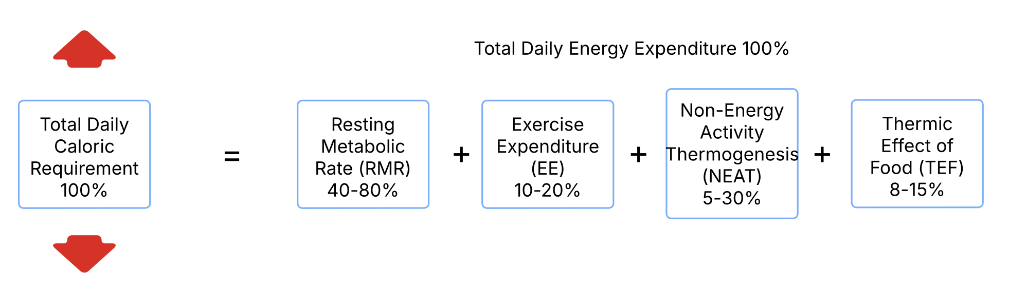
ENERGY BALANCE
Disclaimer: For internal use only

Slide 59
PHYSICAL ACTIVITY
Exercise Expenditure (EE) + Non-Energy Activity Thermogenesis (NEAT)
Exercise is a planned activity
Undervalued as means for weight loss and improved metabolic health
Patient should be screened for appropriateness for exercise and sent for clearance if necessary
Four main areas of focus:
  Strength Training
    Resistance
    Concentric vs Eccentric (contributes to stability)
  Aerobic Endurance
    Zone 2 training (60-70% max heart rate) – should be 70-80% of aerobic physical activity.
  Aerobic Intensity
    High Intensity Interval Training (HIIT)
    VO2 max
  Stability
    Core: Tai-chi, yoga, pilates
Disclaimer: For internal use only

Slide 60
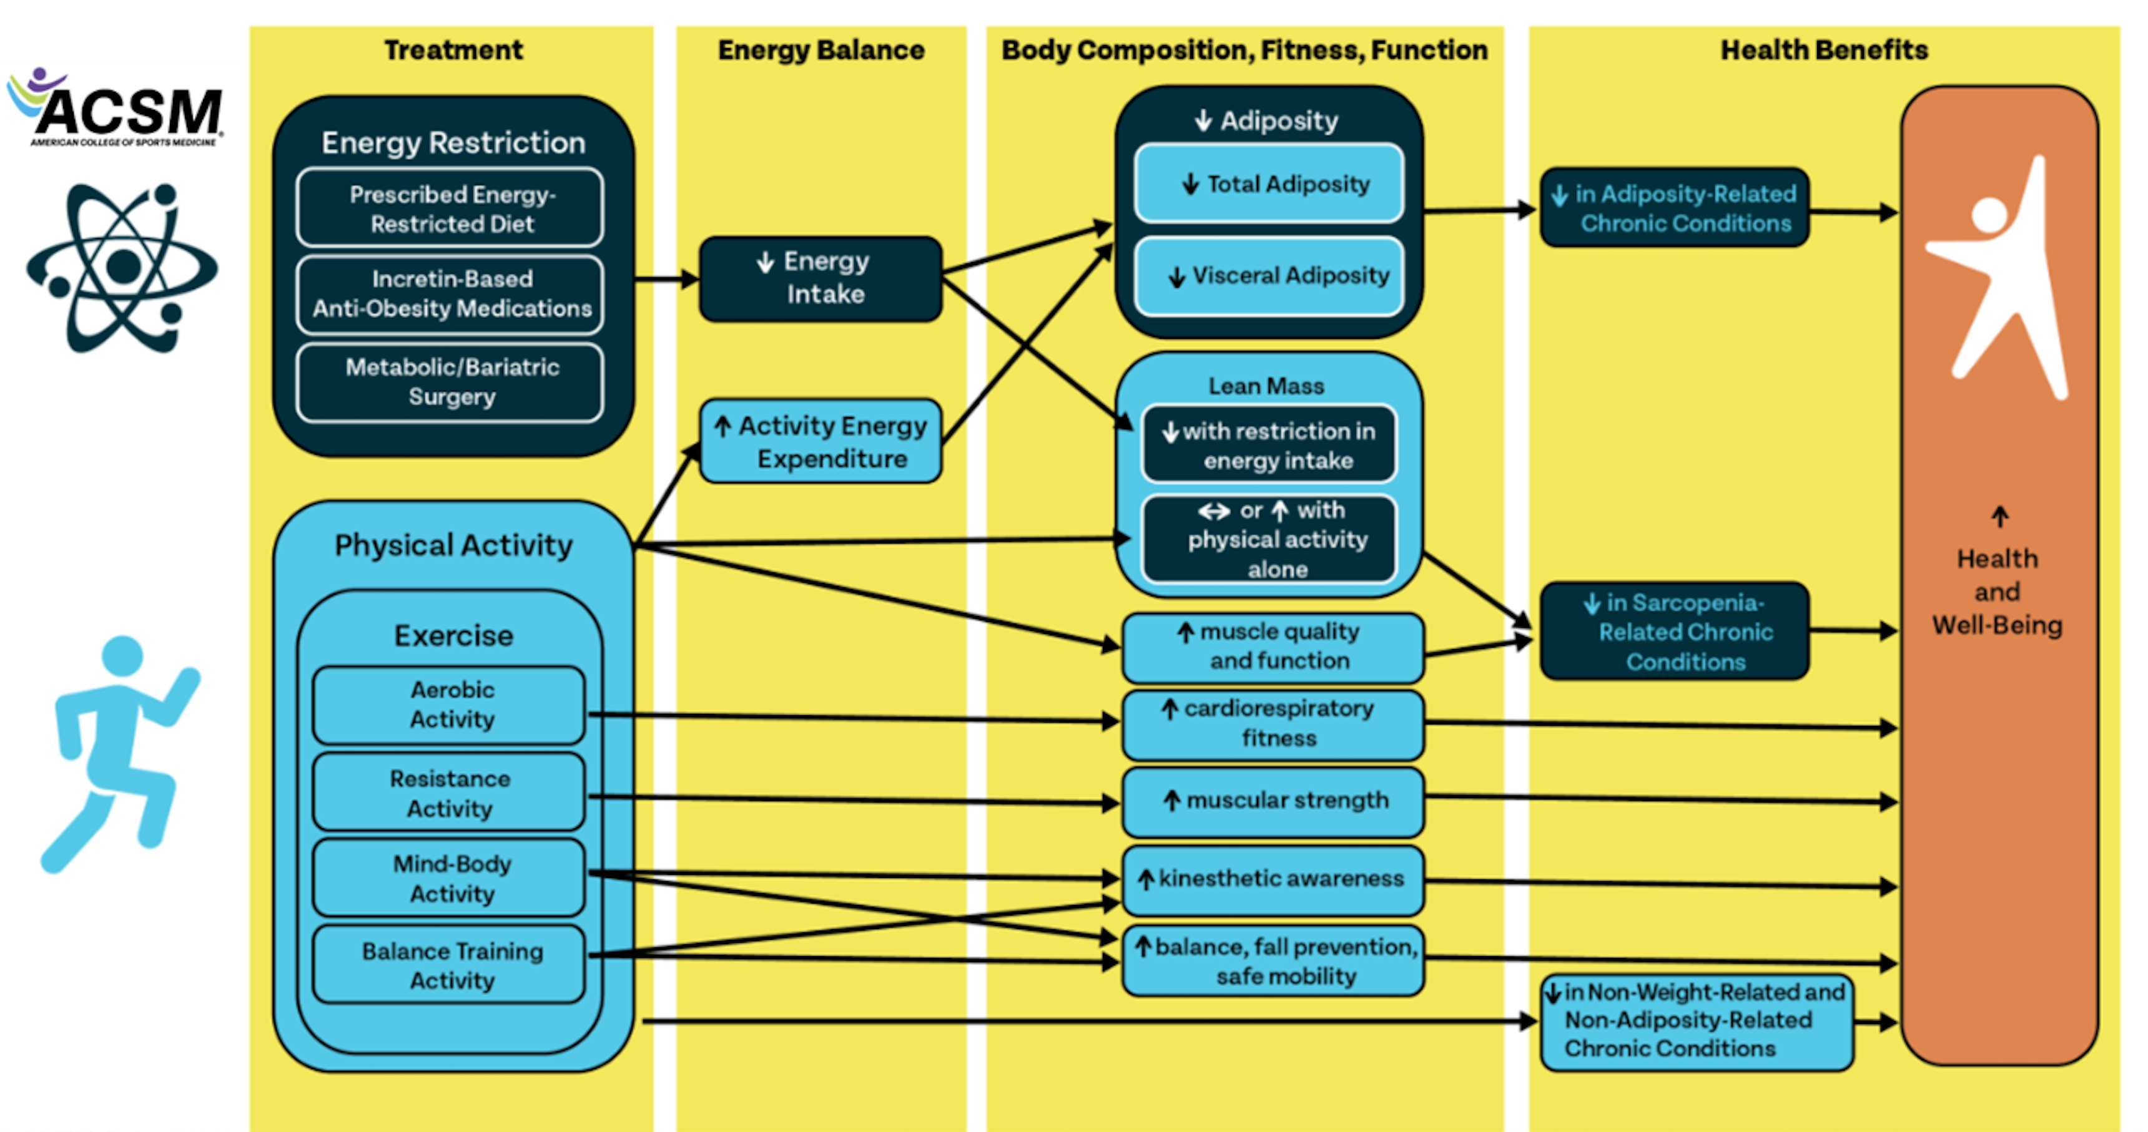
Disclaimer: For internal use only

Slide 61
PHYSICAL ACTIVITY
Maximum Heart Rate (MHR) is defined as 220-age
Zone | % Max HR | Intensity | Benefit | Feel
1 | 50-60% | Very light (warm-up/recovery) | Improves overall health, fat metabolism | Easy, relaxed
2 | 60-70% | Light (fat burning zone) | Builds endurance, uses fat for fuel | Conversational
3 | 70-80% | Moderate (aerobic zone) | Boosts aerobic fitness, heart health | Breathing heavier, still in control
4 | 80-90% | Hard (threshold zone) | Improves speed, lactate threshold | Talking is hard
5 | 90-100% | Very Hard (VO2 max zone) | Max performance, sprinting capacity | Breathless, max effort
Disclaimer: For internal use only

Slide 62
PHYSICAL ACTIVITY SCREENING
ACC/AHA/ACSM Guidelines (2020+ simplified model)
  Determine Current Physical Activity Level
    Active: Regular exercise ≥3 days/week, 30 minutes/session for ≥3 months
    Inactive: Not meeting the above
  Look for Known Cardiovascular, Metabolic, or Renal Disease
    Coronary artery disease (CAD)
    Heart failure
    Peripheral artery disease (PAD)
    Diabetes Mellitus (Type 1 or 2)
    Chronic kidney disease (CKD)
  Assess for Signs or Symptoms Suggestive of Disease
    Chest pain/discomfort with exertion
    Shortness of breath at rest or with mild exertion
    Dizziness or syncope
    Ankle edema
    Palpitations or irregular heartbeat
    Known heart murmur
    Unusual fatigue with usual activities
Disclaimer: For internal use only

Slide 63
PHYSICAL ACTIVITY SCREENING
Physical Activity Status | Known Disease? | Symptoms? | Medical Clearance?* | OK to Exercise?
Inactive | No | No | Not needed | Start light-moderate
Inactive | Yes | No | Recommended | After clearance
Inactive | Yes or No | Yes | Required | After clearance
Active | No | No | Not needed | Continue/intensify
Active | Yes | No | Not needed | Moderate OK, vigorous consider clearance
Active | Yes or No | Yes | Required | After clearance
*treadmill stress test and cardiologist evaluation
Disclaimer: For internal use only

Slide 64
NUTRITION
There are only three changes that can be made to a patient’s nutrition:
  Restrict amount of food (Caloric restriction)
  Restrict time of feeding (e.g., intermittent fasting)
  Restrict type of food (e.g., macronutrients, type of food)
Most conventional ”diets” are one or a combination of these three changes
Some patients may get discouraged or be set up to fail with too much restriction
Disclaimer: For internal use only

Slide 65
NUTRITION
Macronutrient | Kcal/gram | Recommended Daily Allowance (RDA)
Carbohydrates | 4 | 130g
Alcohol | 7 | N/A
Protein | 4 | Male:56g, Female:46g
Fat | 9 | Omega 6: 7-17g, Omega 3: 0.5-1.6g
Disclaimer: For internal use only

Slide 66
PROTEIN
Protein helps slow muscle loss which happens with weight loss.
Protein promotes satiety.
U.S. Recommended Dietary Allowance (RDA) of 0.8 grams per kilogram
For weight loss 0.5-1 gram(s) per pound is recommended for patients without preexisting kidney disease
Disclaimer: For internal use only

Slide 67
FATS
There is no specific goal
There are significant cardiovascular health benefits of mono-unsaturated fatty acids (MUFAs)
Extra virgin olive oil is a preferred source and is the backbone of the Mediterranean Diet which is endorsed with the American Heart Association (AHA).
Balanced fat intake is recommended
  50–55% from MUFAs​
  15–20% from saturated fats​
  25–35% from polyunsaturated fats (PUFAs), including
  omega-3s (DHA/EPA/ALA)
Disclaimer: For internal use only

Slide 68
CARBOHYDRATES
In general, it is recommended to limit simple and refined carbohydrates, however, there is no specific goal
Significant restriction leads to ketosis
Fiber is a type of insoluble carbohydrate that promotes satiety, improves cholesterol, improves blood glucose and promotes good gut health
Adequate Intake according to the Dietary Guidelines for Americans:
  Men (ages 19–50): 38 grams/day
  Men (51+): 30 grams/day
  Women (ages 19–50): 25 grams/day
  Women (51+): 21 grams/day
Disclaimer: For internal use only

Slide 69
CONTINUOUS GLUCOSE MONITORING (CGM)
We no longer must rely upon dietary recall alone.
Tests interstitial fluid, not a capillary or venous blood sample.
Great for monitoring diet and instituting dietary changes.
Not meant for diagnosis.
Readings may be up to 10 nmol/dL off and may be delayed by 15 minutes depending upon monitor.
Goal is an average blood glucose of 95 nmol/dL ± 15
Disclaimer: For internal use only

Slide 70
CGM OPTIONS
Prescription CGMs:
  Dexcom G6:
    Receiver (one-time): Approximately $437.
    Sensors (monthly): Around $420 for a 30-day supply.
    Transmitter (quarterly): About $300 every 90 days.
    Total Estimated Monthly Cost: Approximately $500 without insurance. ​
  Dexcom G7:
    Cost: Varies; Dexcom offers a savings program providing over 50% off the standard monthly cash price.
  Abbott FreeStyle Libre 2:
    Reader: Approximately $130 to $150 (one-time).
    Sensors: Around $130 for a month's supply.
    Total Estimated Monthly Cost: About $130 without insurance.
  Abbott FreeStyle Libre 3 Plus:
    Cost with Insurance: Most commercially insured patients pay between $0 to $75 per month.
Over-the-Counter (OTC) CGMs:
  Dexcom Stelo:
    One-time purchase: $99 for two sensors (30-day supply).
    Monthly subscription: $89 per month for two sensors.
  Abbott Lingo:
    One-time purchase: $49 for a 14-day sensor.
    Monthly subscription: $89 for two sensors (28-day supply).
Disclaimer: For internal use only

Slide 71
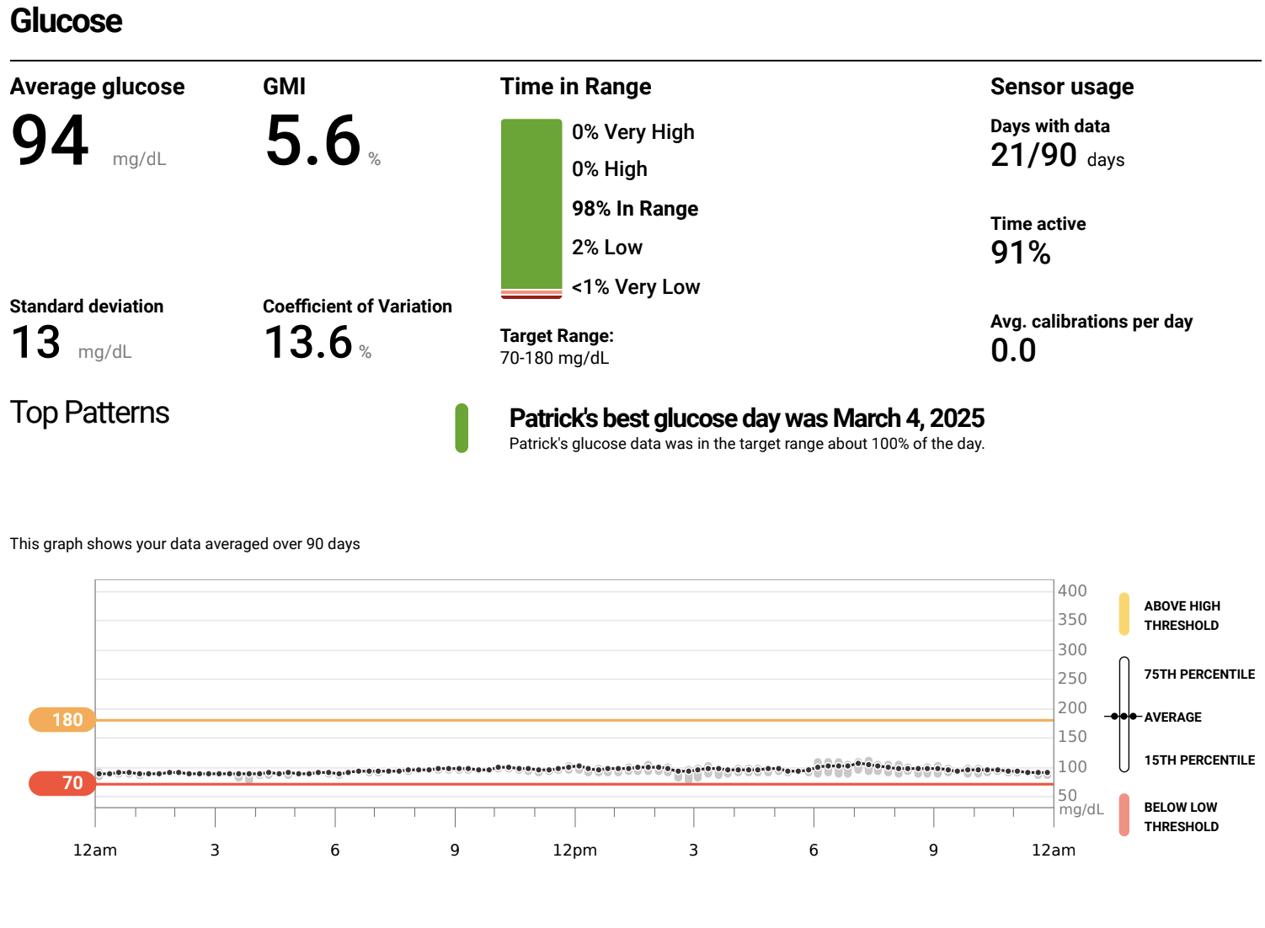
CGM DATA
Disclaimer: For internal use only

Slide 72
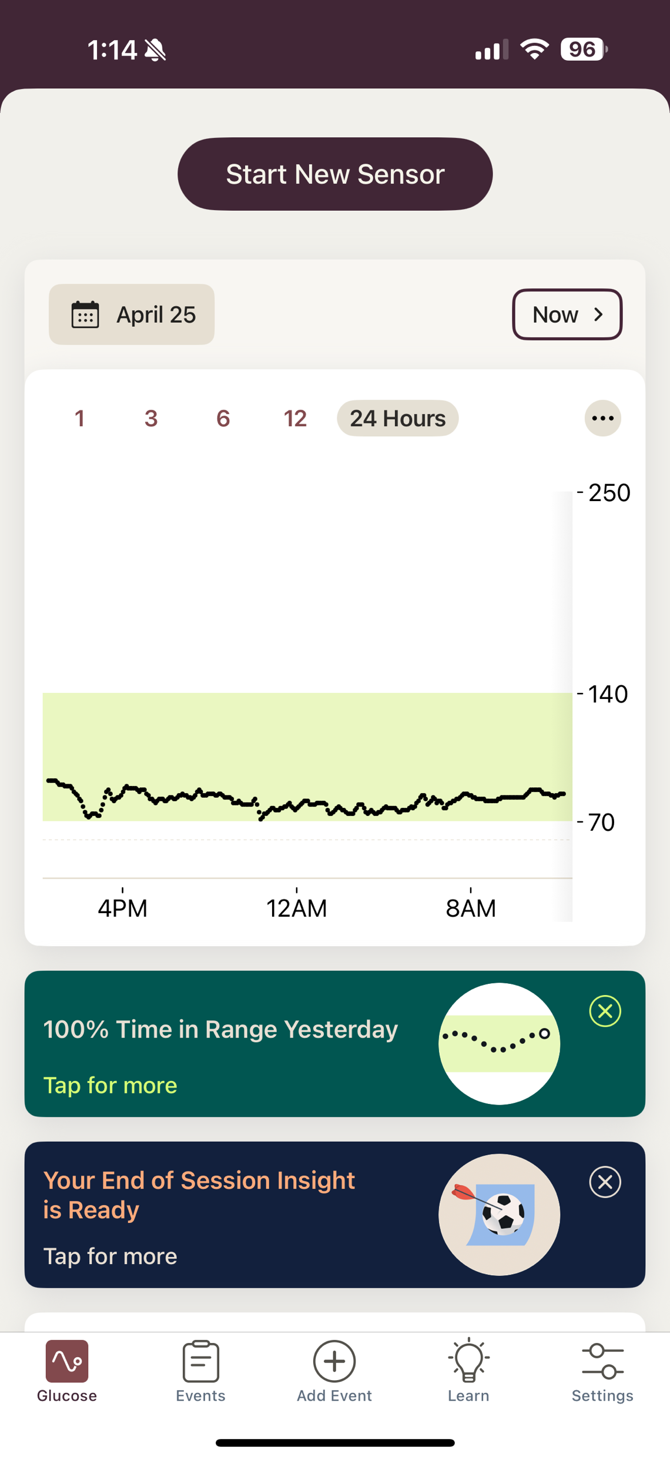
CGM DATA
Disclaimer: For internal use only

Slide 73

CGM DATA
Disclaimer: For internal use only

Slide 74
ALCOHOL
There is no healthy level of alcohol consumption.
Disclaimer: For internal use only

Slide 75
TIME RESTRICTION
Intermittent fasting has shown varying levels of success depending upon the outcome being measured (e.g., weight loss, metabolic health, insulin sensitivity)
  Time-Restricted Eating (TRE)
    16:8 is the most well studied
    Average weight loss is 2-3kg over 12 weeks
    Modest reduction in insulin resistance
    No difference in lean muscle mass compared to control
    8:6 or 20:4 regimens often show faster weight loss, but may be harder to maintain and risk muscle loss if not combined with resistance training and sufficient protein
    Early Time-Restricted Eating (eTRE) defined as eating window from 7a-3p did not show significant improvements in weight, but improvements in insulin sensitivity, lower blood glucose and oxidative stress
  5:2 Twice-Weekly fasting
    Comparable weight loss to daily calorie restriction
    Greater improvement in insulin sensitivity
    Adherence can be better than daily restriction due to fewer fasting days
  Alternate Day Fasting (ADF)
    Comparable weight loss to daily calorie restriction (5–6% of body weight)
    Improved LDL cholesterol and triglycerides
    Adherence is often harder due to hunger and fatigue
Disclaimer: For internal use only

Slide 76
TIME RESTRICTION
Method | Weight Loss | Insulin Sensitivity | Adherence | Notable Benefit
16:8 | Moderate | Good | Easy | Habit-forming
18:6 or 20:4 | Faster | Good | Medium | Fast results
eTRE | Mild | High | Medium | Best metabolically
5:2 | Moderate | High | High | Long-term success
ADF | High | High | Low | Rapid weight loss
Disclaimer: For internal use only

Slide 77
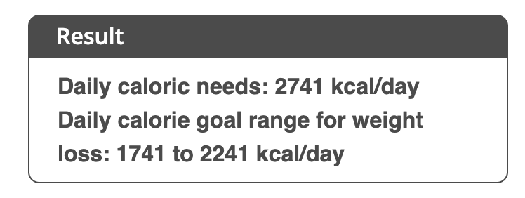
CALORIC RESTRICTION
Sometimes patients fail despite adhering to a balanced nutrition regimen and require more intensive management
Mifflin-St. Jeor Equation provides
daily caloric need as well as daily
caloric range for weight loss
Harris-Benedict Equation is older and
provides an estimated
Basal Metabolic Rate (BMR)
Equations are sometimes unreliable
Indirect Calorimetry is superior to get an accurate Resting Metabolic Rate (RMR) but may cost $100-200.
Mifflin-St. Jeor
Disclaimer: For internal use only

Slide 78
SLEEP
Poor sleep can significantly impair weight loss by affecting hormones, metabolism, appetite, and willpower
  Hormonal disruption
    Decreased Leptin (satiety hormone) and increased Ghrelin (hunger hormone)
    Increased appetite, especially for high-carb, high-fat foods
    Increased cravings & emotional eating
    Impulse control drops which leads to overeating
  Insulin resistance
    Higher blood glucose and more fat storage, especially visceral fat
    Even short-term sleep loss (4–5 nights) can increase insulin resistance.
  Slower metabolism and reduced physical activity
    Resting energy expenditure decreased
    The body conserves energy when sleep-deprived.
    Low energy leads to less motivation to exercise
    Fatigue also makes workouts less effective or shorter.
Patients who sleep <6 hours/night lose less fat mass than those who sleep 7–9 hours, even with the same calorie intake.
Sleep-deprived patients tend to consume 200–500 more calories/day on average.
Aim for 7–9 hours of quality sleep
Disclaimer: For internal use only

Slide 79
OBSTRUCTIVE SLEEP APNEA (OSA)
Sleepy: Epworth Sleepiness Scale (EPSS)
Scoring System (per question):
  0 = Would never doze
  1 = Slight chance of dozing
  2 = Moderate chance of dozing
  3 = High chance of dozing
The 8 Situations:
  Sitting and reading
  Watching TV
  Sitting inactive in a public place (e.g., a theater or meeting)
  As a passenger in a car for an hour without a break
  Lying down to rest in the afternoon when circumstances permit
  Sitting and talking to someone
  Sitting quietly after a lunch without alcohol
  In a car, while stopped for a few minutes in traffic
Interpretation of Total Score:
  0–7 = Normal sleepiness
  8–9 = Mild sleepiness
  10–15 = Moderate sleepiness (Needs further evaluation)
  16–24 = Severe sleepiness (strongly suggests a sleep disorder)
Not Sleepy: STOP-BANG Questionnaire
  Snoring: Do you snore loudly (louder than talking or loud enough to be heard through closed doors)?
  Tired: Do you often feel tired, fatigued, or sleepy during the daytime?
  Observed: Has anyone observed you stop breathing during your sleep?
  Pressure: Do you have or are you being treated for high blood pressure?
  BMI: Is your body mass index (BMI) over 35 kg/m²?
  Age: Are you over 50 years old?
  Neck circumference: Is your neck circumference greater than 40 cm (15.75 inches)?
  Gender: Are you male?
Scoring:
  0–2 points: Low risk of OSA
  3–4 points: Intermediate risk
  5–8 points: High risk
Disclaimer: For internal use only

Slide 80
MENTAL HEALTH
Mental health can significantly impact weight loss efforts through:
Mood disorders (e.g., MDD, SAD, etc): decreased motivation, increased emotional eating
Anxiety and stress: increased cortisol, increased cravings, increased fat storage
Emotional eating: Using food to cope with sadness, boredom, loneliness
Negative self-talk: Shame, all-or-nothing thinking, giving up easily
Executive dysfunction (e.g., ADHD, PTSD, etc): Inconsistent habits, poor planning
Support mental health to support weight loss: therapy, mindfulness, routines, sleep, and self-compassion.
Disclaimer: For internal use only

Slide 81
ANTI-OBESITY MEDICATIONS (AOMs)
Disclaimer: For internal use only

Slide 82
INDICATIONS*
BMI ≥ 30 kg/m²
BMI ≥ 27kg/m² plus comorbidities
  Type 2 Diabetes Mellitus
  Hypertension
  Dyslipidemia
  Cardiovascular disease
    Coronary Artery Disease
    History of CVA
    History of MI
    Peripheral Artery Disease
  Obstructive Sleep Apnea
To be used alongside lifestyle modifications
* With exception of Setmelanotide
Disclaimer: For internal use only

Slide 83
LONG-TERM AOMs
Disclaimer: For internal use only

Slide 84
ORLISTAT (ALLI)
Approval | FDA approved 1999, study duration 4 years, approved for use in pediatrics
Mechanism | Lipase inhibitor – causes malabsorption of 30% of ingested fat
Percent weight loss | 2.9-3.4%
Dose | 60-120mg TID before meals
Side effects | Steatorrhea, fecal incontinence, urgency, flatulence, decreased absorption of vitamins A,D,E, and K
Contraindications/Cautions | Pregnant, breastfeeding, cholestasis, malabsorption syndromes, warfarin, antiepileptic medications
Additional outcomes | Reduced incidence of T2DM, mixed effect of lipid profiles (lower LDL & HDL), decreased blood pressure, better glycemic control in T2DM
Disclaimer: For internal use only

Slide 85
PHENTERMINE/TOPIRAMATE (QSYMIA)
Approval | FDA approved 2012, study duration 2 years
Mechanism | NE releasing agent/GABA receptor modulator
Percent weight loss | 6.6-8.6%
Dose | 3.75/23mg daily, then 7.5/46mg daily, then 11.25/69mg daily then 15/92mg daily
Side effects | Drowsiness, insomnia, paresthesia cognitive changes, nephrolithiasis, constipation, hypokalemia, metabolic acidosis
Contraindications/Cautions | Pregnancy, breastfeeding, nephrolithiasis, hyperthyroid, glaucoma, MAOi use, severe depression, uncontrolled hypertension
Additional outcomes | Decreased incidence of T2DM, lowered blood pressure, improved lipid profile
Disclaimer: For internal use only

Slide 86
BUPROPRION/NALTREXONE (CONTRAVE)*
Approval | FDA approved in 2014
Mechanism | Opiate antagonist/reuptake inhibitor of dopamine and NE
Percent weight loss | 4.8-6.0%, study duration 2 years
Dose | 8mg/90mg tablets Titration: 1 tab daily, 1 tab BID, 2 tab qAM and 1 tab qPM, 2 tabs BID (increase dose weekly as tolerated.
Side effects | Headache, constipation, nausea, vomiting, anxiety, dizziness, increased blood pressure
Contraindications/Cautions | Uncontrolled blood pressure, seizure disorder, bulimia, MAOi use, history of withdrawal from drugs or ETOH, pregnancy or breastfeeding
Additional outcomes | Better HDL and TG, improved glycemia control, improved weight related QoL, control overeating behaviors and sexual function
*Can consider generic bupropion & naltrexone separately off-label for an affordable alternative.
Disclaimer: For internal use only

Slide 87
LIRAGLUTIDE (SAXENDA)
Approval | FDA approved 2014, approved in pediatric patients >12
Mechanism | GLP-1 RA – decreases appetite in hypothalamus, slows gastric emptying, etc
Percent weight loss | 7-8%, study duration 1 year
Dose | 0.6mg, 1.2mg, 1.8mg (diabetic doses 1.8mg and below available as generic), 2.4mg, 3.0mg, subcutaneously daily
Side effects | Nausea, vomiting, diarrhea, constipation, fatigue, reflux
Contraindications/Cautions | History of medullary thyroid cancer or MEN-2 syndrome, history of pancreatitis, gastroparesis, diabetic retinopathy, pregnancy or breastfeeding
Additional outcomes | Better cardiovascular outcomes in T2DM
Disclaimer: For internal use only

Slide 88
SEMAGLUTIDE (WEGOVY)
Approval | FDA approved in June 2021 for weight loss
Mechanism | GLP-1 RA – decreases appetite in hypothalamus, slows gastric emptying, etc
Percent weight loss | 14.9% over 68 weeks (STEP 3 trial showed 16% with intensive lifestyle modification)
Dose | Titrate: 0.25mg, 0.5mg, 1.0mg, 1.7mg, 2.4mg subcutaneously weekly
Side effects | Nausea, vomiting, diarrhea, constipation, fatigue, reflux
Contraindications/Cautions | History of medullary thyroid cancer or MEN-2 syndrome, history of pancreatitis, gastroparesis, diabetic retinopathy, pregnancy or breastfeeding
Additional outcomes | Increased physical functioning scores, decreased BP, improved QoL, decreased CV events in T2DM
Disclaimer: For internal use only

Slide 89
TIRZEPETIDE (ZEPBOUND)
Approval | FDA approved in November 2023 for weight loss, Feb 2025 for OSA
Mechanism | GLP-1/GIP RA – decreases appetite in hypothalamus, slows gastric emptying, etc
Percent weight loss | 20.8% over 68 weeks (SURMOUNT trial)
Dose | Titrate: 2.5mg, 5.0mg, 7.5mg, 10.00mg, 12.50mg, 15.00mg subcutaneously weekly
Side effects | Nausea, vomiting, diarrhea, constipation, fatigue, reflux
Contraindications/Cautions | History of medullary thyroid cancer or MEN-2 syndrome, history of pancreatitis, gastroparesis, diabetic retinopathy, pregnancy or breastfeeding
Additional outcomes | Increased physical functioning scores, decreased BP, improved sleep apnea
Disclaimer: For internal use only

Slide 90
SETMELANOTIDE (IMCIVREE)*
Approval | November 25, 2020 for use only in patients > 2 years with obesity due to Bardet-Biedl syndrome (BBS), or due to pro-opiomelanocortin (POMC), proprotein convertase subtilisin/kexin type 1 (PCSK1), or leptin receptor (LEPR) deficiency confirmed by genetic testing demonstrating variants in POMC, PCSK1, or LEPR genes that are interpreted as pathogenic, likely pathogenic, or of uncertain significance.
Mechanism | MC4R agonist that restores the function of the melanocortin-4 receptor in the brain to regulate hunger and metabolism, thereby reducing appetite and promoting weight loss in individuals with rare genetic forms of obesity.
Percent weight loss | POMC deficiency: Mean weight loss of 25.4%, approximately 31.9 kg (70.2 lbs), with 80% of participants achieving at least 10% weight loss LEPR deficiency: Mean weight loss of 12.5%, about 16.7 kg (36.8 lbs), with 45.5% of participants achieving at least 10% weight loss Hypothalamic obesity: Mean BMI reduction of 25.5%
Dose | 2 mg once daily for 2 weeks, then increase to the maintenance dose of 3 mg once daily
Side effects | Nausea, vomiting, diarrhea, fatigue, headache, mood changes, skin darkening
Contraindications/Cautions | Pregnancy or breastfeeding, patients < 2 years
Additional outcomes | N/A
* Special indication only for rare genetic forms (BBS, POMC, PCSK1 or LEPR) of obesity
Disclaimer: For internal use only

Slide 91
CELLULOSE & CITRIC ACID HYDROGEL (PLENITY)*
Approval | FDA approval on April 12, 2019, for adults 22 and up with a BMI of 25 to 40
Mechanism | Expands in the stomach and small intestine after water intake to create a sense of fullness, helping reduce appetite and calorie intake without being absorbed or metabolized.
Percent weight loss | In the initial 24-week GLOW study, participants taking Plenity lost an average of 6.4% of their body weight
Dose | 2.25 g (3 capsules) twice daily (before lunch and dinner)
Side effects | bloating, constipation, nausea, diarrhea, abdominal discomfort
Contraindications/Cautions | History of bowel obstruction, gastroparesis, chronic malabsorption syndrome, pregnancy or breastfeeding
Additional outcomes | No absorption into the bloodstream. Functions as a device, not a medication. DISCONTINUED DUE TO MANUFACTURER FINANCIAL DIFFICULTY
* Special indication for BMI 25-40%
Disclaimer: For internal use only

Slide 92
SHORT-TERM AOMs
Disclaimer: For internal use only

Slide 93
PHENTERMINE (ADIPEX-P, LOMAIRA)*
Approval | FDA approved in 1952 for short-term use (12 weeks), study duration 2-52 weeks, approved for adolescents (defined as 17+)
Mechanism | Norepinephrine (NE) – releasing agent reduces reuptake of NE from the synapse, effects serotonin and dopamine reuptake
Percent weight loss | 5-7.8%
Dose | 8-37.5mg, lower doses 2-3x daily
Side effects | Palpitations, tachycardia, increased blood pressure, ischemic events, insomnia, anxiety, headache, psychosis, euphoria, dysphoria, tremor
Contraindications/Cautions | Pregnancy, breastfeeding, history of heart disease, uncontrolled blood pressure, hyperthyroidism, glaucoma, history of substance abuse, MAOi use, concurrent stimulant use
Additional outcomes | Controlled substance, Long term use (off-label) associated with mild elevations in blood pressure (+3 points SBP), stimulant medications are generally limited due to concerns for side effects (hypertension, tachycardia) and risk of addiction, Most well studied of all stimulant based AOMs
*Other short acting stimulant-based medications include diethylpropion, phendimetrazine, and benzphetamine. Of these, phentermine has been studied the most extensively and has the most favorable safety profile.
Disclaimer: For internal use only

Slide 94
DIETHYLPROPION
Approval | FDA approved in 1959 for short-term use (12 weeks), approved for adolescents (defined as 16+)
Mechanism | Norepinephrine (NE) – releasing agent reduces reuptake of NE from the synapse, effects serotonin and dopamine reuptake
Percent weight loss | 5-7.8%
Dose | Immediate release: 25 mg 3 times daily 1 hour before meals Controlled release: 75 mg once daily in the midmorning
Side effects | Palpitations, tachycardia, increased blood pressure, ischemic events, insomnia, anxiety, headache, psychosis, euphoria, dysphoria, tremor
Contraindications/Cautions | Pregnancy, breastfeeding, history of heart disease, uncontrolled blood pressure, hyperthyroidism, glaucoma, history of substance abuse, MAOi use
Additional outcomes | Controlled substance, stimulant medications are generally limited due to concerns for side effects (hypertension, tachycardia) and risk of addiction
Disclaimer: For internal use only

Slide 95
PHENDIMETRAZINE
Approval | FDA approved in 1959 for short-term use (12 weeks), approved for adolescents (defined as 17+)
Mechanism | Norepinephrine (NE) – releasing agent reduces reuptake of NE from the synapse, effects serotonin and dopamine reuptake
Percent weight loss | 5-7.8%
Dose | Extended release: 105 mg once daily 30 to 60 minutes before morning meal Immediate release: 17.5 to 35 mg 2 or 3 times daily, 1 hour before meals
Side effects | Palpitations, tachycardia, increased blood pressure, ischemic events, insomnia, anxiety, headache, psychosis, euphoria, dysphoria, tremor
Contraindications/Cautions | Pregnancy, breastfeeding, history of heart disease, uncontrolled blood pressure, hyperthyroidism, glaucoma, history of substance abuse, MAOi use
Additional outcomes | Controlled substance, stimulant medications are generally limited due to concerns for side effects (hypertension, tachycardia) and risk of addiction
Disclaimer: For internal use only

Slide 96
BENZPHETAMINE
Approval | FDA approved in 1960 for short-term use (12 weeks), approved for adolescents (defined as 17+)
Mechanism | Norepinephrine (NE) – releasing agent reduces reuptake of NE from the synapse, effects serotonin and dopamine reuptake
Percent weight loss | 5-7.8%
Dose | 25 to 50 mg once daily, may increase up to 50 mg 3 times daily based on response and tolerability
Side effects | Palpitations, tachycardia, increased blood pressure, ischemic events, insomnia, anxiety, headache, psychosis, euphoria, dysphoria, tremor
Contraindications/Cautions | Pregnancy, breastfeeding, history of heart disease, uncontrolled blood pressure, hyperthyroidism, glaucoma, history of substance abuse, MAOi use
Additional outcomes | Controlled substance, stimulant medications are generally limited due to concerns for side effects (hypertension, tachycardia) and risk of addiction
Disclaimer: For internal use only

Slide 97
OFF-LABEL AOMs
Disclaimer: For internal use only

Slide 98
METFORMIN (off-label)
Approval | FDA approved for diabetes in 1995, approved for T2DM in pediatrics
Mechanism | Reduces hepatic glucose production, decreased interstitial glucose absorption, increases peripheral insulin sensitivity, may reduce appetite by raising GLP-1 levels
Percent weight loss | Average of 3kg (6.6lbs) over 12 months
Dose | 500mg-2000mg
Side effects | Diarrhea, nausea, flatulence, dyspepsia, vomiting, abdominal pain, lactic acidosis, B12 deficiency
Contraindications/Cautions | Renal dysfunction, history of metabolic acidosis, pregnancy or breastfeeding (although used in pregnancy, not for weight loss)
Additional outcomes | Prevention of T2DM, treatment of PCOS, prevents antipsychotic weight gain
Disclaimer: For internal use only

Slide 99
TOPIRAMATE (off-label)
Approval | FDA approved for seizures in 1998, also approved for migraine prophylaxis
Mechanism | Unknown
Percent weight loss | 6% weight loss at 6 months. Study duration 60 weeks.
Dose | Starting dose 25mg qhs, titrate to 200-300mg/day
Side effects | Paresthesias, dizziness, dysgeusia, insomnia, constipation, dry mouth, and cognitive dulling
Contraindications/Cautions | Pregnancy (teratogenic– oral cleft deficits), glaucoma, nephrolithiasis
Additional outcomes | Migraine prevention, also useful in Binge-Eating Disorder
Disclaimer: For internal use only

Slide 100
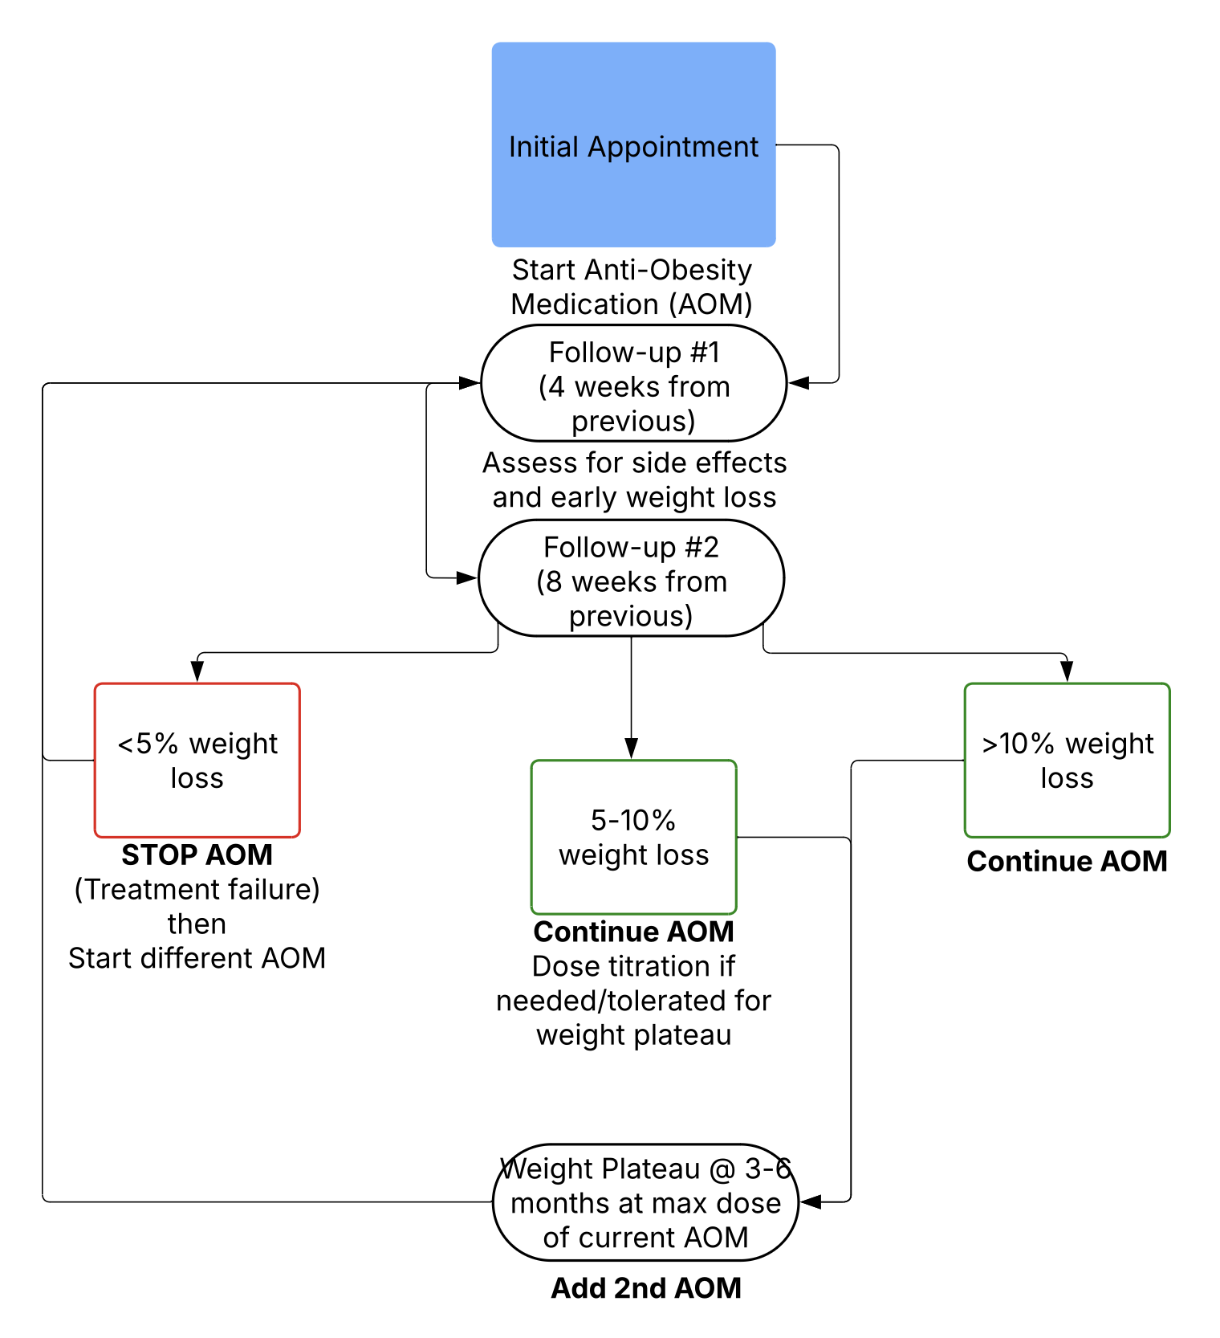
Disclaimer: For internal use only

Slide 101
CONSIDERATIONS FOR PRESCRIBING
If: | Consider
T2DM | GLP-1, metformin
Headaches | Topiramate
Binge-Eating | Topiramate or bupropion/naltrexone
Desires pregnancy or PCOS | Metformin
ETOH/tobacco use | Bupropion/naltrexone
If: | Avoid
Bulimia or seizures | Bupropion/naltrexone
Nephrolithiasis | Topiramate
Opioid use | Bupropion/naltrexone
Glaucoma | Phentermine
Cardiovascular disease or uncontrolled Hypertension | Phentermine
Disclaimer: For internal use only

Slide 102
COVERAGE*
Medication | Lowest Cost/Month | Where
Orlistat | $77.00 | Amazon
Phentermine | $13.05 | GoodRx (Publix)
Phentermine/Topiramate (Qsymia) | $98.00 | Qsymia Engage (mail-order partner pharmacy)
Wellbutrin/ Naltrexone (Contrave) | $99.00 | CurxAccess Program (Ridgeway mail-order pharmacy)
Liraglutide (Saxenda) | $375.96 $1,369.80 | 1.8mg, GoodRx (Target) 3.0mg, GoodRx (Food Lion)
Semaglutide (Wegovy) | $499.00 | Wegovy savings card through NovoCare Pharmacy
Tirzepatide (Zepbound) | $349.00-499.00* | Lilly Direct Cash Pay (or Self Pay) Pharmacy *vials, not pens
Topiramate (off-label) | $4.93 | GoodRx (Walmart)
Metformin (off-label) | $4.00 | GoodRx (Walmart)
Medicare does not *currently* cover anti-obesity medications for weight loss
Coverage by private insurances is variable
* For commonly prescribed AOMs, not a complete list
Disclaimer: For internal use only

Slide 103
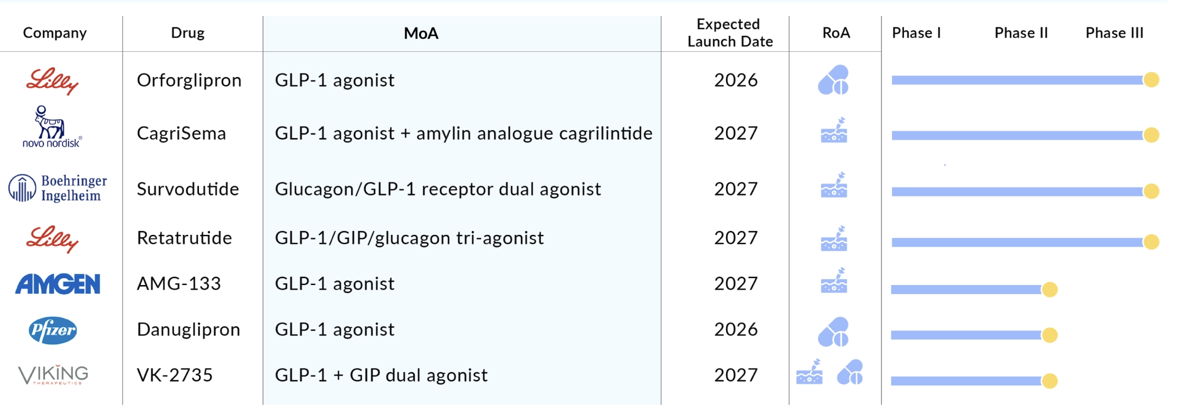
EMERGING THERAPIES
Disclaimer: For internal use only

Slide 104
BARIATRIC SURGERY
18–65 years old
Failure of conservative treatments (nutrition, physical activity, medical therapy).
BMI ≥ 40 kg/m²
BMI ≥ 35kg/m² plus 1+ comorbidities
  Type 2 Diabetes Mellitus
  Hypertension
  Dyslipidemia
  Metabolic-associated Steatotic Liver Disease LSLD
  Obstructive Sleep Apnea
  Osteoartritis
BMI ≥ 30kg/m² in select cases
  Poorly-controlled Type 2 Diabetes Mellitus
Disclaimer: For internal use only

Slide 105
CODING
Disclaimer: For internal use only

Slide 106
CODING
Obesity | E66.9 | Exogenous | E66.09 | Gene mutation, Leptin Receptor (LEPR) | E88.82
w/alveolar hypoventilation | E66.2 | Drug-induced | E66.1 | Melanocortin 4 (MC4) | E88.82
Adrenal | E27.8 | Endocrine, Constitutional | E66.89 | Nuclear Receptor Coactivator 1 (NCOA1) | E88.82
Class 1 | E66.811 | Excess calories, nutritional | E66.09 | Proopiomelanocortin (POMC) | E88.82
Class 2 | E66.812 | Severe | E66.01 | Proprotein Convertase Subtilisin/kexin type 1 (PCSK1) | E88.82
Class 3 | E66.813 | Pituitary | E23.6 | SRC Homology 2B Adaptor Signaling Protein (SH2B1) | E88.82
Complicating childbirth | O99.214 | Pregnancy | O99.21 | Puerperium | O99.215
* Morbid obesity is no longer an appropriate diagnosis. It has been replaced with Obesity Class 3.
Disclaimer: For internal use only

Slide 107
SEQUENCING
Obesity Diagnosis* E66.XX
BMI Diagnosis* Z68.XX
Comorbidities I.10
Dietary Counseling & Surveillance Z71.3
This sequencing aligns with how most payer policy's structure coverage criteria for both weight loss medications and bariatric surgery.
* Based on starting weight. This is the disease state you are treating for.
Disclaimer: For internal use only

Slide 108
REFERENCES
Kivipelto, M., Ngandu, T., Fratiglioni, L., Viitanen, M., Kåreholt, I., Winblad, B., ... & Nissinen, A. (2005). Obesity and vascular risk factors at midlife and the risk of dementia and Alzheimer disease. Archives of Neurology, 62(10), 1556–1560.
https://pubmed.ncbi.nlm.nih.gov/29024348/
Shrestha, S., & Lautenschlager, N. T. (2015). Overweight, obesity and Parkinson’s disease: A meta-analysis of observational studies. Movement Disorders, 30(5), 677–683.
https://pubmed.ncbi.nlm.nih.gov/24672544/
Centers for Disease Control and Prevention. (2021). Obesity and Cancer. CDC. Retrieved from https://www.cdc.gov/cancer/risk-factors/obesity.html
Berrington de González, A., Hartge, P., Cerhan, J. R., Flint, A. J., Hannan, L., MacInnis, R. J., ... & Thun, M. J. (2010). Obesity and cancer risk: a meta-analysis of the worldwide epidemiologic data. The Lancet, 375(9732), 1697-1707. https://doi.org/10.1016/S0140-6736(10)60130-0
Calle, E. E., & Kaaks, R. (2004). Overweight, obesity and cancer: epidemiological evidence and proposed mechanisms. Nature Reviews Cancer, 4(8), 579-591. https://doi.org/10.1038/nrc1408
Fryar, C. D., Carroll, M. D., & Ogden, C. L. (2024). Prevalence of overweight, obesity, and severe obesity among adults aged 20 and over: United States, August 2021–August 2023 (NCHS Data Brief No. 508). National Center for Health Statistics. Retrieved from: https://www.cdc.gov/nchs/products/databriefs/db508.htm
Disclaimer: For internal use only

Slide 109
REFERENCES
Shrestha, S., & Lautenschlager, N. T. (2015). Overweight, obesity and Parkinson’s disease: A meta-analysis of observational studies. Movement Disorders, 30(5), 677–683.
https://pubmed.ncbi.nlm.nih.gov/24672544/
National Heart, Lung, and Blood Institute. (2012). Integrated guidelines for cardiovascular health and risk reduction in children and adolescents. Retrieved from https://www.nhlbi.nih.gov/health-topics/integrated-guidelines-for-cardiovascular-health-and-risk-reduction-in-children-and-adolescents
American Heart Association. (n.d.). Lipoprotein(a). Retrieved April 8, 2025, from https://www.heart.org/en/health-topics/cholesterol/genetic-conditions/lipoprotein-a
Tchernof A, Després JP. Pathophysiology of human visceral obesity: an update. Physiol Rev. 2013 Jan;93(1):359-404. doi: 10.1152/physrev.00033.2011. PMID: 23303913.
DelveInsight. (2024, August 9). 7 promising obesity drugs set to launch by 2027. DelveInsight. https://www.delveinsight.com/blog/obesity-drugs-launch​
Disclaimer: For internal use only

Slide 110
QUESTIONS
Disclaimer: For internal use only

Slide 111
CONTACT
PATRICK STEVENS DO DABOM
Family and Obesity Medicine Physician/Medical Advisor
pstevens@hughchatham.org
Disclaimer: For internal use only

Slide 112
Disclaimer: For internal use only

