Slide 1
Obesity Medicine Approach
Part 1: Understanding the disease & Eating Disorders
Courtney Floyd, MD

Slide 2
Outline
Definition of Obesity
Evaluation approach
Pathophysiology of the Disease
Eating Disorders to be aware of

Slide 3
Definitions​
BMI
Waist circumference
AACE
Obesity Medicine Association
Ethnic Criteria
Edmonton Obesity Staging System
Pediatric Criteria

Slide 4
Normal weight 18.5-24.9
Overweight 25.0-29.9
Class 1 obesity 30.0-34.9
Class 2 obesity 35.0-39.9
Class 3 obesity >40.0
BMI

Slide 5
Waist Circumference
MEN
  ≥40in
  S. Asian, Chinese, Japanese ≥90cm=35.4in
  Europids ≥94 cm=37in
WOMEN
  ≥35in
  S. Asian, Chinese, Japanese ≥80cm=31.5in
  Europids ≥80cm=31.5in

Slide 6
China – overweight >23-24, obesity >27-29
Japan – overweight >24, obesity >29
India – overweight >23, obesity >27
Singapore – overweight>22, obesity >27
Ethnic south and central Americans similar to South Asians
Ethnic Criteria – Intl DM federation

Slide 7
Obesity Medicine Association
“Obesity is defined as a chronic, relapsing,multi-factorial, neurobehavioral disease, wherein an increase in body fat promotes adipose tissue dysfunction and abnormal fat mass physical forces, resulting in adverse metabolic, biomechanical, and psychosocial health consequences”

Slide 8
Obesity as a Disease
Obesity is not caused by insufficient willpower, lack of discipline and bad choices
Transformed after 2013 when AMA labeled it as a disease
Pts have impaired metabolic pathways along with disordered signaling for hunger, satiety and fullness.
Not just one cause or type of obesity.

Slide 9
Adiposity-related diseases
IFG, DM, insulin resistance
HTN
HLD
CVD
CVA
Cancer (uterus, gallbladder, kidney, cervix, thyroid, leukemia)
MAFLD
OSA
OA
depression/anxiety
PCOS, infertility
AFib
Gallbladder disease
Cellulitis
Intertrigo

Slide 10
Tips to initiate discussion of obesity
Use people-first language
  “pt with obesity”
  Avoid: “obese patient”
Focus on health not weight alone
Use weight-friendly language
  Overweight, unhealthy weight instead of fat, obese
  Eating habits instead of diet
  Physical activity instead of exercise

Slide 11
Meds, Fhx, SocHx
Medication Hx
  Medications that can cause weight gain
  Medications that require monitoring during tx
Family Hx
  Obesity, DM, HTN, HLD, CVD, Cancers, thyroid disease, psychiatric
Social Hx
  Cultural background, socio-economic, occupation, household issues, menstrual cycles, Birth control/pregnancy, sleep

Slide 12
Pathophysiology

Slide 13
Outside of the Brain
Regulators of Appetite
    Stomach-- ghrelin
    Small intestine – CCK, GLP1, OXM, PYY
    Large intestine – GLP1, OXM, PYY
    Pancreas – pancreatic polypeptide, insulin, amylin
    Adipocytes – leptin, adiponectin

Slide 14
Ghrelin
Significant decrease with a sleeve gastrectomy
“hunger hormone”
Secreted by the gastric fundus and body
When stomach is empty ghrelin is secreted. Levels surge and peak prior to meals.
When stomach is stretched secretion is inhibited, levels drop after meal and nutrient ingestion (less of a drop in patients with obesity)
Stimulates NPY/AgRP in CNS
Vagotomy inhibits ghrelin
Stomach

Slide 15
CCK – I cells of prox small bowel, in response to fat and protein ingestion. Short acting. Slows gastric emptying and reduces appetite
GLP1 – L cells of distal small bowel and colon, in response to carbs. Glucose dependent insulin secretion, reduced gluconeogenesis, delayed gastric emptying and reduced appetite
OXM (oxyntomodulin) – L cells of distal small bowel. Cosecreted with GLP1. Decreased appetite/feeding. Less GI sx than GLP1 when given exogenously
Peptide YY – L cells distal small bowel, colon, rectum. Elevated within 1 hour post feeding. Binds Y2 receptor. Potent appetite suppression
Small & Large Intestine

Slide 16
Pancreatic polypeptide – F cells in response to caloric load, binds to Y4 receptor in gut decreasing gastric emptying. Y4 in hypothalamus inhibiting NPY and reducing hunger
Insulin – B cells. In the hypothalamus it inhibits AgRP/NPY neurons and centrally deactivates the feeding response
Amylin – B cells.reduces food intake, slows gastric emptying, suppresses glucagon production. Similar effect to GLP1
Pancreas (endocrine)

Slide 17
Leptin – weight loss, fullness, satiety. Secreted by white adipose tissue. Levels decline with weight loss. Stimulates POMC pathway and inhibits NPY/AgRP
Adiponectin – improves insulin sensitivity. Made in white adipose tissue. Enhances insulin sensitivity in the liver, stimulates glucose use in the muscle, works in vascular enodthelium to increase NO (reduce inflammation)
Adipocyte

Slide 18
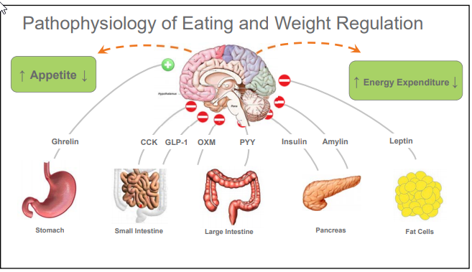
Outside of the brain

Slide 19
Inside of the Brain
    Arcuate nucleus is part of the hypothalamus near the base and located near the blood brain barrier so it can take in peripheral circulating signals and relay them to the CNS
    First order neurons are in the arcuate nucleus
    Second order neurons are deeper in hypothalamus
Regulators of Appetite

Slide 20
First Order Neurons
2 neuron systems
  Weight gaining (NPY/AgRP)
  Weight losing (POMC/CART)
  Receives the peripheral signals and activates either of the 1st order neuron systems

Slide 21
First Order Neurons
Neuropeptide Y/ Agouti related peptide
Activated by ghrelin
Inhibited by leptin
When neuron activated, releases NPY/AgRP that go on to second order neurons
Proopiomelanocortin/ cocaine and amphetamine-regulated transcript
Activated by leptin and insulin
Inhibited by NPY/AgRP neurons
Causes aMSH release that goes on to second order neurons

Slide 22
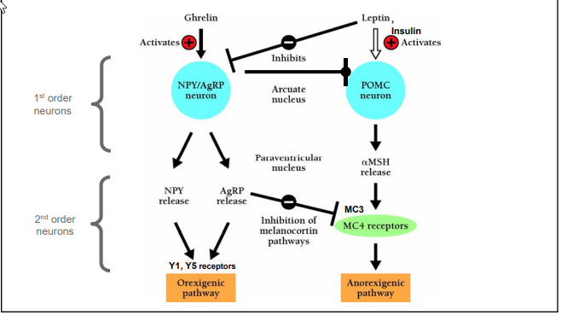
First order neurons

Slide 23
Second Order Neurons
Y1 and Y5 receptors
Activated by NPY and AgRP
AgRP also inhibits MC4 pathway
Y1 causes MCH release→ sensory processing, anxiety, aggression, feeding, pleasure, reward, learning
Y2 causes orexin A&B release→ increased arousal, hunt for food
MC3&4 receptors
Activated by aMSH
Causes decreased appetite, increased energy expenditure

Slide 24
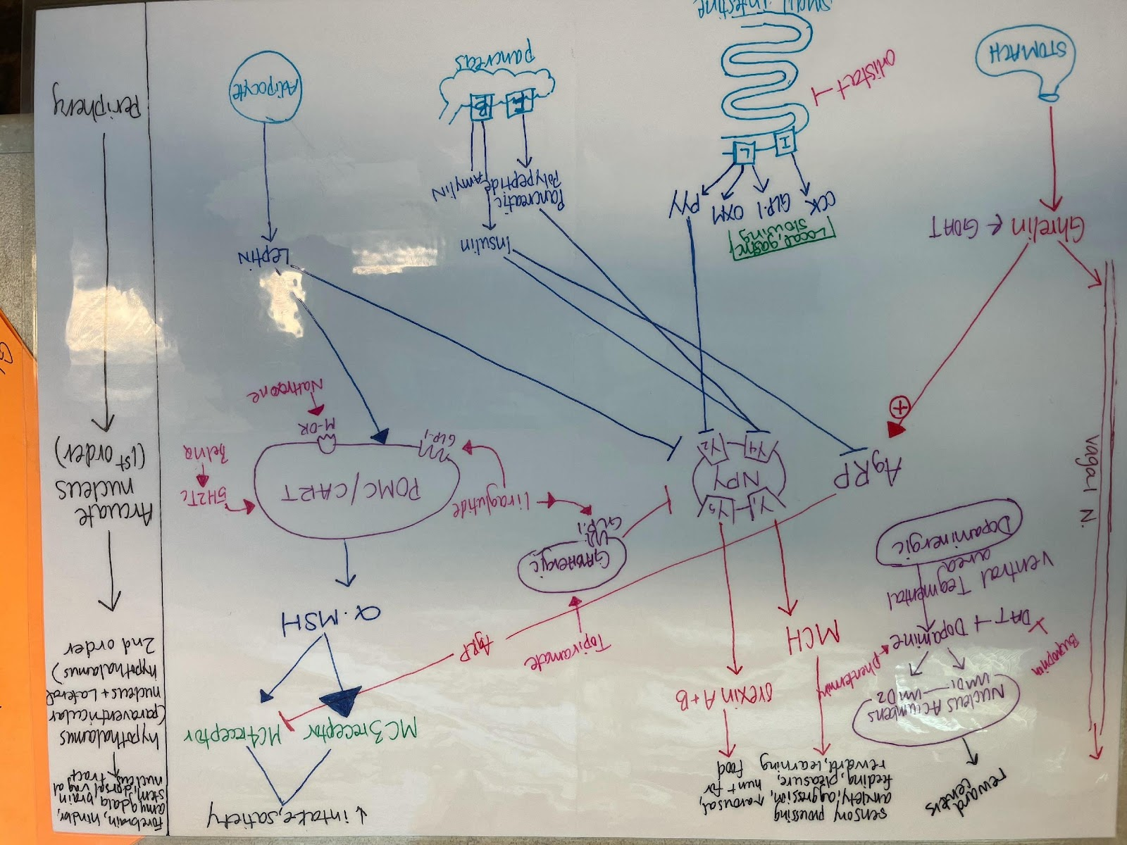

Slide 25
Eating Disorders

Slide 26
Eating Disorders
Binge eating disorder
Night eating syndrome
Grazing
Bulimia Nervosa
Anorexia Nervosa
Sleep related eating disorder (parasomnia)**

Slide 27
-Most common.
-30% in weight control programs
-Recurrent episodes of binge eating marked by:
  Eating large amount in a discrete period of time
  A sense of lack of control with eating during the time
-Associated with 3 or more:
  Eating more rapidly than normal, until uncomfortably full, large amounts when not physically hungry, hiding behavior bc of embarrassment, feeling disgusted, depressed, guilty after
Binge Eating Disorder

Slide 28
CBT
Lisdexamfetamine (Vyvanse) FDA approved
Topiramate, qsymia, zonisamide, wellbutrin, fluoxetine, sertraline, citalopram – off label
Suggestion of CBT + topiramate working best
BED

Slide 29
Repetitive and unplanned eating of small amounts of food that sometimes includes feeling of loss of control
Considered compulsive d/o
Grazing

Slide 30
Defined by AM anorexia, PM hyperphagia, insomnia, consume 25-50% calories after evening meal
Up to 40% NES engage in binge eating
Highly responsive to sertraline (off label)
Encourage regular meal consumption earlier in day, increase protein
personal trend noticed – high incidence in pts on atypical antipsychotics
Night Eating Syndrome

Slide 31
Bulimia Nervosa
Recurrent episodes of binge eating
Recurrent inappropriate compensatory behavior to prevent weight gain (purging)
  Vomiting, laxatives, diuretics, fasting, excessive exercise
  At least once per week for 3 months
Tx with CBT, SSRIs (fluoxetine FDA approved). Avoid wellbutrin as it may cause seizures

Slide 32
Prevalence 0.3-1.0%
Usually higher socio-economic status
Dysfunctional family common
3/3: restriction of energy intake leading to low weight (BMI<18.5), intense fear of gaining weight, distorted body image
Anorexia Nervosa

Slide 33
Body Image Disorders
Anorexia Nervosa (eating d/o but hallmark)
Body dysmorphic d/o (OCD)
Body image dissatisfaction

Slide 34
Body Image Dx
Body dysmorphic
  Appearance preoccupations with excessive concern looking at flaws >1hr/day
  Repetitive behaviors
  distress/impairment
  Not better accounted for by another dx
  Tx: SSRI*, CBT, topamax*, lamictal*
Body Image Dissatis.
  Negative thoughts and feelings about own body
  Associated with AN and BN
  Tx CBT

Slide 35
Mood disorders and obesity
Mood disorders impact obesity and obesity impacts mood d/o
  children/adolescents with MDD – increased risk for overweight
  Bipolar – elevated rates of overweight/obesity
  People with obesity seeking weight loss have elevated rates of MDD and bipolar
  Atypical depression in females is associated with being overweight
  Obesity associated with MDD in females

Slide 36

Mood disorders and obesity
42% of patients in a study seeking medical or surgical weight loss had at least one psychiatric d/o
Mood, anxiety and eating disorders most common
Personality d/o least common

Slide 37

Summary – eating disorders
Gather a history that allows you to assess for other behavioral disturbances impacting weight
If identified, treat disturbance prior to treating weight
CBT is something you can do with the proper time and training

Slide 38
Questions?

