Slide 1
Obesity Medicine
Part 1: Assessment

Slide 2
Definitions
BMI
Waist circumference
AACE
Obesity Medicine Association
Ethnic Criteria
Edmonton Obesity Staging System
Pediatric Criteria

Slide 3
BMI
Normal weight 18.5-24.9
Overweight 25.0-29.9
Class 1 obesity 30.0-34.9
Class 2 obesity 35.0-39.9
Class 3 obesity >40.0

Slide 4
Waist Circumference
Abdominal Obesity Men
  ≥40in
  S. Asians, Chinese, Japanese ≥90cm=35.4in
  Europids
    ≥94 cm=37in
Abdominal Obesity Women
  ≥35 in
  S. Asians, Chinese, Japanese ≥80cm=31.5in
  Europids
    ≥80cm=31.5in

Slide 5
AACE (endocrine)
Overweight – BMI 25-29.9 without complications
Obesity – BMI >30 no complications
Obesity stage 1 BMI>25 with mild-mod complications (abnml waist circ, BP, HDL, TG. OSA AHI 5-29, PCOS no infertility, OA mild to mod impairment)
Obesity stage 2 BMI>25 with severe complications (IFG, met sx, DM, OSA AHI>29, PCOS with infertility, OA with mod to severe functional impairment)

Slide 6
Obesity Medicine Association
“Obesity is defined as a chronic, relapsing,multi-factorial, neurobehavioral disease, wherein an increase in body fat promotes adipose tissue dysfunction and abnormal fat mass physical forces, resulting in adverse metabolic, biomechanical, and psychosocial health consequences”

Slide 7
Ethnic Criteria – Intl DM federation
China – overweight >23-24, obesity >27-29
Japan – overweight >24, obesity >29
India – overweight >23, obesity >27
Singapore – overweight>22, obesity >27
Ethnic south and central Americans similar to South Asians

Slide 8
Edmonton Obesity staging System
Stage 0- no signs of risk factors
Stage 1- subclinical risk factors
Stage 2 – comorbidities requiring intervention
Stage 3 – significant end organ damage
Stage 4 – end stage disease or disability

Slide 9
Pediatric Criteria
BMI 85-<95% = overweight
BMI 95-<99% = obesity
120% of the 95th or ≥35kg/m2 = severe obesity
BMI not used until 2 years of age
CDC growth charts white American children,most not breast fed
WHO is more diverse, mostly breast fed

Slide 10
Obesity as a Disease
Obesity is not caused by insufficient willpower, lack of discipline and bad choices
Transformed after 2013 when AMA labeled it as a disease
Debated a bit still
Pts have impaired metabolic pathways along with disordered signaling for hunger, satiety and fullness.
Not just one cause or type of obesity.

Slide 11
Genetic Factors influencing
Monogenic obesity – defect in a gene resulting in obesity.
  Several single gene d/o result in severe, early onset obesity. (prader-willi)
Complex monogenic obesity syndromes
  Mendelian disorders with obesity as a clinical feature
  Over 30 syndromes that include obesity identified
Complex polygenic (non-mendelian)
  Human genome project found genetic contributors to obesity.
  FTO gene – role in controlling feeding behavior, energy expenditure
  Over 60 relatively common genetic markers implicated in increased susceptibility to obesity
  The only chromosome without an obesity loci is the Y chromosome

Slide 12
Environmental Factors
Prenatal influences
Possible chemical exposures
Stress
Heavy metal pollutants
Poor sleep

Slide 13
Cultural factors
Low fat diet introduction in 1980
Different meaning to food
Mealtimes as part of family time
“finish your plate”

Slide 14
Adiposity-related diseases
IFG, DM, insulin resistance
HTN
HLD
CVD
CVA
Cancer (uterus, gallbladder,kidney, cervix, thyroid, leukemia)
NAFLD
OSA
OA
depression/anxiety
PCOS, infertility
AF
Gallbladder disease
Cellulitis
Intertrigo
**assess these when seeing a patient to make sure insurance will cover the E&M code

Slide 15
Tips to initiate discussion of obesity
Use people-first language
  “pt with obesity”
  Avoid: “obese patient”
Focus on health not weight alone
Use weight-friendly language
  Overweight, unhealthy weight instead of fat, obese
  Eating habits instead of diet
  Physical activity instead of exercise

Slide 16
Tips to initiate discussion of obesity
5 A’s
Ask for permission to discuss body weight
  Explore readiness to change
Assess BMI, waist circ, obesity stage
  Explore drivers and complications of excess weight
Advise the patient about the health risks of obesity, benefits of modest weight loss,need for a long term strategy and tx options
Agree on realistic weight loss expectations, targets, behavioral changes, specific details of tx plan
Arrange/Assist in identifying and addressing barriers, provide resources, assist in finding and consulting with appropriate providers, arrange fu

Slide 17
Readiness to change
Transtheoretical model
Precontemplation – do not even consider changing
Contemplation – ambivalent about change
Preparation – patients prepare to make a specific change, may experiment with small change
Action – patient takes steps to make the change occur
Maintenance and relapse prevention – incorporating the new behavior over the long haul

Slide 18
Gathering a History
Age of onset
Highest weight ever? Lowest or best?
Rate of weight gain – almost chart it out
Inciting factors
What has been tried in the past? Diet, exercise, meds, surgery
What worked? What didnt?
What motivates you to lose weight now?

Slide 19
History - nutrition
Is there a general understanding of the basics of nutrition? **assess this before referral
Food quality
Patterns
Triggers
Reasons for eating out
Household factors

Slide 20
History – Physical Activity
Has PA been used before for weight loss or maintenance
Current level of PA?
Favorite past activities?
What were they able to stick with?
Any barriers?

Slide 21
History - PMH
IFG/DM/gestational DM
CVD/HLD
Thyroid disease
PCOS
Gout
Sleep apnea
Depression
Eating d/o
Body dysmorphic d/o

Slide 22
Meds, fam hx, social hx
Meds that will require monitoring with wt loss/diet change
Meds that cause weight gain
  Anti-depressants
  Antipsychotics
  Insulin, SFU
  Steroids,hormones
Fam hx obesity, DM, HTN, HLD, CVA, Cancer, thyroid dz, psych
Social hx
  Cultural background, socio-economic, occupation
  Household issues
  Menstrual cycles
  Birth control/pregnancy
  sleep

Slide 23
Physical Exam
Neck, waist, hip circumference
HEENT – acanthosis nigricans, hirsutism
Abdomen – panus, striae, liver size, ascites
Neuro – weakness
Extremities – lipedema – spares ankles
Dercums disease – painful fat

Slide 24
Diagnostic Testing
CBC – anemia→ fatigue worsening inactivity
CMP – baseline before meds, screen for IFG
TSH – it has to be my thyroid!
Lipids – met sx, baseline in case of keto
Uric acid – uricemia common, certain diets increase risk of gout
DM screen – high risk
Vit D – very common, fat soluble vitamin

Slide 25
What you should do before referring
Initiate a discussion about obesity
Assess their readiness to change (preparation & action)
Discuss their willingness to participate in an intensive weight management program
Give them realistic expectations
  Frequent visits to ESL (working on integrating other offices)
  Must adhere to nutrition plan, exercise plan, log intake to be successful
  Medications not for everyone, but often can be used

Slide 26
Pathophysiology

Slide 27
Regulators of Appetite
Outside of the brain
    Stomach-- ghrelin
    Small intestine – CCK, GLP1, OXM, PYY
    Large intestine – GLP1, OXM, PYY
    Pancreas – pancreatic polypeptide, insulin, amylin
    Adipocytes – leptin, adiponectin

Slide 28
Stomach
Ghrelin
  “hunger hormone”
  Secreted by the gastric fundus and body
  When stomach is empty ghrelin is secreted. Levels surge and peak prior to meals.
  When stomach is stretched secretion is inhibited, levels frop after meal and nutrient ingestion (less of a drop in patients with obesity)
  Stimulates NPY/AgRP in CNS
  Vagotomy inhibits ghrelin
  Significant decrease with a sleeve gastrectomy

Slide 29
Small & Large Intestine
CCK – I cells of prox small bowel, in response to fat and protein ingestion. Short acting. Slows gastric emptying and reduces appetite
GLP1 – L cells of distal small bowel and colon, in response to carbs. Glucose dependent insulin secretion, reduced gluconeogenesis, delayed gastric emptying and reduced appetite
OXM (oxyntomodulin) – L cells of distal small bowel. Cosecreted with GLP1. Decreased appetite/feeding. Less GI sx than GLP1 when given exogenously
Peptide YY – L cells distal small bowel, colon, rectum. Elevated within 1 hour post feeding. Binds Y2 receptor. Potent appetite suppression

Slide 30
Pancreas (endocrine)
Pancreatic polypeptide – F cells in response to caloric load, binds to Y4 receptor in gut decreasing gastric emptying. Y4 in hypothalamus inhibiting NPY and reducing hunger
Insulin – B cells. In the hypothalamus it inhibits AgRP/NPY neurons and centrally deactivates the feeding response
Amylin – B cells.reduces food intake, slows gastric emptying, suppresses glucagon production. Similar effect to GLP1

Slide 31
Adipocyte
Leptin – weight loss, fullness, satiety. Secreted by white adipose tissue. Levels decline with weight loss. Stimulates POMC pathway and inhibits NPY/AgRP
Adiponectin – improves insulin sensitivity. Made in white adipose tissue. Enhances insulin sensitivity in the liver, stimulates glucose use in the muscle, works in vascular enodthelium to increase NO (reduce inflammation)

Slide 32
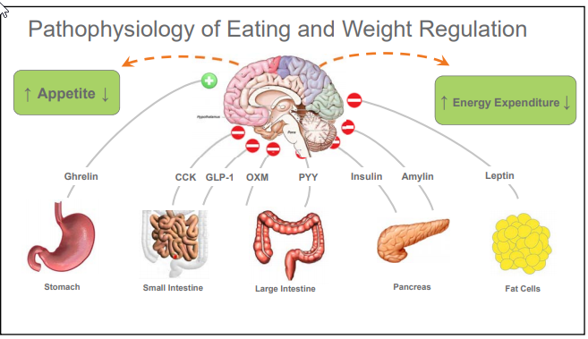
Outside of the brain

Slide 33
Regulators of Appetite
Inside of the brain
    Arcuate nucleus is part of the hypothalamus near the base and located near the blood brain barrier so it can take in peripheral circulating signals and relay them to the CNS
    First order neurons are in the arcuate nucleus
    Second order neurons are deeper in hypothalamus

Slide 34
First Order Neurons
2 neuron systems
  Weight gaining (NPY/AgRP)
  Weight losing (POMC/CART)
  Receives the peripheral signals and activates either of the 1st order neuron systems

Slide 35
First Order Neurons
Neuropeptide Y/ Agouti related peptide
Activated by ghrelin
Inhibited by leptin
When neuron activated, releases NPY/AgRP that go on to second order neurons
Proopiomelanocortin/ cocaine and amphetamine-regulated transcript
Activated by leptin and insulin
Inhibited by NPY/AgRP neurons
Causes aMSH release that goes on to second order neurons

Slide 36
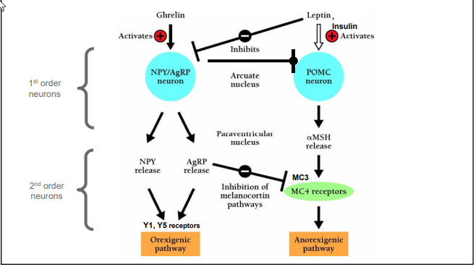
First order neurons

Slide 37
Second Order Neurons
Y1 and Y5 receptors
Activated by NPY and AgRP
AgRP also inhibits MC4 pathway
Y1 causes MCH release→ sensory processing, anxiety, aggression, feeding, pleasure, reward, learning
Y2 causes orexin A&B release→increased arousal, hunt for food
MC3&4 receptors
Activated by aMSH
Causes decreased appetite, increased energy expenditure

Slide 38
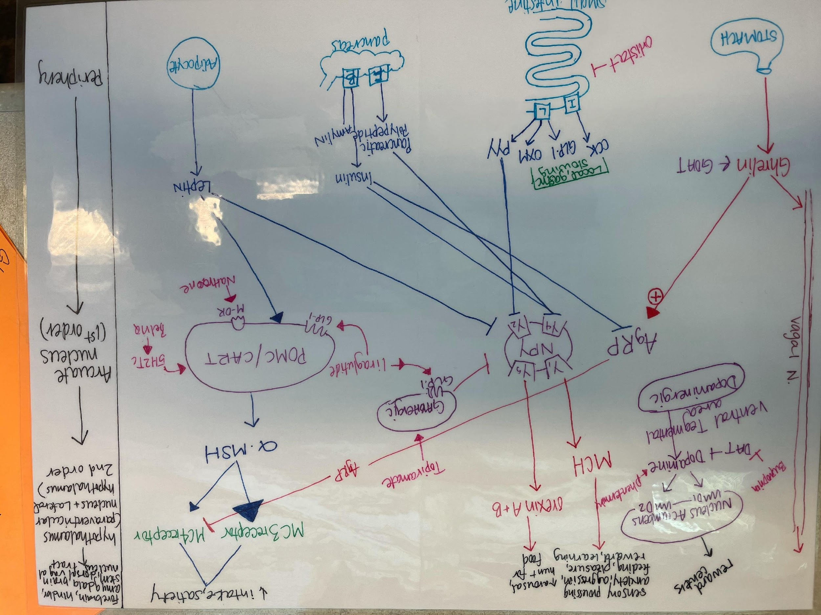
Regulators of Appetite

