Slide 1
Obesity Medicine
Part 3: Behavioral Therapy & Eating disorders

Slide 3
Outline
Behavioral Therapy
  Behavioral influence on appetite
  Psychotherapeutic treatments
  obesity related behavioral problems

Slide 4
Behavior influencing appetite
Obesity is a result of chronic sustained energy intake AND
Energy intake is entirely accounted for by behavior
Therefore, behavior directly controls obesity
Neurophysiology of obesity is based on survival mechanisms from earlier times

Slide 5
Behavior influencing appetite
Many functions contribute to appetite and energy intake – all in the brain
  Stress, fatigue, mood, hunger, sedentariness, etoh all positively modulate the appetite system
There is conditioned “wanting” – learned times you make food choices

Slide 6
Psychotherapeutic Tx
Motivational Interviewing (strengthen a patients own motivation for target behavior)
Transtheoretical Model (readiness to change)
Cognitive, Behavioral and Other Therapies:
  Cognitive behavioral therapy (CBT)
  Dialectical Behavior Therapy (CBT focusing on mindfulness, emotional regulation)
  Interpersonal psychotherapy (component of MI, resolving mood effects arising from interpersonal conflicts)

Slide 7
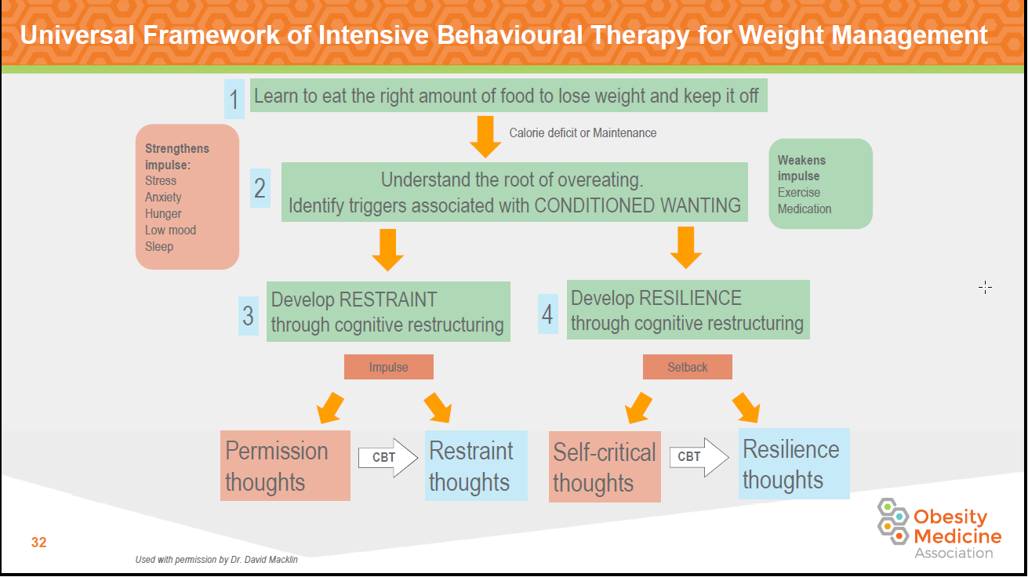
Psychotherapeutic Tx

Slide 8
CBT
Maladaptive Behaviors are directly linked to automatic thoughts and emotions
Thoughts
Emotions
Behavior
The Cognitive Triangle

Slide 9
Behaviors are preceded by thoughts
Setting: watching TV after dinner
Thoughts
“I’ve been good lately, so a bag of chips wont hurt!”
Emotions
Behavior
Frustrated
Overeating Episode

Slide 10
Behaviors are preceded by thoughts
Setting: Conflict at work
Thoughts
“I deserve a treat after all the stress at work today”
Emotions
Behavior
Guilty, hopeless
Overeating Episode

Slide 11
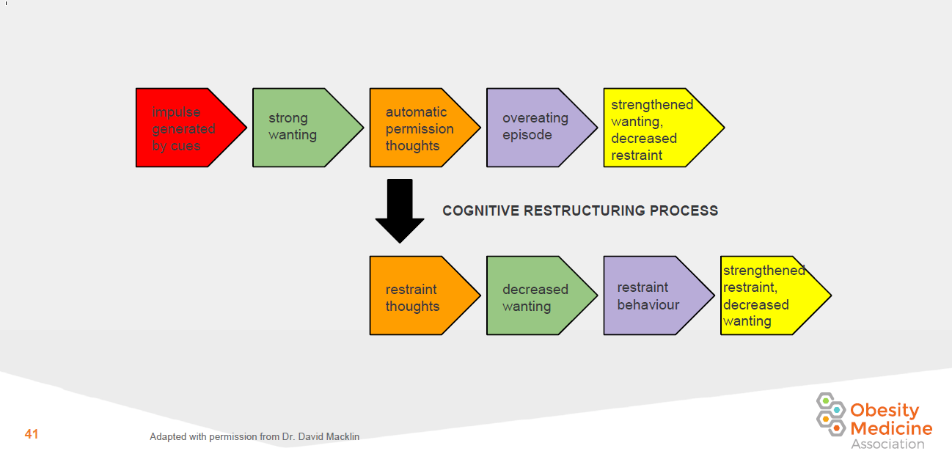
Teaching restraint

Slide 12
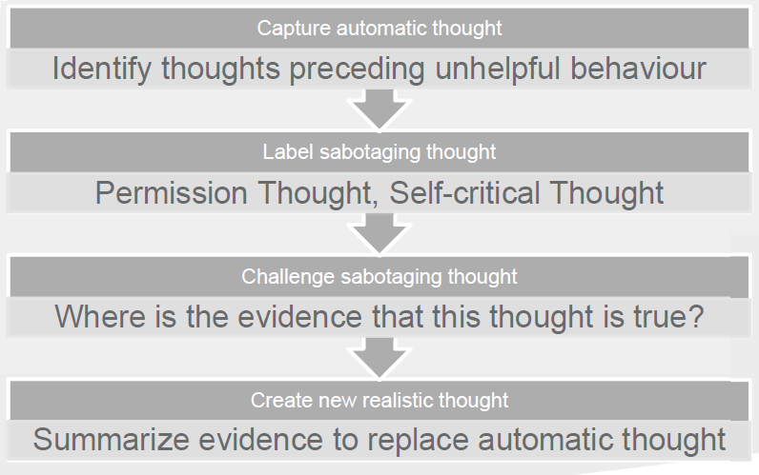
Identify automatic thoughts

Slide 13
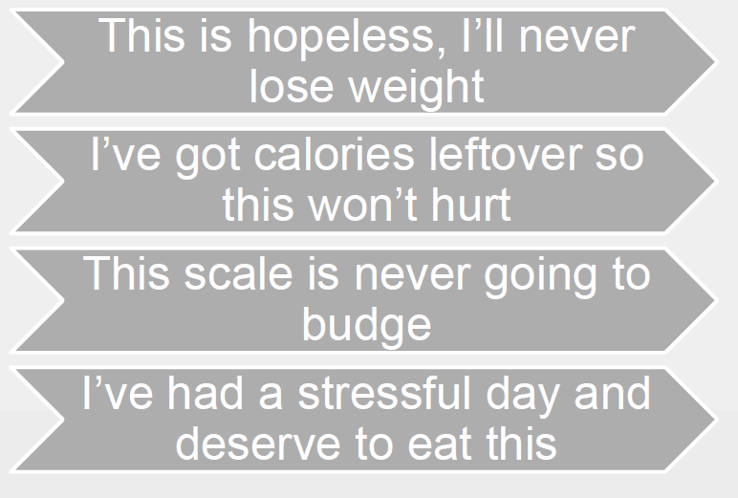
Automatic Thoughts ID’d

Slide 14
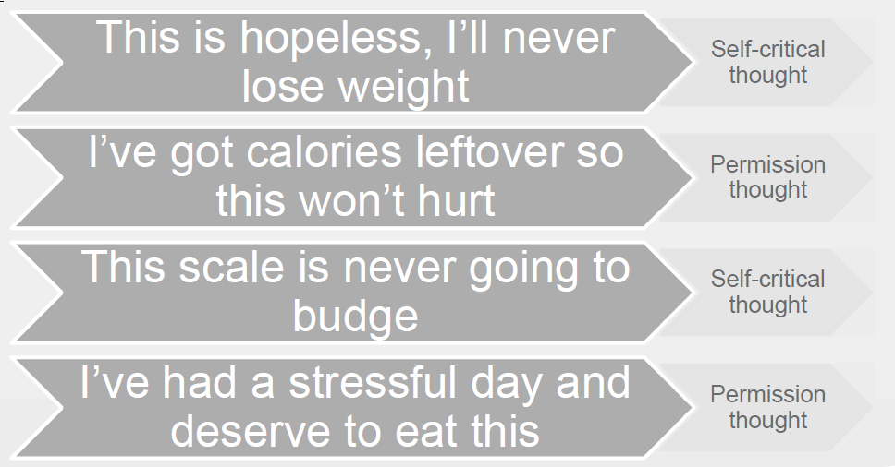
Label common distortions

Slide 15
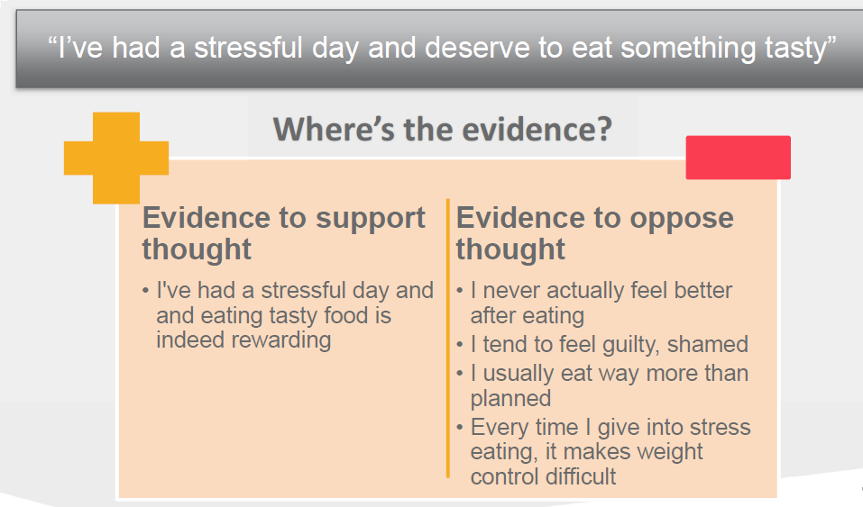
Challenge sabotaging thought

Slide 16
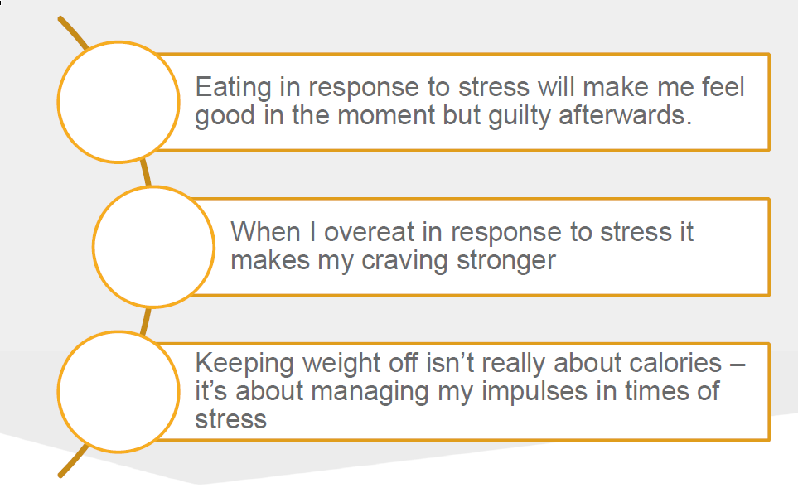
Create new realistic thought

Slide 17
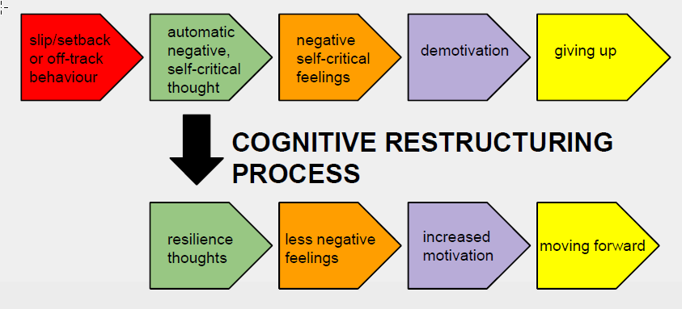
Resilience
The ability to restore positive functioning in the face of a lapse

Slide 18
Obesity related Behavioral Problems
Eating Disorders
Body Image Disorders
Sleep disorders
Mood disorders

Slide 19
Eating Disorders
Binge eating disorder
Night eating syndrome
Grazing
Bulimia Nervosa
Anorexia Nervosa
Sleep related eating disorder (parasomnia)**

Slide 20
Binge Eating D/o
Most common. 30% in weight control programs
Recurrent episodes of binge eating marked by
  Eating large amount in a discreet period of time
  A sense of lack of control with eating during the time
Associated with 3 or more
  Eating more rapidly than normal, until uncomfortably full, large amounts when not physically hungry, hiding behavior bc of embarrassment, feeling disgusted, depressed, guilty after

Slide 21
BED
CBT
Lisdexamfetamine FDA approved
Topiramate, qsymia, zonisamide, wellbutrin, fluoxetine, sertraline, citalopram
Suggestion of CBT + topiramate working best

Slide 22
Grazing
Repetitive and unplanned eating of small amounts of food that sometimes includes feeling of loss of control
Considered compulsive d/o

Slide 23
Night Eating Syndrome
Defined by AM anorexia, PM hyperphagia, insomnia, consume 25-50% calories after evening meal
Up to 40% NES engage in binge eating
Highly responsive to sertraline (off label)
Encourage regular meal consumption earlier in day, increase protein
personal trend noticed – high incidence in pts on atypical antipsychotics

Slide 24
Bulimia Nervosa
Recurrent episodes of binge eating
Recurrent inappropriate compensatory behavior to prevent weight gain (purging)
  Vomiting, laxatives, diuretics, fasting, excessive exercise
  At least once per week for 3 months
Tx with CBT, SSRIs (fluoxetine FDA approved). Avoid wellbutrin as it may cause seizures

Slide 25
Anorexia Nervosa
Prevalence 0.3-1.0%
Usually higher socio-economic status
Dysfunctional family common
3/3: restriction of energy intake leading to low weight (BMI<18.5), intense fear of gaining weight, distorted body image

Slide 26
Body Image Disorders
Anorexia Nervosa (eating d/o but hallmark)
Body dysmorphic d/o (OCD)
Body image dissatisfaction

Slide 27
Body Image Dx
Body dysmorphic
  Appearance preoccupations with excessive concern looking at flaws >1hr/day
  Repetitive behaviors
  distress/impairment
  Not better accounted for by another dx
  Tx: SSRI*, CBT, topamax*, lamictal*
Body Image Dissatis.
  Negative thoughts and feelings about own body
  Associated with AN and BN
  Tx CBT

Slide 28
Sleep Disorders
Obstructive Sleep Apnea
Obesity Hypoventilation Syndrome
Shift work sleep disorder
Sleep-related eating disorder
Insomnia

Slide 29
Sleep and Obesity
Sleep deprivation associated with
  Decreased leptin
  Increased ghrelin, orexin and NPY
  Leads to increased appetite and decreased energy expenditure
  7 is magic number

Slide 30
OSA/obesity hypoventilation
Treat to improve obesity
Improve obesity and can improve OSA/OHS

Slide 31
Mood Disorders Affecting Obesity
Major Depression
Dysthymia
Bipolar
Cyclothymia
Acute stress reaction
Anxiety related d/o

Slide 32
Mood disorders and obesity
Mood disorders impact obesity and obesity impacts mood d/o
  children/adolescents with MDD – increased risk for overweight
  Bipolar – elevated rates of overweight/obesity
  People with obesity seeking weight loss have elevated rates of MDD and bipolar
  Atypical depression in females is associated with being overweight
  Obesity associated with MDD in females

Slide 33
Mood disorders and obesity
42% of patients in a study seeking medical or surgical weight loss had at least one psychiatric d/o
Mood, anxiety and eating disorders most common
Personality d/o least common

Slide 34
Personality Disorders
Pds associated with obesity
  Borderline personality most common
  Narcissistic next most common
  Obsessive compulsive personality associated with restrictive pathologies like anorexia
Borderline associated with impulsive eating
  Binge eating, bulimia
  15-30% in medical/surgical settings

Slide 35
Summary
Gather a history that allows you to assess for other behavioral disturbances impacting weight
If identified, treat disturbance prior to treating weight
CBT is something you can do in the office when seeing patients
Encourage making time for sleep if able

