Slide 1

Antibiotic Stewardship

Slide 2

Antibiotic resistance is among the greatest public health threats today, leading to an estimated 2 million infections and 23,000 deaths per year in the United States.
Antibiotic-resistant infections can lead to increased health care costs and, most importantly, to increased morbidity and mortality. The most important modifiable risk factor for antibiotic resistance is inappropriate prescribing of antibiotics.
ThePhoto by PhotoAuthor is licensed under CCYYSA.

Slide 3
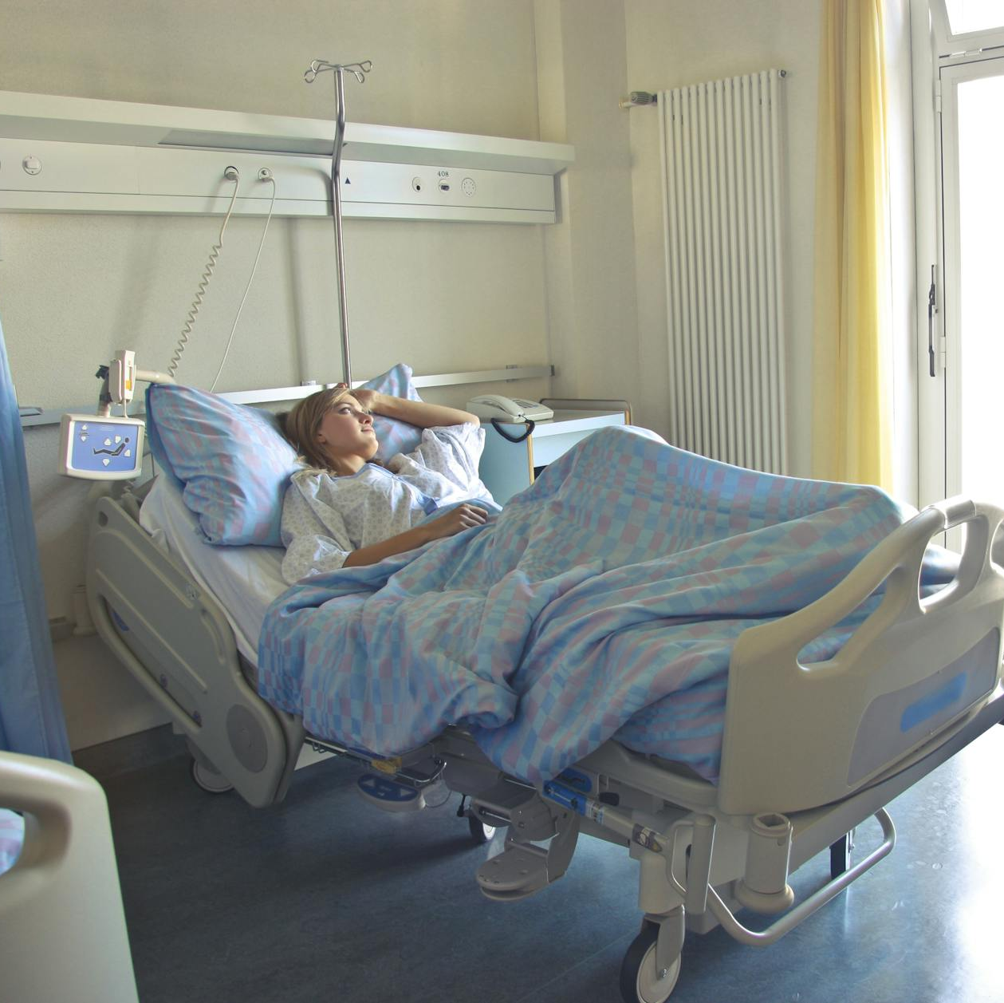
Each year in the US, at least 2.8 million people became infected with an antimicrobial resistant infection and more than 35,000 people die.
Antimicrobial resistance jeopardizes advancements in modern health care that we have come to rely on, such as joint replacements, organ transplants, and cancer therapy.

Slide 4

Why do we love antibiotics?
Before antibiotics, even minor infections could be deadly. Pneumonia, childbirth complications, and simple wounds often turned fatal. Antibiotics dramatically changed this, giving us a powerful tool to fight bacterial infections.
Antibiotics can significantly shorten the duration and severity of illness. They stop bacteria from multiplying, allowing the immune system to take over and clear the infection. This means faster recovery, less pain, and fewer complications.

Slide 5

Widespread antibiotic use has contributed significantly to improved public health by reducing the spread of infectious diseases. This has led to longer lifespans, healthier populations, and stronger economies.
Some antibiotics have anti-inflammatory effects, mainly macrolide. This can reduce the discomfort from an infection even if it is a viral infection.

Slide 6

Fear of not getting better quickly
Fear of worsening illness
Fear of missing work/ school/ family get togethers/ travel/ meetings/ etc.
Fear of spreading illness to others like family members or co-workers.
No time for illness. "I don't have time to be sick".
ThePhoto by PhotoAuthor is licensed under CCYYSA.

Slide 7

Viral illness most of the time resolves even while taking an antibiotic that wasn't needed. This confirms for the patient that they wouldn't have gotten better without it.
Sense of security. Patients feel more confident that their symptoms will resolve if they have an antibiotic "just in case it is a bacterial infection".

Slide 8
Individual behaviors and knowledge:
Patient pressure: Patients may pressure healthcare providers to prescribe antibiotics even if not medically necessary, due to fears of complications or simply wanting a quicker recovery.
Lack of awareness: Both patients and healthcare professionals may not fully understand the potential dangers of antibiotic overuse and misuse, including the rise of antibiotic resistance.
Self-medication: Over-the-counter availability of some antibiotics in some countries can lead to self-medication for minor infections, further contributing to overuse.
Barriers to Antibiotic Steward Ship

Slide 9
Healthcare system factors:
Diagnostic limitations: Delays or inaccuracies in diagnostic tests can lead to unnecessary antibiotic use as a precaution until a clearer diagnosis is available.
Work pressures: Time constraints and heavy workloads on healthcare providers can increase the likelihood of quick antibiotic prescriptions without thorough diagnosis or evaluation.
Financial incentives: In some healthcare systems, financial incentives for providers may inadvertently encourage unnecessary antibiotic use.
Lack of resources: Limited access to proper diagnostic tools, antimicrobial stewardship programs, and educational resources for healthcare professionals can hinder effective implementation.

Slide 10

Societal and cultural factors:
Public expectations: Societal expectations of rapid recovery and fear of infections can contribute to pressure for antibiotic use.
Misinformation and stigma: Myths and misconceptions about antibiotics, like their effectiveness against viral infections, can lead to inappropriate use.
Antibiotic availability: Easy access to antibiotics in some countries through pharmacies or informal channels can contribute to overuse and misuse.

Slide 11

How can we improve antibiotic stewardship?
It starts with a commitment to do what's right by the individual prescriber, the staff, and the organization as a whole.
Individual prescriber:
Commitment to reduce antibiotic use for the safety of the patient and the population. Commitment to educate patients about the dangers of overuse of antibiotics and reasons they aren't always necessary for resolution of illness
Staff:
Commitment to educate patients about the dangers of overuse of antibiotics and support prescribers in their decision making by reassuring the patient that time may be needed for the illness to resolve without antibiotic use
Organization:
Commitment to support the prescriber with education for patients on the dangers of overuse of antibiotics.
Commitment to support providers in their decision to not prescribe antibiotics when unnecessary. Understanding negative reviews.

Slide 12
Education and awareness campaigns: Educating both healthcare professionals and the public about antibiotic resistance, responsible use, and alternative treatment options.
Improved diagnostic tools and practices: Investing in rapid and accurate diagnostics to reduce reliance on antibiotics for unconfirmed infections.
Development and implementation of effective antibiotic stewardship programs: These programs can provide tools, guidelines, and support for healthcare professionals to optimize antibiotic use.
Regulatory measures: Implementing regulations to restrict unnecessary antibiotic use in specific contexts, such as animal agriculture.
Addressing financial incentives: Ensuring healthcare systems don't reward practices that encourage overprescribing of antibiotics.
Combating misinformation and stigma: Providing accurate and accessible information about antibiotics and antibiotic resistance to counter myths and misconceptions.

Slide 13

The 5 Ds of antibiotic stewardship
Diagnosis
Drug
Dose
Duration
De-escalation
ThePhoto by PhotoAuthor is licensed under CCYYSA.
Diagnosis:
Ensuring an accurate diagnosis is crucial before prescribing antibiotics. This involves conducting proper clinical evaluations, utilizing appropriate diagnostic tests, and avoiding presumptive antibiotic use based solely on symptoms.

Slide 14
Drugs:
Selecting the right antibiotic for the specific type of infection is essential. Factors like the suspected or confirmed pathogen, local resistance patterns, and patient allergies or intolerances must be considered. Narrow-spectrum antibiotics should be preferred over broad-spectrum whenever possible.
Dose:
Prescribing the correct dose of the chosen antibiotic is key to effective treatment and minimizing side effects. Factors like patient age, weight, kidney function, and the severity of infection play a role in determining the appropriate dosage.
Duration:
Antibiotics should not be taken for longer than necessary. The duration of treatment should be tailored to the specific type of infection and the patient's response to therapy. Stopping antibiotics as soon as possible helps prevent unnecessary exposure and reduces the risk of resistance developing.

Slide 15

De-escalation:
When possible, switching from broad-spectrum antibiotics to narrower-spectrum ones as soon as culture and susceptibility results become available is an important aspect of antibiotic stewardship. This helps narrow down the target bacteria and minimizes the impact on the wider microbiome.

Slide 16
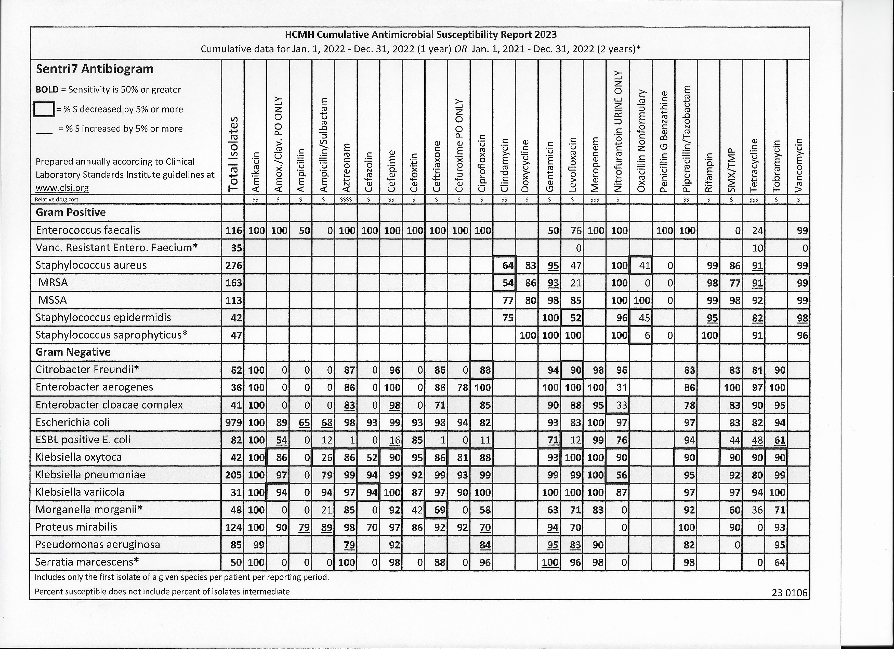
Quick Click
Physician Portal
Decision Support

Slide 17
Part of an antibiotic stewardship program is identifying where the focus needs to start.
Examples of types of high-priority conditions for improving antibiotic prescribing include:
conditions for which antibiotics are overprescribed, such as conditions for which antibiotics are not indicated (e.g., acute bronchitis, nonspecific upper respiratory infection, or viral pharyngitis).ª
conditions for which antibiotics might be appropriate but are overdiagnosed, such as a condition that is diagnosed without fulfilling the diagnostic criteria (e.g., diagnosing streptococcal pharyngitis and prescribing antibiotics without testing for group A Streptococcus).^{b}
conditions for which antibiotics might be indicated but for which the wrong agent, dose, or duration often is selected, such as selecting an antibiotic that is not recommended (e.g., selecting azithromycin rather than amoxicillin or amoxicillin/clavulanate for acute uncomplicated bacterial sinusitis).^{c}
conditions for which watchful waiting or delayed prescribing is appropriate but underused (e.g., acute otitis media or acute uncomplicated sinusitis).^{d}
conditions for which antibiotics are underused or the need for timely antibiotics is not recognized (e.g., missed diagnoses of sexually transmitted diseases or severe bacterial infections such as sepsis).

Slide 18

Other tools that can be used for Antibiotic Stewardship
Clinical decision support systems (CDSS): These electronically integrate into healthcare records, offering real-time guidance on antibiotic selection, dosing, and duration based on patient factors and local resistance patterns.
Antibiograms: These reports track local antibiotic resistance patterns for specific bacteria and inform clinicians about the most effective antibiotics for a given infection.
Diagnostic tests: Rapid diagnostic tests can differentiate bacterial from viral infections, helping avoid unnecessary antibiotic use for viral illnesses.

Slide 19
Developing a stewardship plan
Develop educational tools with standards of care for specific illnesses frequently over prescribed antibiotics, like
  Sinusitis
  Otitis
  Pharyngitis
  URI
  Conjunctivitis
  Etc.
Utilize tools within the EMR to track antibiotic use and regularly evaluate improvement in overall treatment strategies

Slide 20
Sinusitis
Key Recommendations from AAFP
Acute bacterial rhinosinusitis (ABRS) should be distinguished from acute rhinosinusitis due to viral respiratory infections and noninfectious conditions. ABRS should be diagnosed when signs and symptoms of acute rhinosinusitis (ARS) (purulent nasal drainage plus nasal obstruction, facial pain-pressure or both) persist without improvement for at least 10 days or if signs and symptoms worsen within 10 days after initial improvement.
Radiographic imaging should not be performed in patients with ARS unless a complication or alternative diagnosis is suspected.
Analgesics, intranasal steroids and/or nasal saline irrigation may be recommended for symptomatic relief of viral or bacterial rhinosinusitis.
Adults with uncomplicated ABRS should be either offered watchful waiting or prescribed antibiotic therapy. Patients undergoing watchful waiting should be prescribed antibiotics if their symptoms fail to improve after 7 days or worsen at any time.
If a decision is made to treat ABRS with antibiotics, amoxicillin with or without clavulanate should be prescribed as first-line therapy for 5-10 days. Amoxicillin with clavulanate should be prescribed for patients at high risk of being infected by an organism resistant to amoxicillin.

Slide 21
Patients with an allergy to penicillin should be prescribed doxycycline or a respiratory quinolone as first-line therapy.
For patients who fail to improve or worsen by 7 days following initial treatment, they should be reassessed to confirm the diagnosis and to detect complications. If initial treatment involved watchful waiting, antibiotics should be prescribed. If initial treatment included an antibiotic, a different antibiotic should be prescribed.
Chronic rhinosinusitis (CRS) and recurrent acute rhinosinusitis should be distinguished from isolated episode of ABRS.
The diagnosis of CRS should be confirmed with documentation of sinonasal inflammation using anterior rhinoscopy, nasal endoscopy, or computed tomography.
Saline nasal irrigation, intranasal corticosteroids, or both should be prescribed for symptom relief in patients with CRS.
Testing for allergy and immune function may be obtained when evaluating a patient with for CRS or recurrent ARS.

Slide 22

Important things to remember as we move forward with Antibiotic Stewardship
Be kind and understanding with patients.
Education is the way we move forward but expect resistance. Patients only want to get better. Patient parents only want their children to get better.
Be understanding with other providers
All general practice providers struggle with this issue.

Slide 23
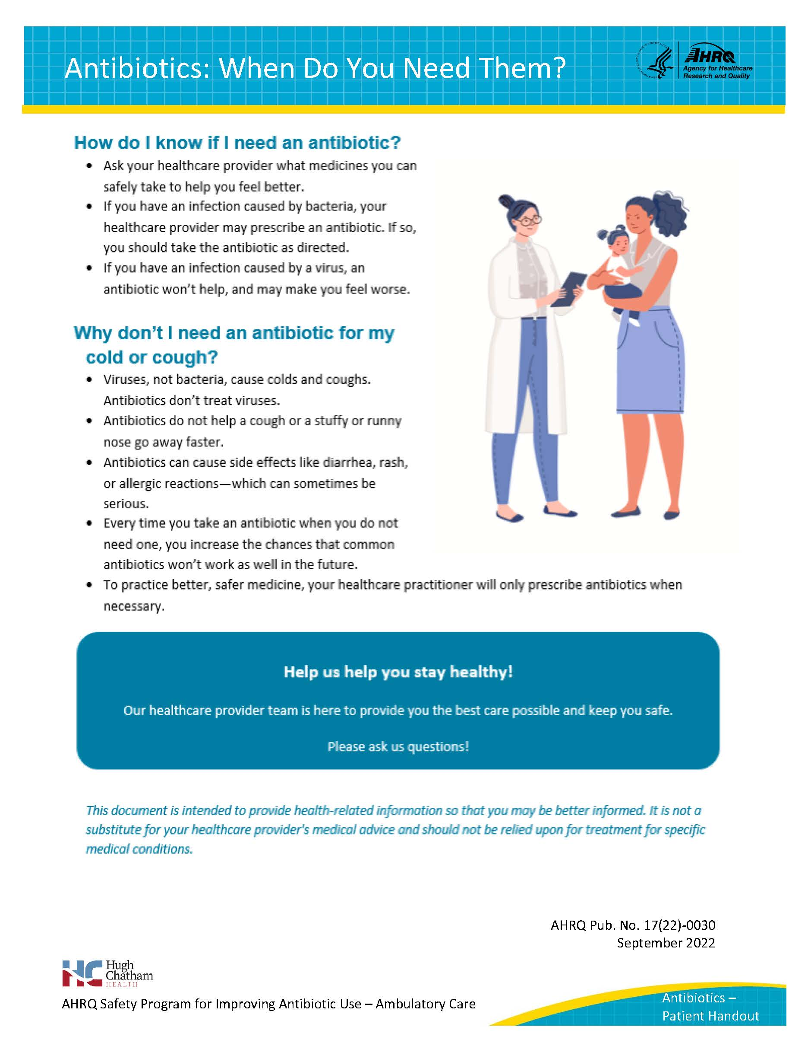

Slide 24
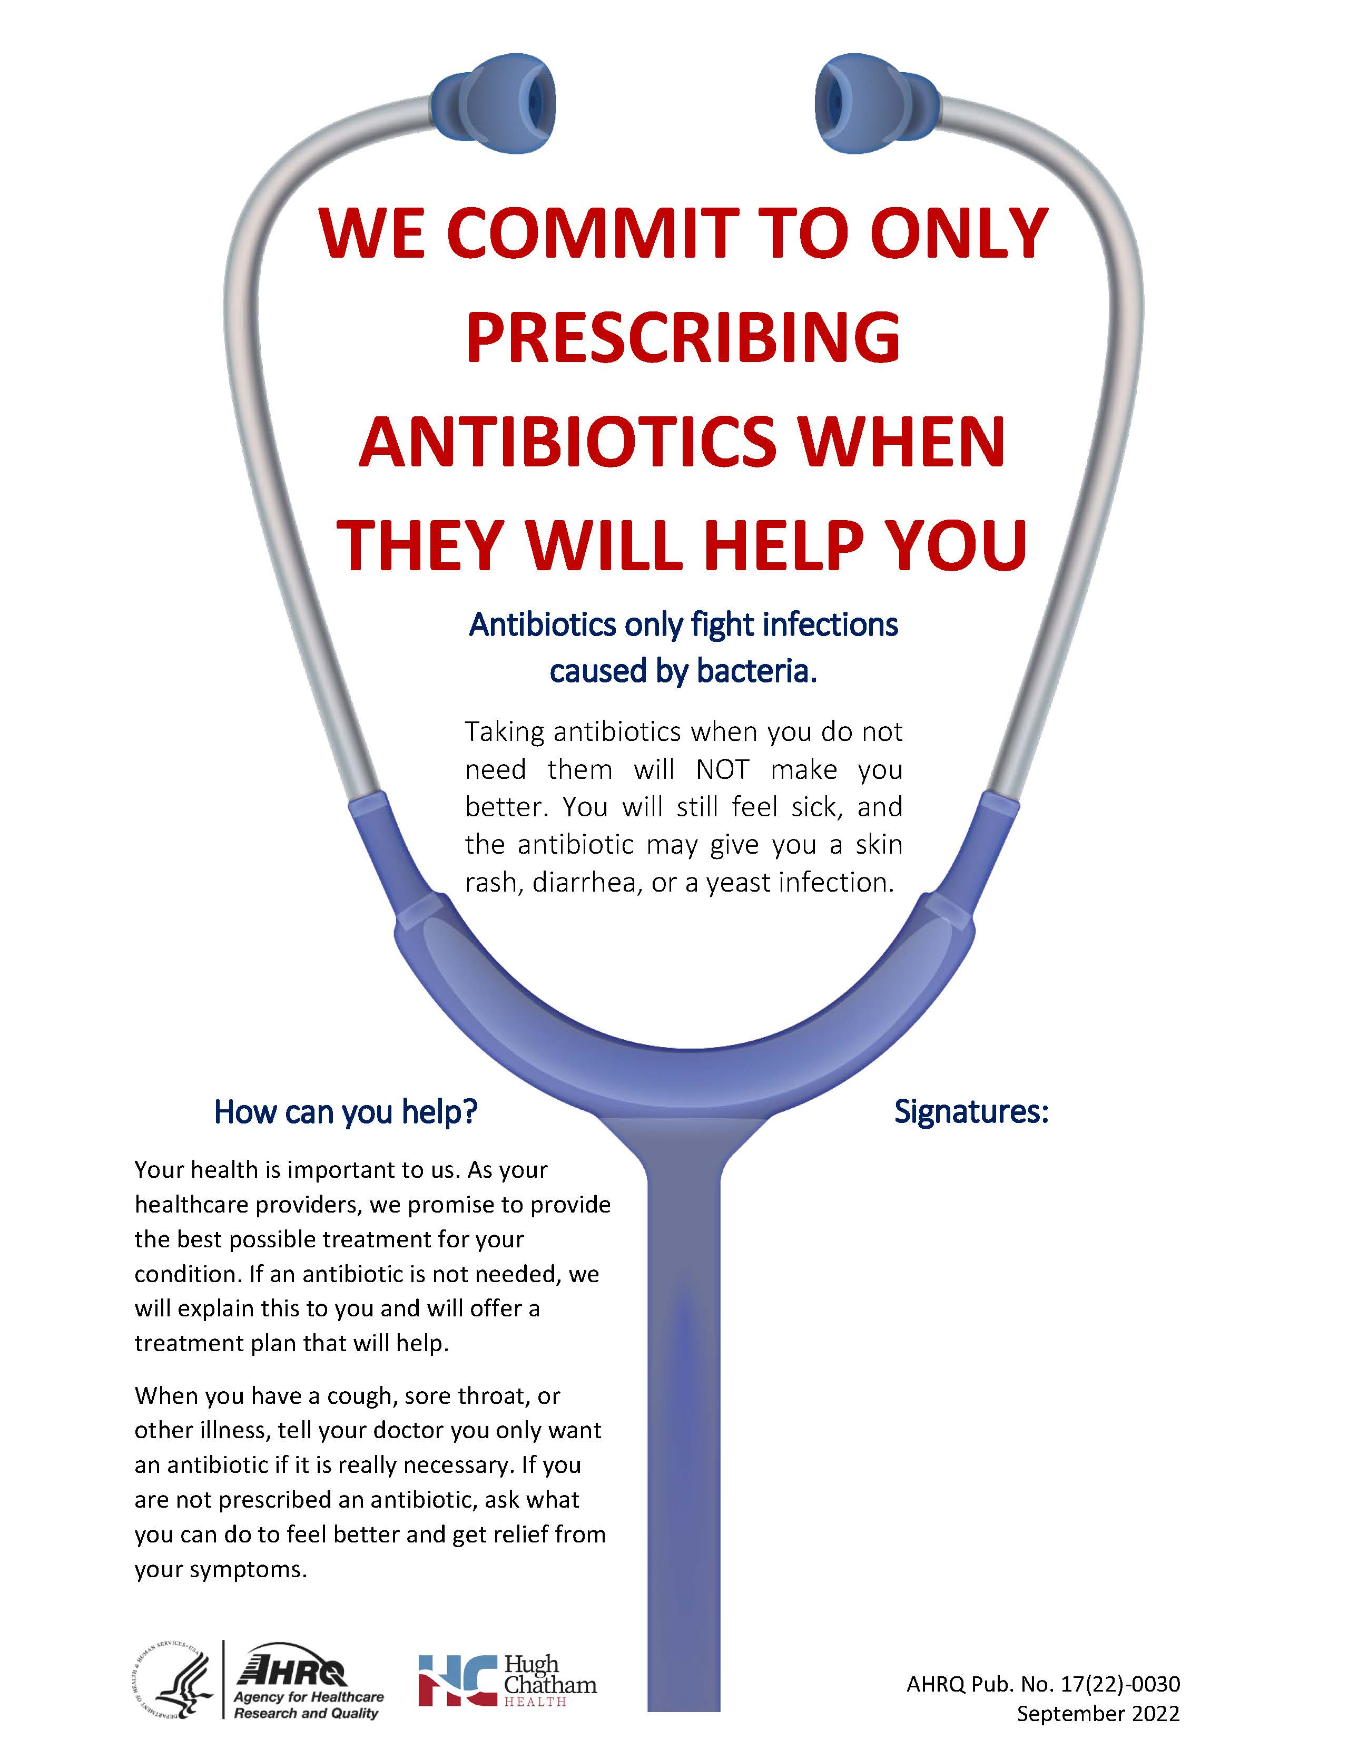

Slide 25
Patient Oriented Approach to Antibiotic Stewardship
Explain the difference between bacterial and viral infections: Many common illnesses, like colds and flu, are caused by viruses and won't benefit from antibiotics.
Highlight the potential side effects of antibiotics: Explain common side effects like nausea, diarrhea, and yeast infections, emphasizing that these can be unpleasant and even worsen the overall feeling of being unwell.
Discuss the risk of antibiotic resistance: Explain how overusing antibiotics can contribute to the development of antibiotic-resistant bacteria, making future infections harder to treat for everyone.
Emphasize the importance of a strong immune system: Encourage healthy habits like proper sleep, hydration, and nutritious food to help the body fight off infections naturally.
Promote open communication and shared decision-making:

