Slide 1
Thyroid Disease

Slide 2
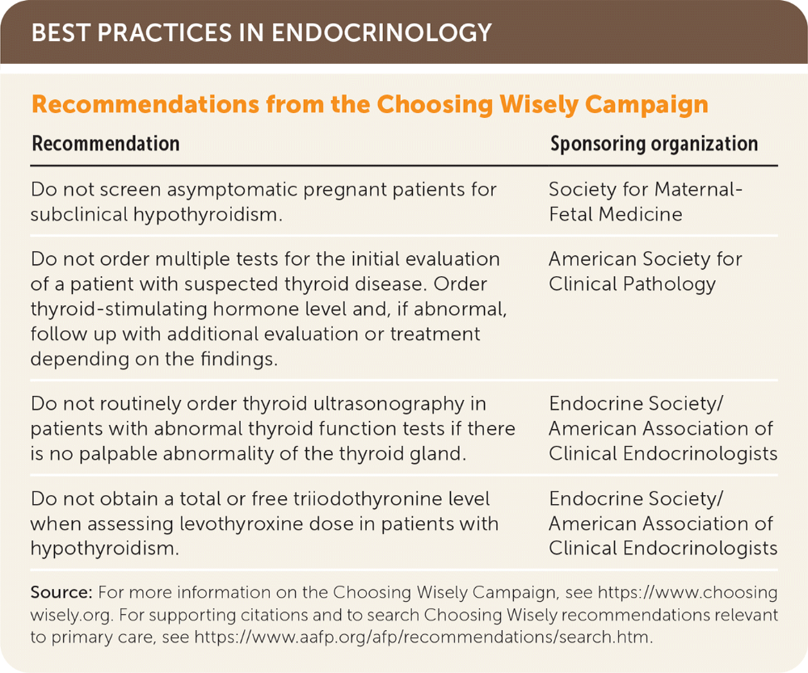

Slide 3
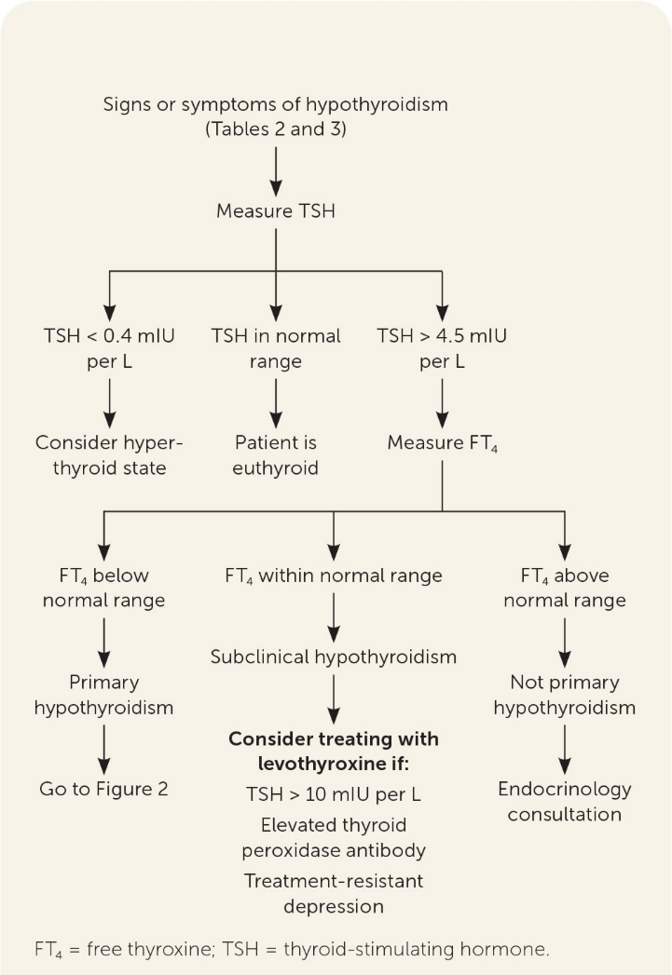

Slide 4
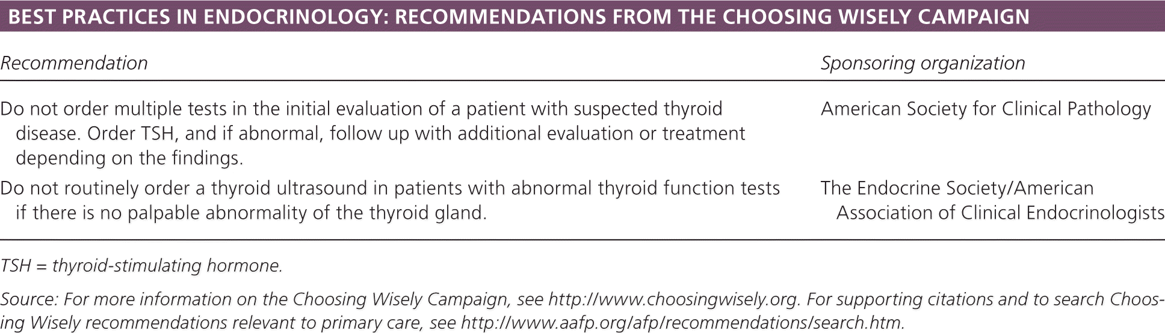

Slide 5
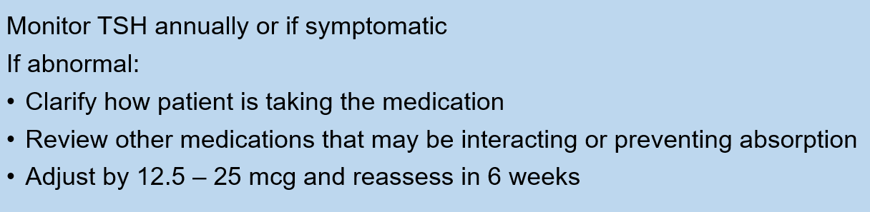

Slide 6

Resources
https://www.aafp.org/pubs/afp/issues/2021/0515/p605.html
https://www.aafp.org/pubs/afp/issues/2016/0301/p363.html

