Slide 1
Conjunctivitis

Slide 2
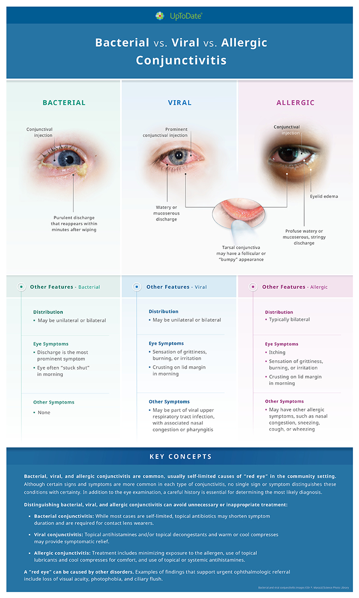

Slide 3
Treatment
Viral – no standard topical or systemic treatment however some OTC therapies provide comfort:
Topical antihistamines – Zaditor, Pataday and generic equivalants (ketotifen, olopatadine hydrochloride.
Topical decongestants – Multiple brands phenylephrine, naphazoline, tetrahydrolazine, and oxymetazoline.
Artificial Tears
Allergic
Topical antihistamines (OTC as above)
Topical Ketorolac (prescription only)
Bacterial
Ophthalmic ointment for children – erythromycin well tolerated, cheap
Trimethoprim- polymyxin B drops, Bacitracin ophth ointment well tolerated
Other options with more side effects, potential allergic reactions, resistances and toxicities: sulfacitamide, Aminoglycoside preps, chloramphenicol, azithromycin, Fluoroquinolones

Slide 4
Return to Life…
School/work:
Bacterial conjunctivitis – after 24 hours of treatment
Viral conjunctivitis – ?
Sports:
Non-contact – based on symptoms
Contact – 5 days
Water sports – 5 days (bacterial and viral)

Slide 5
…except for Arctucus
XBB1.16
Usual Covid-19 symptoms but possibly higher incidence of conjunctivitis.
One household member may get conjunctivitis, another may have other symptoms without conjunctivitis.

Slide 6
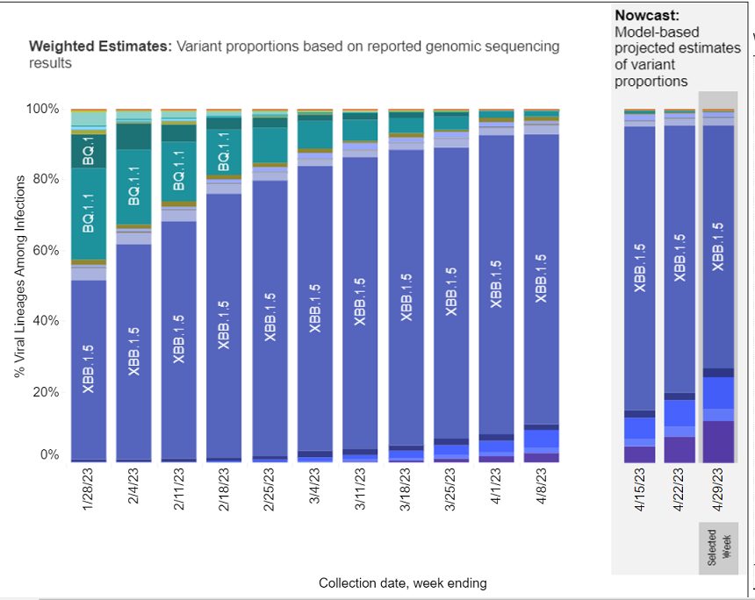
Covid variant surveillance USA

Slide 7
Consider testing for Covid-19
Conjunctivitis
Any fever
Congestion and cough
High risk patient or family member

Slide 8

Resources
https://www.uptodate.com/contents/conjunctivitis?search=conjunctivitis&source=search_result&selectedTitle=1~150&usage_type=default&display_rank=1
https://www.uptodate.com/contents/image?imageKey=PC%2F139015&topicKey=PC%2F6907&search=conjunctivitis&rank=1~150&source=see_link
https://covid.cdc.gov/covid-data-tracker/#variant-proportions

