Slide 1


Slide 2

Adolescent Medicine
Issues, Screening and Wellness
August 12, 2023
Patrick Stevens, DO
Mary-Emma Beres, MD, FAAFP

Slide 3
Statement of Disclosure
We have no financial interest or affiliation concerning material discussed in this presentation
We will not discuss any non-FDA approved or investigational drugs or devices

Slide 4
Learning Objectives
Describe the unique physical, emotional, and social developmental changes that occur during adolescence.
Identify common health concerns and challenges faced by adolescents, including mental health issues, substance abuse, sexual health, and risk-taking behaviors.
Utilize strategies for effective communication and building trust with adolescent patients to promote open and honest discussions about their health concerns.
Recall preventive healthcare measures specific to adolescents, including immunizations, screenings, and health education.
Apply evidence-based approaches for promoting healthy lifestyles and behavior changes among adolescents, such as promoting physical activity, healthy nutrition, and stress management techniques.

Slide 5

Patrick Stevens, DO
Practicing at Hugh Chatham Family Medicine Jonesville
  Chief of Family Practice, HCH
  Medical Director of Hugh Chatham Urgent Care Elkin and Jonesville
  Assistant Consulting Professor, Dept of Family and Community Medicine, Duke University, PA Program
From: South Bend, Indiana
Lives: Elkin, North Carolina
Education:
  BS Biological Sciences, Indiana University
  DO, Campbell University
  Family Medicine Residency, Spectrum Health Lakeland, St. Joseph, MI

Slide 6

Mary-Emma Beres, MD, FAAFP
Practicing at Hugh Chatham Family Medicine Elkin, NC and Independence, VA
  Medical Director of Primary Care, Hugh Chatham Health
  Clinical Assistant Professor, Dept of Family Medicine, Campbell University
  Assistant Consulting Professor, Dept of Family and Community Medicine, Duke University, PA Program
From: Raleigh, NC
Lives: Sparta, North Carolina
Education:
  BA, French, UNC-CH
  MD, UNC School of Medicine
  Residency University of Arizona
  Fellowship University of Rochester, NY

Slide 7


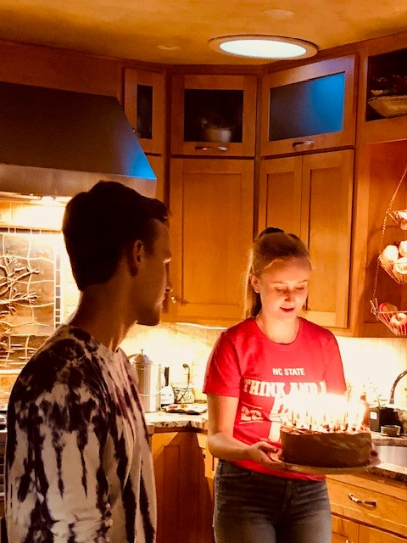
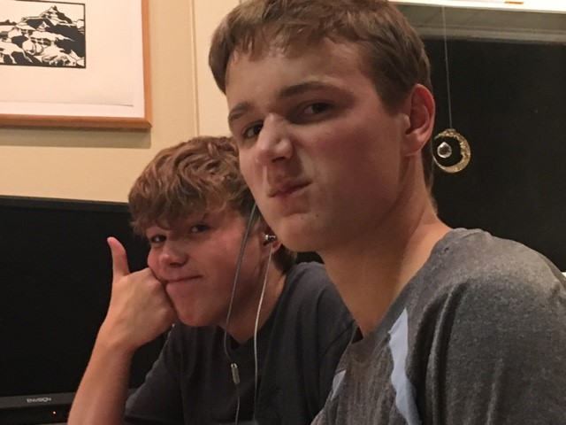
My Other Qualifications

Slide 8
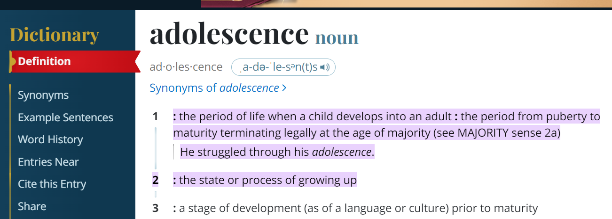
Definitions
From Merriam-Webster’s Dictionary
Merriam-Webster.com/Dictionary https://www.merriam-webster.com/dictionary/adolescence#:~:text=%3A%20the%20period%20of%20life%20when,or%20process%20of%20growing%20up

Slide 9
Definitions
From Merriam-Webster’s Dictionary
Merriam-Webster.com/Dictionary https://www.merriam-webster.com/dictionary/adolescence#:~:text=%3A%20the%20period%20of%20life%20when,or%20process%20of%20growing%20up

Slide 10
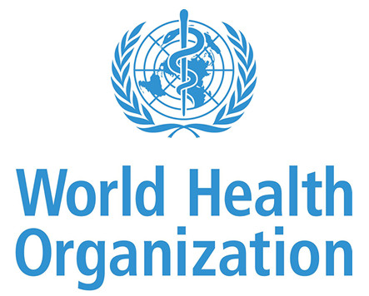
Adolescence is the phase of life between childhood and adulthood, from ages 10 to 19. It is a unique stage of human development and an important time for laying the foundations of good health.
World Health Organization https://www.who.int/health-topics/adolescent-health#tab=tab_2

Slide 11
Development
Physical Development
      Puberty:
      Girls breast development 8 – 13, menarche 2.5 years later
      Boys testicular development 9 – 14
      https://www.aafp.org/pubs/afp/issues/2017/1101/p59.html
Intellectual/Psychological Development
Concrete vs abstract thinking
Gaining knowledge
Social/Emotional Development
Personal identity/autonomy
Friendships
Romantic relationships
Responsibility
Klein DA, Emerick JE, Sylvester JE, Vogt KS. Disorders of Puberty: An Approach to Diagnosis and Management. Am Fam Physician. 2017 Nov 1;96(9):590-599. PMID: 29094880.

Slide 12
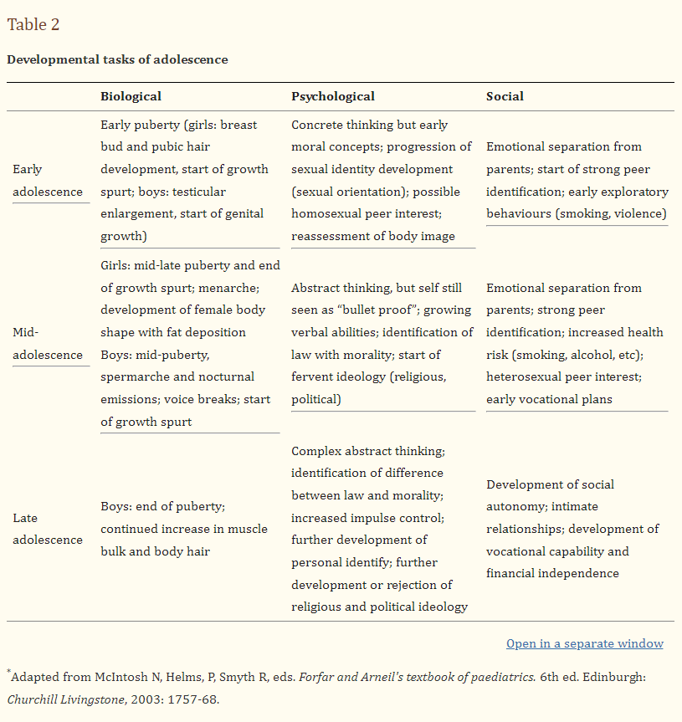
Christie D, Viner R. Adolescent development. BMJ. 2005 Feb 5;330(7486):301-4. doi: 10.1136/bmj.330.7486.301. PMID: 15695279; PMCID: PMC548185

Slide 13
Benefits of Wellness Exams
Early intervention and prevention reduce long-term health issues.
Promotes positive health behaviors and healthy habits.
Addresses mental health concerns, improving overall well-being.
Empowers adolescents to make informed decisions about their health.
* Sports physicals do not cover these important screenings and miss opportunity anticipatory guidance!

Slide 14
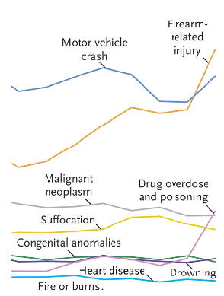
2020 5 Top Causes of Child and Adolescent Death
Firearm related Injury
Motor vehicle crash
Malignant neoplasm
Suffocation
Drug overdose and poisoning
Goldstick, JE, Cunningham RM, Carter PM Current Causes of Death in Children and Adolescents in the United States N Engl J Med 2022; 386:1955-1956 DOI: 10.1056/NEJMc2201761

Slide 15
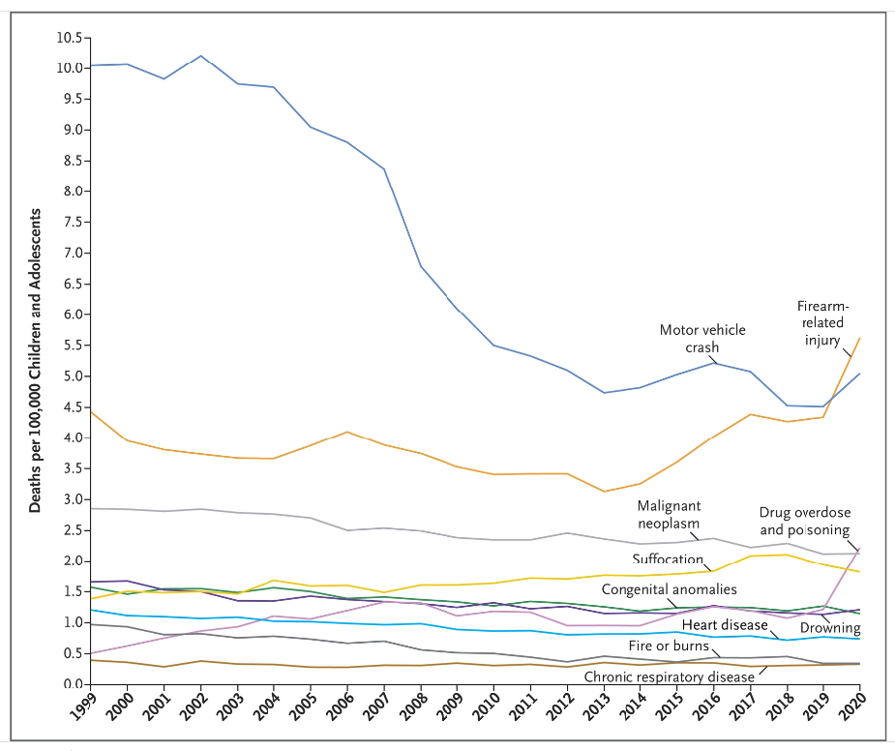
Title
Goldstick, JE, Cunningham RM, Carter PM Current Causes of Death in Children and Adolescents in the United States N Engl J Med 2022; 386:1955-1956 DOI: 10.1056/NEJMc2201761

Slide 16
Gun Deaths
Gun deaths in children and teens (up 18yo) rose by 50% between 2019 and 2021. (1,732 in 2019 to 2,590 in 2021)
Rate of death by firearms in children and adolescents rose 46% from 2019 to 2021. (2.4/100,000 in 2019 to 3.5/100,000 in 2021)
12 - 17 year-olds in 2021
Homicide 60%
Suicide 32%
Accidental 5%
Risks
Male gender 86%
Black race 46%
(while making up 14% of the US under-18 population)
Other social determinants of care
John Gramlich, Pew Research Center https://pewrsr.ch/413hy18

Slide 17
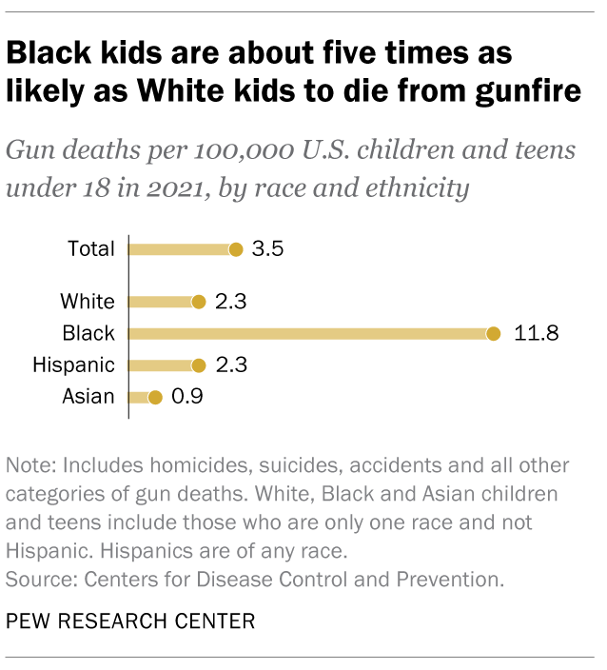
Gun Deaths
John Gramlich, Pew Research Center https://pewrsr.ch/413hy18

Slide 18

Gun Deaths
Male gender accounts for most suicides and homicides among 15 – 24 year olds
American Indian and Alaskan Native youth have the 2nd highest rate of firearm suicide
Suicide attempts with a firearm are most often fatal @ 91% (drug overdose 23%)
80% of youth firearm suicides occur with a gun owned by a family member
Unintentional gun deaths often result from playing with a gun (0-9 yo 63.8%, 10-19 yo 42.8%
In 92% of accidental gun deaths, the gun was left loaded and unlocked, and 64% occurred in in the victim’s home
1/3 of children in the United States live with firearms in the home
https://www.aap.org/en/patient-care/gun-safety-and-injury-prevention/
-Lois K. Lee, Eric W. Fleegler, Monika K. Goyal, Kiesha Fraser Doh, Danielle Laraque-Arena, Benjamin D. Hoffman, THE COUNCIL ON INJURY, VIOLENCE, AND POISON PREVENTION; Firearm-Related Injuries and Deaths in Children and Youth: Injury Prevention and Harm Reduction. Pediatrics December 2022; 150 (6): e2022060070. 10.1542/peds.2022-060070
-Solnick, S.J., Hemenway, D. Unintentional firearm deaths in the United States 2005–2015. Inj. Epidemiol. 6, 42 (2019). https://doi.org/10.1186/s40621-019-0220-0

Slide 19
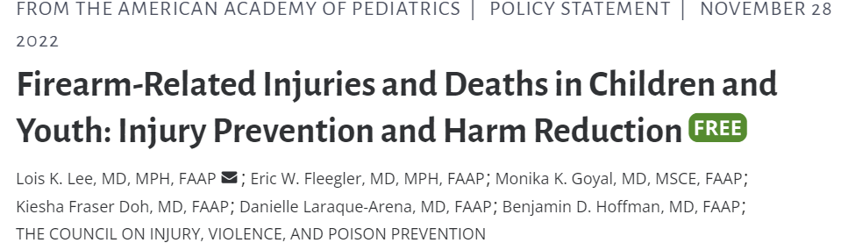
Prevention
https://publications.aap.org/pediatrics/article/150/6/e2022060070/189686
Harm Reduction
Similar to reducing motor vehicle deaths
Anticipatory Guidance on proper storage – unloaded and locked, store ammunition separately and also locked
Ask about firearms in homes of relatives or friends where the child visits
Culturally appropriate messaging
Five Easy Questions: What You Should Ask Before the Sleepover
https://www.parentmap.com/article/five-easy-questions-what-you-should-ask-before-the-sleepover

Slide 20
Suicide/Depression
From 2007- 2018 the suicide rate for people 10 – 24 years-old rose 57.4%
In 2021 30% of high school females and 14% of high school males seriously considered suicide; 45% of self-identified LGBQ+ HS students contemplated suicide.
Also in 2021 57% of HS females and 29% of HS males reported persistent feelings of sadness or hopelessness. (2011 36% and 21%, respectively)
Previously adolescent males were 4 times more likely to die by suicide but this gender gap is narrowing to 1.8 times, with the 10 -14 year-old female rate of suicide climbing the most.
-Sally C Curtin, MA National Vital Statistics Reports, Vol. 69, No. 11, September 11, 2020
-Youth Risk Behavior Survey 2011-2021 CDC.gov
-Ruch, D; Sheftall, A, Schlagbaum, P et al Trends in Suicide Among Youth Aged 10-19 Years in the United States, 1975 to 2016 JAMA Netw Open. 2019;2(5):e193886. doi:10.1001/jamanetworkopen.2019.3886

Slide 21
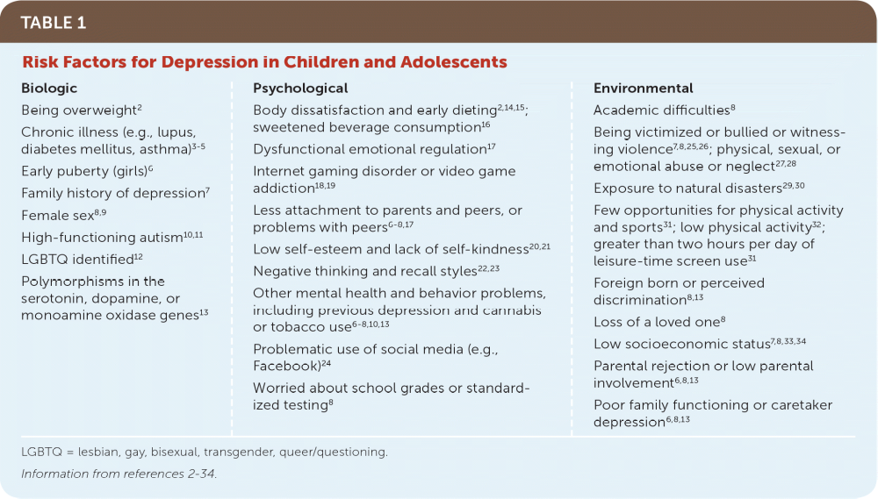
Copyright © 2019 by the American Academy of Family Physicians.
Selph SS, McDonagh MS. Depression in Children and Adolescents: Evaluation and Treatment. Am Fam Physician. 2019 Nov 15;100(10):609-617. PMID: 31730312.

Slide 22
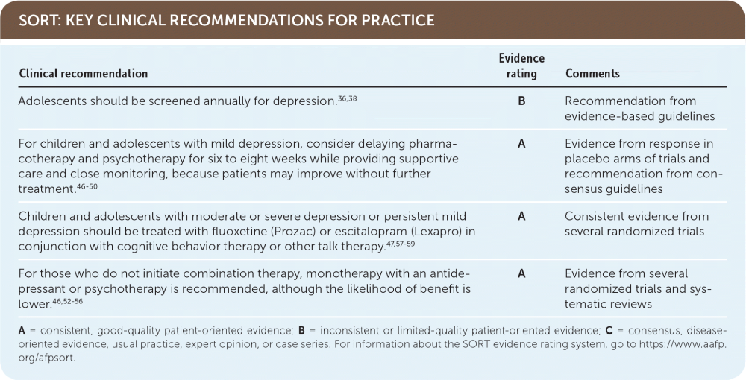
Copyright © 2019 by the American Academy of Family Physicians
Selph SS, McDonagh MS. Depression in Children and Adolescents: Evaluation and Treatment. Am Fam Physician. 2019 Nov 15;100(10):609-617. PMID: 31730312.

Slide 23
All you have to do is
ASK

Slide 24
Screening
PHQ 9 – Modified for Teens or PHQ-A
https://www.aafp.org/pubs/afp/issues/2019/1115/p609.html#screening-for-depression
Annually for 12 and older
Use quarterly for ongoing treatment
ASQ – Ask Suicide-Screening Questions
NIH (short and longer versions)
https://www.nimh.nih.gov/research/research-conducted-at-nimh/asq-toolkit-materials#outpatient
a short version @ AAFP
  https://www.aafp.org/pubs/afp/issues/2019/1115/p609.html#risk-assessment-for-suicide

Slide 25
Adverse Childhood Experiences (ACEs)
Abuse (physical, emotional or sexual)
Neglect (physical or emotional)
Separation or divorce
Experience intimate partner conflict – verbal or domestic abuse
Family member with mental illness
Family member with substance use disorder
Incarceration of a family member
Associated Health Conditions/Outcomes
Depression
COPD/Asthma, cancer
CKD, CAD, CVA, obesity
Nicotine use, heavy drinking
Unemployment, lower education level, lack of health insurance
https://www.cdc.gov/injury/budget/policy_approaches_ACEs.html

Slide 26
Pandemic
Food insecurity
More time confined in stressful homes
Social isolation
Parent/Caregiver job loss
Loss of parent/caregiver
2020 Google increase trend of searches:
“my mom beat me”
“my dad hit me”
Child abuse searches increased 19% of weeks from previous intervals (PI) beginning a month after the Pandemic Unemployment Compensation Program ended.
Intimate Partner Violence searches were up 33% of the weeks above the PI after the shelter-in-place policies
-Bryant DJ, Oo M, Damian AJ. The rise of adverse childhood experiences during the COVID-19 pandemic. Psychological Trauma : Theory, Research, Practice and Policy. 2020 Aug;12(S1):S193-S194. DOI: 10.1037/tra0000711. PMID: 32551773.
-Riddell CA, Neumann K, Santaularia NJ, Farkas K, Ahern J, Mason SM. Excess Google Searches for Child Abuse and Intimate Partner Violence During the COVID-19 Pandemic: Infoveillance Approach. J Med Internet Res. 2022 Jun 13;24(6):e36445. doi: 10.2196/36445. PMID: 35700024; PMCID: PMC9202515.

Slide 27
Pandemic
Morbidity and Mortality Weekly Report (MMWR) Oct 14, 2022
73.1% of adolescents under 18 experienced 1 ACE
53.2% experienced 2 ACEs
12.0% experienced 3 ACEs
7.8% experienced 4 or more ACEs
Anderson KN, Swedo EA, Trinh E, et al. Adverse Childhood Experiences During the COVID-19 Pandemic and Associations with Poor Mental Health and Suicidal Behaviors Among High School Students — Adolescent Behaviors and Experiences Survey, United States, January–June 2021. MMWR Morb Mortal Wkly Rep 2022;71:1301–1305

Slide 28
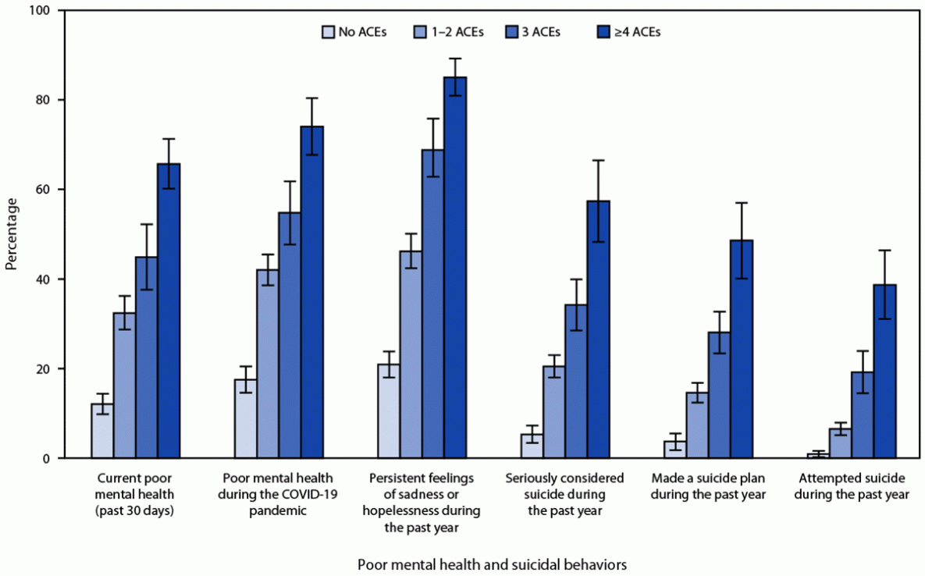
FIGURE. Number of adverse childhood experiences during the COVID-19 pandemic and crude prevalences of poor mental health and suicidal behaviors* among high school students (N = 4,390) — Adolescent Behaviors and Experiences Survey, United States, 2021
Anderson KN, Swedo EA, Trinh E, et al. Adverse Childhood Experiences During the COVID-19 Pandemic and Associations with Poor Mental Health and Suicidal Behaviors Among High School Students — Adolescent Behaviors and Experiences Survey, United States, January–June 2021. MMWR Morb Mortal Wkly Rep 2022;71:1301–1305.

Slide 29
ACEs Screening
Section 1. At any point since you were born…
Your parents or guardians were separated or divorced
You lived with a household member who served time in jail or prison
You lived with a household member who was depressed, mentally ill or attempted suicide
You saw or heard household members hurt or threaten to hurt each other
A household member swore at, insulted, humiliated, or put you down in a way that scared you OR a household member acted in a way that made you afraid that you might be physically hurt
Someone touched your private parts or asked you to touch their private parts in a sexual way that was unwanted, against your will, or made you feel uncomfortable
More than once, you went without food, clothing, a place to live, or had no one to protect you
Someone pushed, grabbed, slapped or threw something at you OR you were hit so hard that you were injured or had marks
You lived with someone who had a problem with drinking or using drugs
You often felt unsupported, unloved and/or unprotected
Total your “yes answers: ___
Amended from CYW ACE-Q Teen SR (13-19 yo) © Center for Youth Wellness 2015 https://centerforyouthwellness.org

Slide 30
ACEs Screening
Section 2. At any point since you were born…
You have been in foster care
You have experienced harassment or bullying at school
You have lived with a parent or guardian who died
You have been separated from your primary caregiver through deportation or immigration
You have had a serious medical procedure or life threatening illness You have often seen or heard violence in the neighborhood or in your school neighborhood
You have been detained, arrested or incarcerated
You have often been treated badly because of race, sexual orientation, place of birth, disability or religion
You have experienced verbal or physical abuse or threats from a romantic partner (i.e. boyfriend or girlfriend)
Total your “yes” answers: ____
Amended from CYW ACE-Q Teen SR (13-19 yo) © Center for Youth Wellness 2015 https://centerforyouthwellness.org

Slide 31

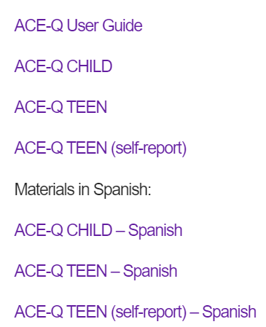
https://centerforyouthwellness.org/cyw-aceq/
Center for Youth Wellness 2015 https://centerforyouthwellness.org

Slide 32
Resources
Bright Futures Pediatric Intake Form (requires subscription)
https://publications.aap.org/toolkits/pages/bright-futures-toolkit
Survey of Well Being of Young Children (Family Questions)
https://pediatrics.tuftsmedicalcenter.org/The-Survey-of-Wellbeing-of-Young-Children/Parts-of-the-SWYC/Family-Questions
The Center for Youth Wellness ACE Questionnaire (CYW ACE-Q)
https://centerforyouthwellness.org/
The Pediatric ACEs and Related Life-Events Screener (PEARLS)
https://www.acesaware.org/learn-about-screening/screening-tools/
The EveryONE Project Social Needs Screening Tool (AAFP) (7 Languages)
https://www.aafp.org/family-physician/patient-care/the-everyone-project/toolkit/assessment.html
The PRAPARE Screening Tool (25 languages including Native American)
https://prapare.org/the-prapare-screening-tool/

Slide 33
Learning Disabilities
Effect 1 in 10 school age children, delay in diagnosis creates a “snowballing effect”
Complete full adolescent history and family history including behavior and academic performance
Medical history: premature birth, low birth weight, recurrent illness, early speech-language delay, neurologic insults, genetic or metabolic disorders
Family history: specific learning disabilities, level of parent education, not reading for pleasure, genetic or disorders
ACEs
School-based multidisciplinary approach (IEP/504)
Differential Diagnosis/Considerations:
Hearing or vision impairment, in utero substance exposure, intellectual disability, neurocutaneous disorders, neurologic conditions, depression, sleep disorders, and more
-https://www.aacap.org/AACAP/Families_and_Youth/Facts_for_Families/FFF-Guide/Children-With-Learning-Disorders-016.aspx
-Curtin MJ, Willis DR, Enneking B. Specific Learning Disabilities: The Family Physician's Role. Am Fam Physician. 2019 Nov 15;100(10):628-635. PMID: 31730315.

Slide 34
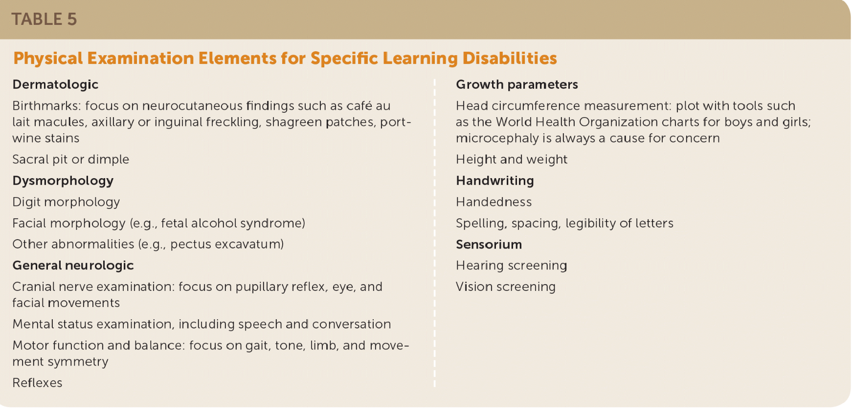
Physical Exam Findings
Curtin MJ, Willis DR, Enneking B. Specific Learning Disabilities: The Family Physician's Role. Am Fam Physician. 2019 Nov 15;100(10):628-635. PMID: 31730315.

Slide 35
Attention-Deficit/Hyperactivity Disorder
Effects 9.4% of U.S children 4 – 17
Racial disparities in diagnosis and treatment exist
Late diagnosis and treatment results in increased incidence of depression and anxiety
Untreated adolescents with ADHD are at greater risk of substance use disorders, achieve lower levels of education and end up in lower paying jobs as adults
2016 survey 62% of adolescents with ADHD were taking medication, 46.7% had received behavioral therapy in the last year and 23.0% had received neither.
College freshman with diagnosed ADHD have about 55% risk of having another psychiatric diagnosis vs 11.2% of their peers without ADHD. 31.8% had 2 or more non-ADHD diagnoses vs 4.0% of peers without ADHD.
-https://www.cdc.gov/ncbddd/adhd/data.html
-Brook JS, Brook DW, Zhang C, Seltzer N, Finch SJ. Adolescent ADHD and adult physical and mental health, work performance, and financial stress. Pediatrics. 2013 Jan;131(1):5-13. doi: 10.1542/peds.2012-1725. Epub 2012 Dec 10. PMID: 23230074; PMCID: PMC3529955
-Biederman J, Monuteaux MC, Spencer T, Wilens TE, Faraone SV. Do stimulants protect against psychiatric disorders in youth with ADHD? A 10-year follow-up study. Pediatrics. 2009 Jul;124(1):71-8. doi: 10.1542/peds.2008-3347. PMID: 19564285; PMCID: PMC2954591.
-Biederman J, Wilens T, Mick E, Spencer T, Faraone SV. Pharmacotherapy of attention-deficit/hyperactivity disorder reduces risk for substance use disorder. Pediatrics. 1999 Aug;104(2):e20. doi: 10.1542/peds.104.2.e20. PMID: 10429138.
-Anastopoulos AD, DuPaul GJ, Weyandt LL, Morrissey-Kane E, Sommer JL, Rhoads LH, Murphy KR, Gormley MJ, Gudmundsdottir BG. Rates and Patterns of Comorbidity Among First-Year College Students With ADHD. J Clin Child Adolesc Psychol. 2018 Mar-Apr;47(2):236-247.

Slide 36
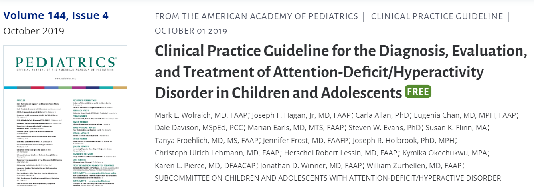
7 Key Action Statements (KASs)
KAS 5c. “ For adolescents (age 12 years to the 18th birthday) with ADHD, the PCC should prescribe FDA-approved medications for ADHD with the adolescent’s assent. The PCC is encouraged to prescribe evidence-based training interventions and/or behavioral interventions as treatment of ADHD, if available. Educational interventions and individualized instructional supports, including school environment, class placement, instructional placement, and behavioral supports, are a necessary part of any treatment plan and often include an IEP or a rehabilitation plan (504 plan). ”
Grade A Recommendation

Slide 37
Screening and Evaluation
Vanderbilt ADHD Teacher and Parent rating scales – moderately sensitive and specific (elementary age children) – need at least 2 teachers or other sources and parent(s)
Full history – prenatal, perinatal, family, school performance, environmental factors
Physical exam
Mental health screenings for comorbid conditions
Diagnosis
Physician/APP evaluation confirming impairment in 2 or more settings (affects the individuals life globally – not just at school).
Assessment of core symptoms using a diagnostic tool based on DSM-4/5
Gaba, P, Giordanengo, M, Attention-Deficit/Hyperactivity Disorder: Screening and Evaluation. American Family Physician, 2019-06-01, Volume 99, Issue 11, Pages 712-712,

Slide 38
DSM-5
“ Inattention: Six or more symptoms of inattention for children up to age 16 years, or five or more for adolescents age 17 years and older and adults; symptoms of inattention have been present for at least 6 months, and they are inappropriate for developmental level”
“Hyperactivity and Impulsivity: Six or more symptoms of hyperactivity-impulsivity for children up to age 16 years, or five or more for adolescents age 17 years and older and adults; symptoms of hyperactivity-impulsivity have been present for at least 6 months to an extent that is disruptive and inappropriate for the person’s developmental level”
In addition: symptoms before age of 12 years, symptoms present in 2 or more settings, interferes with daily function and not explained by another disorder.
https://www.cdc.gov/ncbddd/adhd/diagnosis.html

Slide 39
Challenges to Diagnosis and Treatment of ADHD in Adolescence
Less opportunity for parents to observe behaviors
Multiple teachers
Less likely to exhibit hyperactive behavior (especially girls)
Adolescents down-play their own behaviors
Adolescent participation in evaluation
Symptoms present before the age of 12 (DMS-5)
Comorbid conditions
Social Determinants of Health
Transitioning to college, living independently
Mark L. Wolraich, Joseph F. Hagan, Carla Allan, Eugenia Chan, Dale Davison, Marian Earls, Steven W. Evans, Susan K. Flinn, Tanya Froehlich, Jennifer Frost, Joseph R. Holbrook, Christoph Ulrich Lehmann, Herschel Robert Lessin, Kymika Okechukwu, Karen L. Pierce, Jonathan D. Winner, William Zurhellen, SUBCOMMITTEE ON CHILDREN AND ADOLESCENTS WITH ATTENTION-DEFICIT/HYPERACTIVE DISORDER; Clinical Practice Guideline for the Diagnosis, Evaluation, and Treatment of Attention-Deficit/Hyperactivity Disorder in Children and Adolescents. Pediatrics October 2019; 144 (4): e20192528. 10.1542/peds.2019-2528

Slide 40
ADHD Treatment
Behavioral Interventions
Parent Behavior-Management Training (PBMT)
School Behavior-Management Programs
Cognitive Behavioral Therapy
ADHD Life Coach
Medication Interventions
Stimulants
Methylphenidate, Amphetamine
      (first used in 1937, by 1999 over 300 rigorous studies demonstrated benefit)
Norepinephrine Reuptake Inhibitors
Atomoxetine, Viloxazine
Alpha Agonist
Clonidine (extended release), Guanfacine HCL
Mark L. Wolraich, Eugenia Chan, Tanya Froehlich, Rachel L. Lynch, Ami Bax, Susan T. Redwine, Demvihin Ihyembe, Joseph F. Hagan; ADHD Diagnosis and Treatment Guidelines: A Historical Perspective. Pediatrics October 2019; 144 (4): e20191682. 10.1542/peds.2019-1682

Slide 41
Continuity of Care
Transition to Adulthood
KAS 4: “ADHD is a chronic condition*; therefore, the PCC should manage children and adolescents with ADHD in the same manner that they would children and youth with special health care needs, following the principles of the chronic care model and the medical home.” Grade B Recommendation
*Emphasis mine
Mark L. Wolraich, Joseph F. Hagan, Carla Allan, Eugenia Chan, Dale Davison, Marian Earls, Steven W. Evans, Susan K. Flinn, Tanya Froehlich, Jennifer Frost, Joseph R. Holbrook, Christoph Ulrich Lehmann, Herschel Robert Lessin, Kymika Okechukwu, Karen L. Pierce, Jonathan D. Winner, William Zurhellen, SUBCOMMITTEE ON CHILDREN AND ADOLESCENTS WITH ATTENTION-DEFICIT/HYPERACTIVE DISORDER; Clinical Practice Guideline for the Diagnosis, Evaluation, and Treatment of Attention-Deficit/Hyperactivity Disorder in Children and Adolescents. Pediatrics October 2019; 144 (4): e20192528. 10.1542/peds.2019-2528

Slide 42
Eating Disorders
DSM-5
Pica (Adult/Child) | F98.3/F50.89
Rumination Disorder | F98.21
Avoidant/Restrictive Food Intake Disorder (ARFID) | F50.89
Anorexia Nervosa (AN) Restricting Type Binge-Eating/Purging Type | F50.01 F50.02
Bulimia Nervosa (BN) | F50.2
Binge-Eating Disorder (BED) | F50.81
Other Specified Feeding or Eating Disorder (OSFED) Atypical Anorexia Nervosa Subthreshold Bulimia Nervosa Subthreshold Binge-Eating Disorder Purging Disorder Night Eating Syndrome | F50.89 (lower frequency limited duration, etc..)
Unspecified Feeding or Eating Disorder | F50.9

Slide 43
Eating Disorders
DSM-5
Pica (Adult/Child) | F98.3/F50.89
Rumination Disorder | F98.21
Avoidant/Restrictive Food Intake Disorder (ARFID) | F50.89
Anorexia Nervosa (AN) Restricting Type Binge-Eating/Purging Type | F50.01 F50.02
Bulimia Nervosa (BN) | F50.2
Binge-Eating Disorder (BED) | F50.81
Other Specified Feeding or Eating Disorder (OSFED) Atypical Anorexia Nervosa Subthreshold Bulimia Nervosa Subtrheshold Binge-Eating Disorder Purging Disorder Night Eating Syndrome | F50.89 (lower frequency limited duration, etc..)
Unspecified Feeding or Eating Disorder | F50.9

Slide 44
Fast Facts
1 in 8 children/adolescents will have 1 eating disorder by 20 years of age
More often reported in adolescent and young women (9:1 female-to-male)
Binge-Eating Disorder is more prevalent in young men and older individuals and is the most common ED
Genetics – based on twin and adoption studies, 50% chance of an ED if the other twin has one
Psychological factors – personality traits of perfectionism, obsessive/impulsive/compulsive behavior, harm avoidance, novelty-seeking, anxiety often present
Developmental factors/ACEs – childhood abuse, sexual abuse especially common in Anorexia Nervosa
Socio-cultural factors – cultural importance of thinness media/social media plays an obvious role.
Balasundaram P, Santhanam P. Eating Disorders. [Updated 2023 Mar 8]. In: StatPearls [Internet]. Treasure Island (FL): StatPearls Publishing; 2023 Jan https://www.ncbi.nlm.nih.gov/books/NBK567717

Slide 45
Don’t
Dieting - actually increase risk of adolescent ED (mostly BED) and being overweight in boys and girls
Family Weight Talk - increases incidence of overweight adolescents over 5 years, increased prevalence of ED behaviors in teens.
Weight teasing occurs to 40% of overweight adolescent girls and 37% of adolescent boys. Teen girls who are teased are twice as likely to be overweight in 5 years.
Do
Family Meals – improves intake of nutritional food, shows sustained good nutritional behaviors into adulthood, protects adolescents from developing ED behaviors
Limit Screen time
Neville H. Golden, Marcie Schneider, Christine Wood, COMMITTEE ON NUTRITION, COMMITTEE ON ADOLESCENCE, SECTION ON OBESITY, Stephen Daniels, Steven Abrams, Mark Corkins, Sarah de Ferranti, Sheela N. Magge, Sarah Schwarzenberg, Paula K. Braverman, William Adelman, Elizabeth M. Alderman, Cora C. Breuner, David A. Levine, Arik V. Marcell, Rebecca O’Brien, Stephen Pont, Christopher Bolling, Stephen Cook, Lenna Liu, Robert Schwartz, Wendelin Slusser; Preventing Obesity and Eating Disorders in Adolescents. Pediatrics September 2016; 138 (3): e20161649. 10.1542/peds.2016-1649

Slide 46
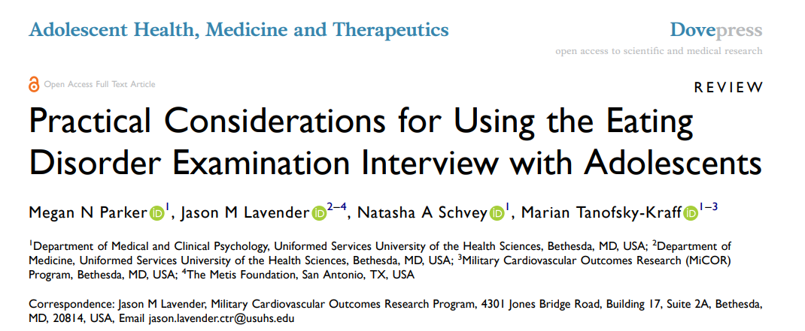
Behaviors Screened
Patterns of eating
Extreme restriction (<1200 calories)
Fasting
Objective over eating
Binge eating
Purging
Excessive and driven exercise
Other extreme weight control measures
Content Screened:
Dietary restriction
Eating concerns
Weight concerns
Shape concerns

Slide 47
Screening
Growth Chart – watch for sudden changes
Body image questions/questionnaire
Menstrual history
Parent questionnaires
In depth Eating Disorder Questionnaire: https://www.cbte.co/site/download/ede-17-0d/?wpdmdl=615&masterkey=5c644ef9b6149
Treatment
Enhanced Cognitive Behavior Therapy (CBT-E) – all EDs
Family-Based Treatment (FBT) – Anorexia Nervosa, Bulimia Nervosa
Interpersonal Therapy – Bulimia Nervosa, Binge-Eating Disorder
Pharmacotherapy
Fluoxetine FDA approved for Bulimia, BED
Lisdexamfetamine FDA approved for BED 18 yo+
Other antidepressants, mood stabilizers or antipsychotics for co-existing illnesses
Nutritional therapy – all EDs
Weight-loss management – BED, multidisciplinary approach
Balasundaram P, Santhanam P. Eating Disorders. [Updated 2023 Mar 8]. In: StatPearls [Internet]. Treasure Island (FL): StatPearls Publishing; 2023 Jan https://www.ncbi.nlm.nih.gov/books/NBK567717

Slide 48
Obesity
Over the past 30 years, the rate of childhood obesity has more than doubled, and the rate of adolescent obesity has quadrupled.
A high adolescent BMI increases adult diabetes and coronary artery disease risks by nearly threefold and fivefold, respectively.
Risks of other conditions, such as hypertension, hyperlipidemia, nonalcoholic fatty liver disease, gallstones, gastro-esophageal reflux, polycystic ovary syndrome, obstructive sleep apnea, asthma, and bone and joint problems, are significantly increased in obese adolescents.
Neville H. Golden, Marcie Schneider, Christine Wood, COMMITTEE ON NUTRITION, COMMITTEE ON ADOLESCENCE, SECTION ON OBESITY, Stephen Daniels, Steven Abrams, Mark Corkins, Sarah de Ferranti, Sheela N. Magge, Sarah Schwarzenberg, Paula K. Braverman, William Adelman, Elizabeth M. Alderman, Cora C. Breuner, David A. Levine, Arik V. Marcell, Rebecca O’Brien, Stephen Pont, Christopher Bolling, Stephen Cook, Lenna Liu, Robert Schwartz, Wendelin Slusser; Preventing Obesity and Eating Disorders in Adolescents. Pediatrics September 2016; 138 (3): e20161649. 10.1542/peds.2016-1649

Slide 49
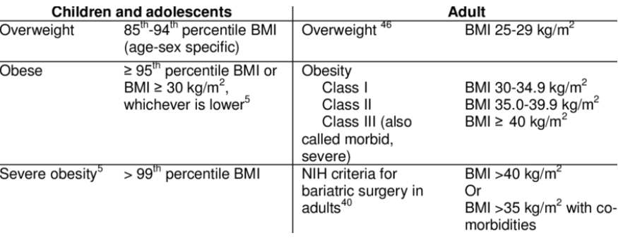
Whitlock, Evelyn & O'Connor, Elizabeth & Williams, Selvi & Beil, Tracy & Lutz, Kevin. (2008). Effectiveness of weight management programs in children and adolescents. Evidence report/technology assessment. 170. 1-308.

Slide 50
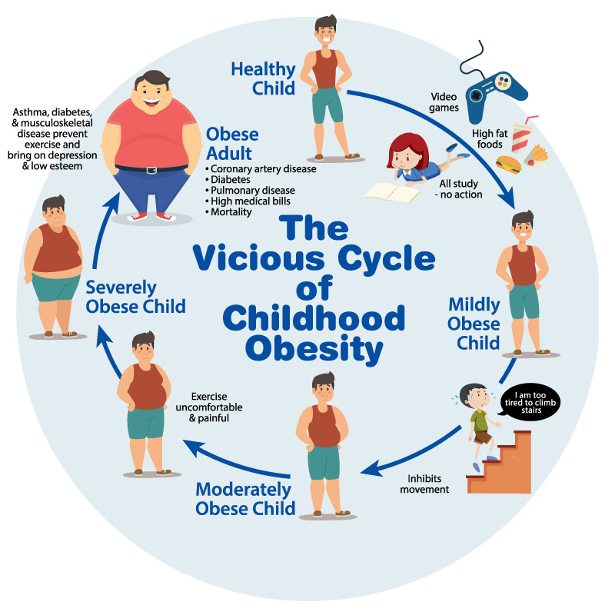
https://theheartfoundation.org/2018/02/09/childhood-obesity/

Slide 51
Dieting
Dieting (caloric restriction for weight loss) was associated with greater weight gain and increased rates of binge eating.
In Project Eating Among Teens (Project EAT), dieting behaviors were associated with a twofold increased risk of becoming overweight and a 1.5-fold increased risk of binge eating at 5-year follow-up.
Girls without obesity who dieted in the ninth grade were 3 times more likely to be overweight in the 12th grade compared with non-dieters.
Students who severely restricted their energy intake and skipped meals were 18 times more likely to develop an eating disorder than those who did not.
Neville H. Golden, Marcie Schneider, Christine Wood, COMMITTEE ON NUTRITION, COMMITTEE ON ADOLESCENCE, SECTION ON OBESITY, Stephen Daniels, Steven Abrams, Mark Corkins, Sarah de Ferranti, Sheela N. Magge, Sarah Schwarzenberg, Paula K. Braverman, William Adelman, Elizabeth M. Alderman, Cora C. Breuner, David A. Levine, Arik V. Marcell, Rebecca O’Brien, Stephen Pont, Christopher Bolling, Stephen Cook, Lenna Liu, Robert Schwartz, Wendelin Slusser; Preventing Obesity and Eating Disorders in Adolescents. Pediatrics September 2016; 138 (3): e20161649. 10.1542/peds.2016-1649

Slide 52
Other Evidence-based Strategies
Family meals: Eating family meals together 7 or more times per week resulted in families consuming 1 serving more of fruits and vegetables per day compared with families who had no meals together.
Promote healthy body image!: Higher scores of body dissatisfaction are associated with more dieting and unhealthy weight-control behaviors in both boys and girls, reduced physical activity in girls, and more binge eating in boys.
Neville H. Golden, Marcie Schneider, Christine Wood, COMMITTEE ON NUTRITION, COMMITTEE ON ADOLESCENCE, SECTION ON OBESITY, Stephen Daniels, Steven Abrams, Mark Corkins, Sarah de Ferranti, Sheela N. Magge, Sarah Schwarzenberg, Paula K. Braverman, William Adelman, Elizabeth M. Alderman, Cora C. Breuner, David A. Levine, Arik V. Marcell, Rebecca O’Brien, Stephen Pont, Christopher Bolling, Stephen Cook, Lenna Liu, Robert Schwartz, Wendelin Slusser; Preventing Obesity and Eating Disorders in Adolescents. Pediatrics September 2016; 138 (3): e20161649. 10.1542/peds.2016-1649

Slide 53
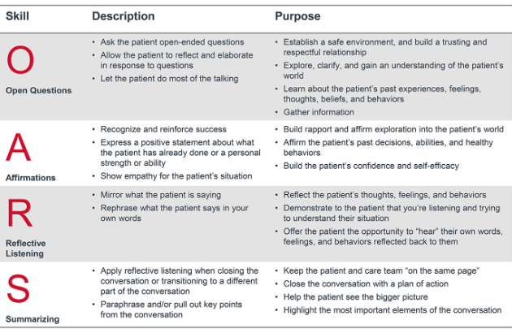
Motivational Interviewing (MI)
A study conducted through the AAP Pediatric Research in Office Settings (PROS) network assessed the effect of MI delivered by pediatricians and found that pediatricians and dietitians who used MI to counsel families with overweight children were successful in reducing children’s BMI percentile by 3.1 more points than a control group in which MI was not used.
Neville H. Golden, Marcie Schneider, Christine Wood, COMMITTEE ON NUTRITION, COMMITTEE ON ADOLESCENCE, SECTION ON OBESITY, Stephen Daniels, Steven Abrams, Mark Corkins, Sarah de Ferranti, Sheela N. Magge, Sarah Schwarzenberg, Paula K. Braverman, William Adelman, Elizabeth M. Alderman, Cora C. Breuner, David A. Levine, Arik V. Marcell, Rebecca O’Brien, Stephen Pont, Christopher Bolling, Stephen Cook, Lenna Liu, Robert Schwartz, Wendelin Slusser; Preventing Obesity and Eating Disorders in Adolescents. Pediatrics September 2016; 138 (3): e20161649. 10.1542/peds.2016-1649

Slide 54


Social Media/Smart Phones
Photo credit: https://www.apa.org/topics/social-media-internet/health-advisory-adolescent-social-media-use

Slide 55
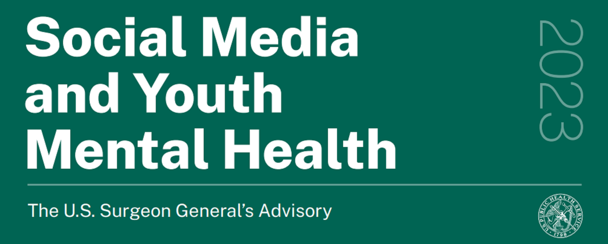
https://www.hhs.gov/sites/default/files/sg-youth-mental-health-social-media-advisory.pdf

Slide 56
Social Media/Smart Phones
In the US, 89% of 13- 17 yo have smart phone, this double over 6 years, 95% have social media accounts.
Increase use of social media directly related to insufficient sleep – as much as 40 of US adolescents sleeping less than 7 hours a night
Nighttime cell phone use also directly related to depression in teens
Effects are worse on adolescent girls and young adult women.
Nearly 6-in-10 adolescent girls say they’ve been contacted by a stranger on certain social media platforms in ways that make them feel uncomfortable.
Parental modeling – parents who spend more time on social media are associated with poorer quality interactions with their children
Abi-Jaoude E, Naylor KT, Pignatiello A. Smartphones, social media use and youth mental health. CMAJ. 2020 Feb 10;192(6):E136-E141. doi: 10.1503/cmaj.190434. PMID: 32041697; PMCID: PMC7012622
Gwenn Schurgin O'Keeffe, Kathleen Clarke-Pearson, Council on Communications and Media; The Impact of Social Media on Children, Adolescents, and Families. Pediatrics April 2011; 127 (4): 800–804. 10.1542/peds.2011-0054

Slide 57
Social Media/Smart Phones
Cons
Facebook Depression
Sexting, exposure to preditors
Sleep deprivation
Cyber bullying/stalking
Privacy issues
Advertising/influencing
Body image concerns/disordered eating
Logarithms with built-in racism
Pros
Support network (especially for those who identify as LGBTQ)
Health promotion
Support groups (Facebook, Meetup, etc..)
Gwenn Schurgin O'Keeffe, Kathleen Clarke-Pearson, Council on Communications and Media; The Impact of Social Media on Children, Adolescents, and Families. Pediatrics April 2011; 127 (4): 800–804. 10.1542/peds.2011-0054
https://www.apa.org/topics/social-media-internet/health-advisory-adolescent-social-media-use

Slide 58


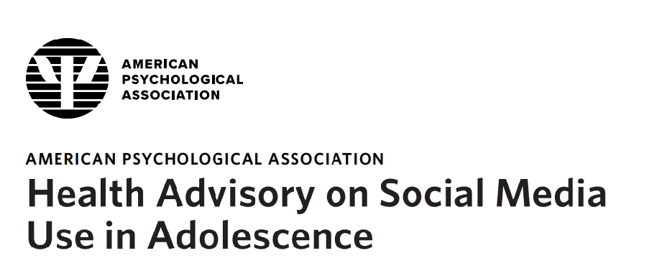
For Parents
https://www.aap.org/en/patient-care/media-and-children/center-of-excellence-on-social-media-and-youth-mental-health/
https://tdsu.org/
https://www.apa.org/topics/social-media-internet/health-advisory-adolescent-social-media-use.pdf

Slide 59
Smoking versus Vaping
The Youth Risk Behavior Survey reports a decrease in combustible cigarettes use from 70% in 1991 to 58.4% in 2003 and 28.9% in 2017.
There has been a 10% increase in adolescents using e-cigarettes between 2017 and 2018, approximately 1.3 million teenagers
Adolescents who use e-cigarettes are 3.6 times more likely to use cigarettes later in life
-Slekman J. Vaping: It’s all a smokescreen. Pediatric Nursing. 2019;45(1):12–15. 35.
-Jenssen BP, Wilson KM. What is new in electronic-cigarettes research? Current Opinion in Pediatrics. 2019;31(2):262–266. doi: 10.1097/mop.0000000000000741.
-Jones K. Salzman G. The Vaping Epidemic in Adolescents. Mo Med. 2020 Jan-Feb; 117(1): 56–58.

Slide 60
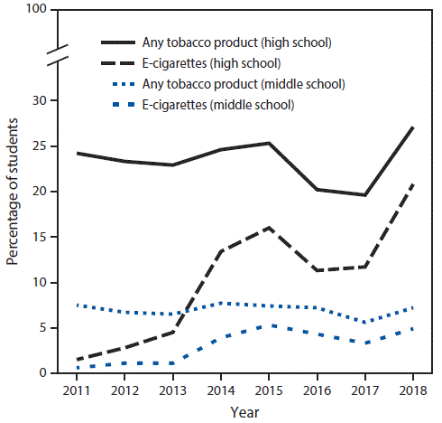
Cullen KA, Ambrose BK, Gentzke AS, Apelberg BJ, Jamal A, King BA. Notes from the Field: Use of Electronic Cigarettes and Any Tobacco Products Among Middle and High School Students – United States, 2011-2018. MMWR Morb Mortal Wkly Rep 2018;67:1276-1277

Slide 61
Alcohol
Nearly two-thirds of middle school and high school aged youth know people around their age who have tried alcohol.
The average age that most youth try alcohol for the first time is 14.
Thirty-eight percent of eighth graders have had alcohol at least once.
About 10 percent of 12-year-olds say they have tried alcohol. By age 15, that number jumps to 50 percent.
- The State of Underage Drinking in North Carolina, North Carolina ABC Commission, 2014, page 8
- The State of Underage Drinking in North Carolina, North Carolina ABC Commission, 2015, page 10
- North Carolina Youth Risk Behavior Survey, North Carolina Department of Public Instruction, Healthy Schools Initiative, 2013, page 27

Slide 62
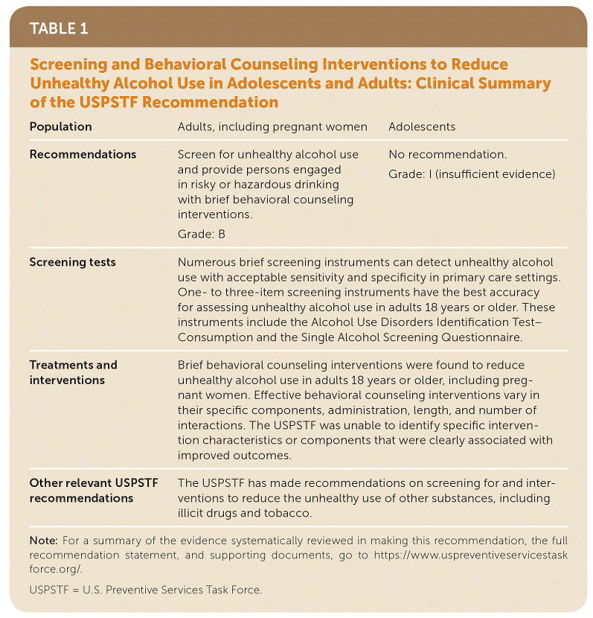
Copyright © 2019 by the American Academy of Family Physicians
- Am Fam Physician. 2019;99(12). https://www.aafp.org/pubs/afp/issues/2019/0615/od1.html
- National Institute on Alcohol Abuse and Alcoholism. Helping patients who drink too much: a clinician's guide; 2005. https://www.niaaa.nih.gov/guide. Accessed October 1, 2018.

Slide 63
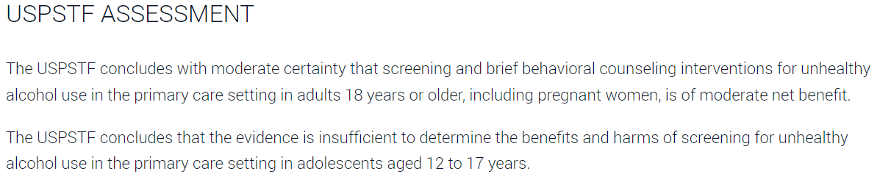
- Am Fam Physician. 2019;99(12). https://www.aafp.org/pubs/afp/issues/2019/0615/od1.html
- National Institute on Alcohol Abuse and Alcoholism. Helping patients who drink too much: a clinician's guide; 2005. https://www.niaaa.nih.gov/guide. Accessed October 1, 2018.

Slide 64
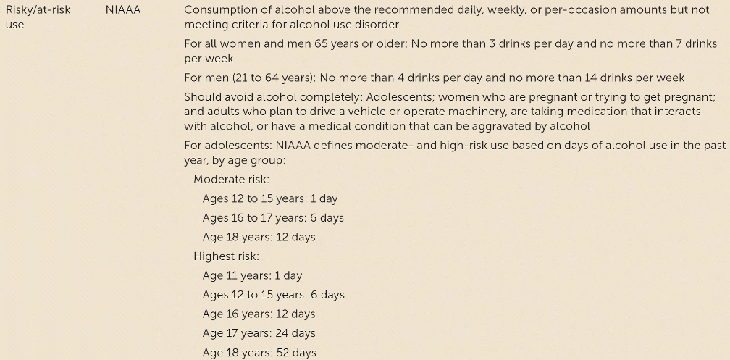
Copyright © 2019 by the American Academy of Family Physicians
- Am Fam Physician. 2019;99(12). https://www.aafp.org/pubs/afp/issues/2019/0615/od1.html
- National Institute on Alcohol Abuse and Alcoholism. Helping patients who drink too much: a clinician's guide; 2005. https://www.niaaa.nih.gov/guide. Accessed October 1, 2018.

Slide 65
CRAFT
Have you ever ridden in a CAR driven by someone (including yourself) who was "high" or had been using alcohol or drugs?
Do you ever use alcohol or drugs to RELAX, feel better about yourself, or fit in?
Do you ever use alcohol or drugs while you are by yourself, ALONE?
Do you FORGET things you did while using alcohol or drugs?
Do your family or FRIENDS ever tell you that you should cut down on your drinking or drug use?
Have you ever gotten into TROUBLE while you were using alcohol or drugs?

Slide 66
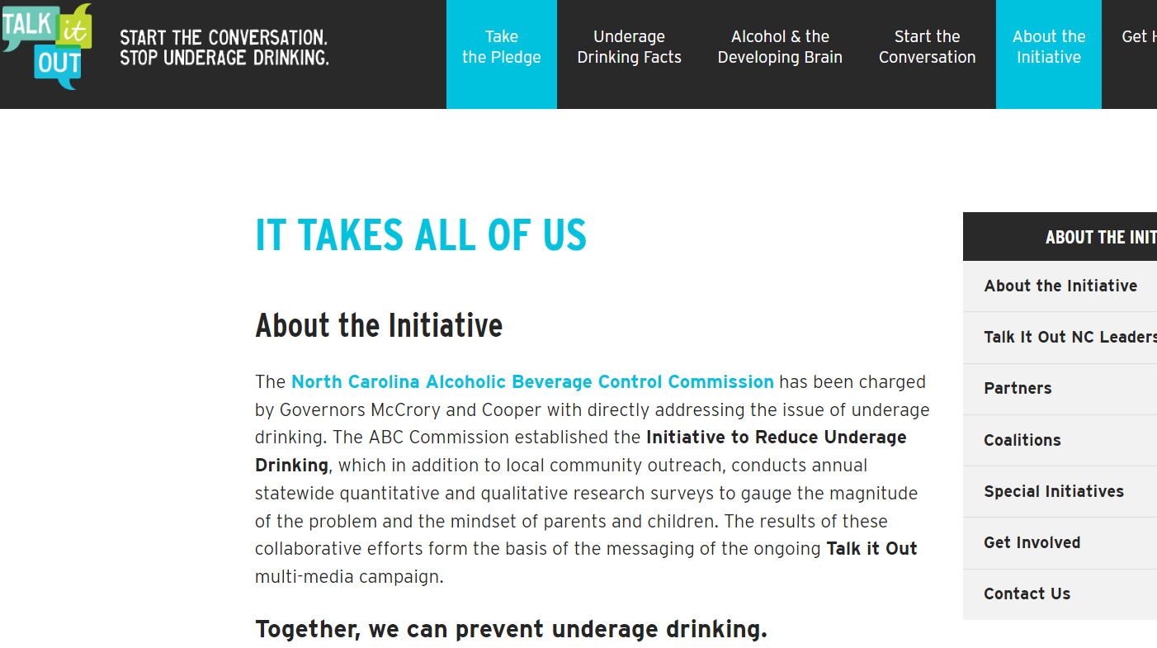
talkitoutnc.org

Slide 67
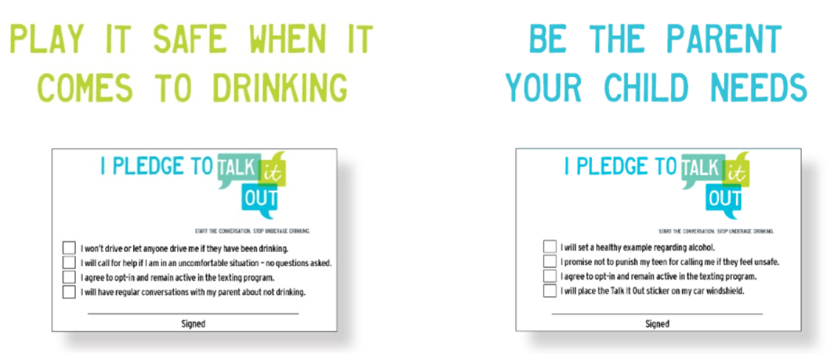
talkitoutnc.org

Slide 68
Cannabis
Eighth graders: 7.1% reported using marijuana in the past year in 2021, compared to 11.4% in 2020
10th graders: 17.3% reported using marijuana in the past year in 2021, compared to 28.0% in 2020
12th graders: 30.5% reported using marijuana in the past year in 2021, compared to 35.2% in 2020
NIDA. 2021, December 15. Percentage of adolescents reporting drug use decreased significantly in 2021 as the COVID-19 pandemic endured. Retrieved from https://nida.nih.gov/news-events/news-releases/2021/12/percentage-of-adolescents-reporting-drug-use-decreased-significantly-in-2021-as-the-covid-19-pandemic-endured on 2023, June 24

Slide 69
Other Illicit Drugs
Eighth graders: 4.6% reported using any illicit drug (other than marijuana) in the past year in 2021, compared to 7.7% in 2020
10th graders: 5.1% reported using any illicit drug (other than marijuana) in the past year in 2021, compared to 8.6% in 2020
12th graders: 7.2% reported using any illicit drug (other than marijuana) in the past year in 2021, compared to 11.4% in 2020
NIDA. 2021, December 15. Percentage of adolescents reporting drug use decreased significantly in 2021 as the COVID-19 pandemic endured. Retrieved from https://nida.nih.gov/news-events/news-releases/2021/12/percentage-of-adolescents-reporting-drug-use-decreased-significantly-in-2021-as-the-covid-19-pandemic-endured on 2023, June 24

Slide 70
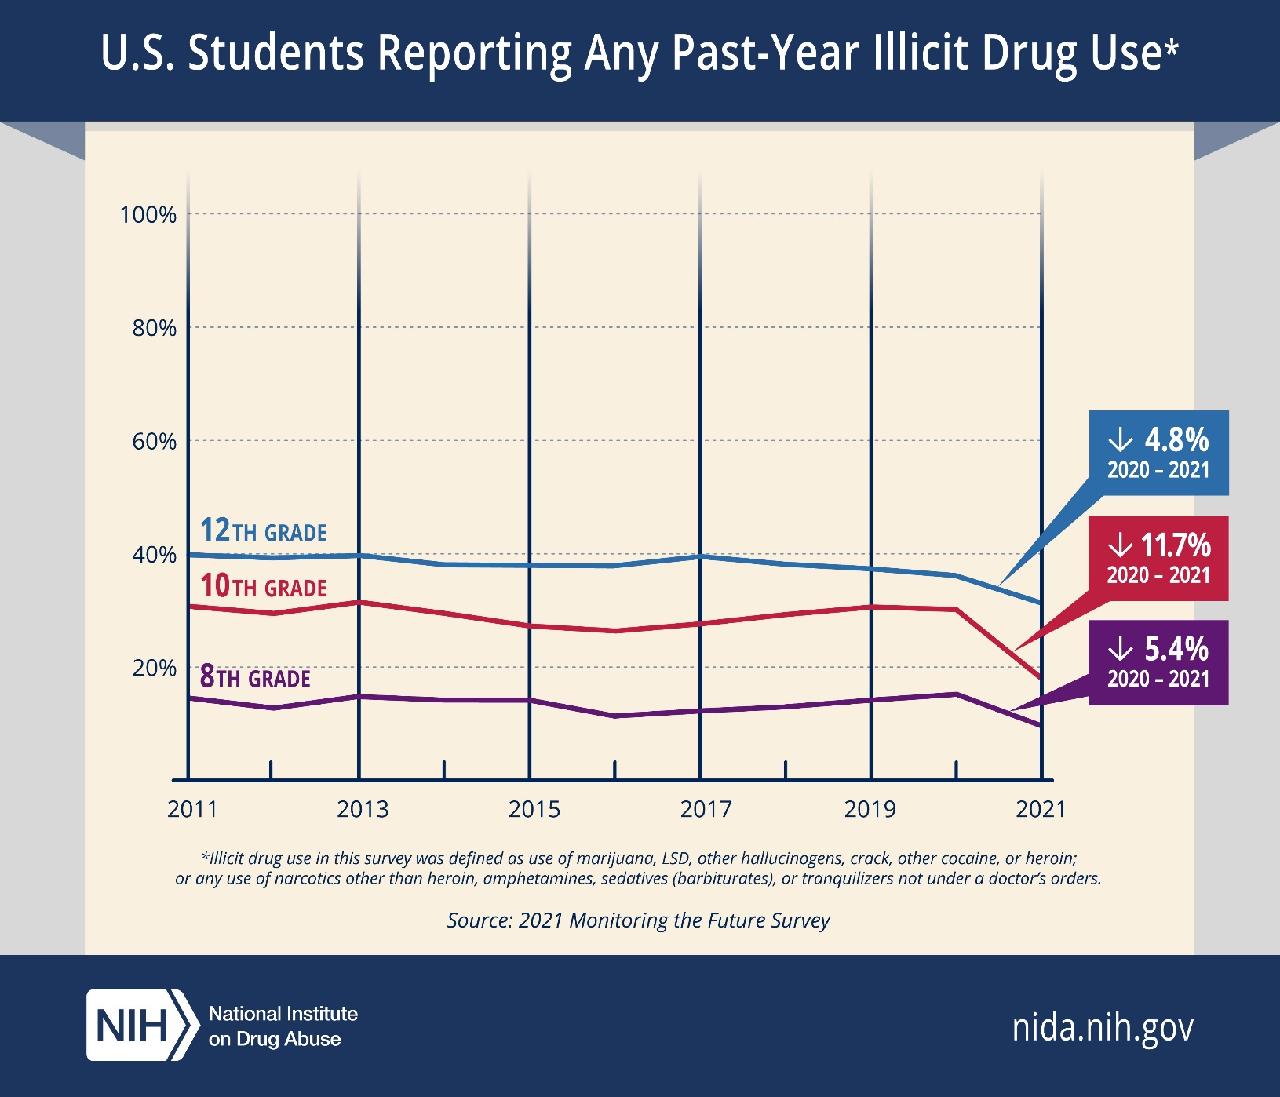
NIDA. 2021, December 15. Percentage of adolescents reporting drug use decreased significantly in 2021 as the COVID-19 pandemic endured. Retrieved from https://nida.nih.gov/news-events/news-releases/2021/12/percentage-of-adolescents-reporting-drug-use-decreased-significantly-in-2021-as-the-covid-19-pandemic-endured on 2023, June 24

Slide 71
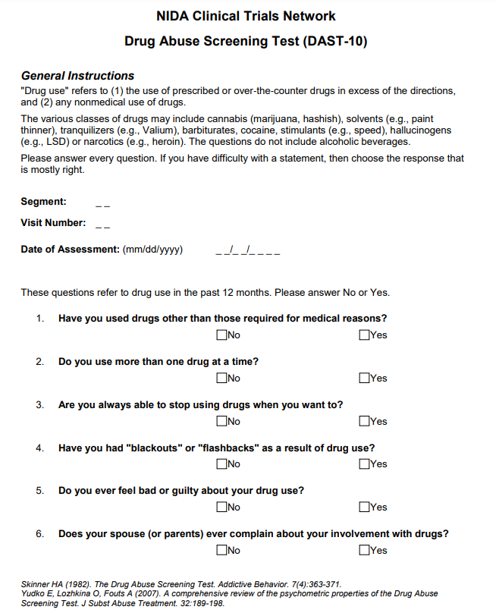
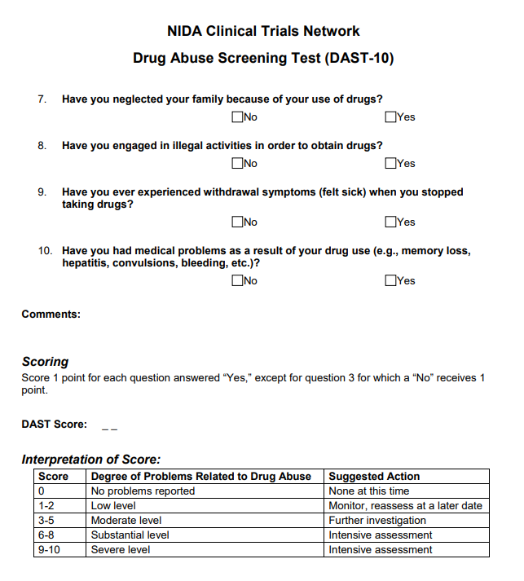

Drug Abuse Screening Test (DAST-10)

Slide 72
Reproductive Health
Embrace the awkward! 😱
Sexually active adolescents are at particular risk of chlamydia and gonorrhea infection and other sexually transmitted infections (STIs).
Screening for chlamydia and gonorrhea is recommended for all females younger than 25 years who are sexually active (15-24).
HIV screening should be offered to all sexually active adolescents.
Multiple medical societies recommend that clinicians privately assess patients' sexual behaviors and have awareness of challenges in protecting confidentiality.
All states explicitly allow minors to consent for their own
STI care.
Klein DA, Valerio CR, Cofield ZN. Sexually Transmitted Infections: Updated Guideline From the CDC. Am Fam Physician. 2022 May 1;105(5):553-557. PMID: 35559622

Slide 73
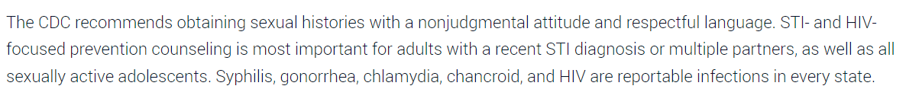
Screening Recommendations
Klein DA, Valerio CR, Cofield ZN. Sexually Transmitted Infections: Updated Guideline From the CDC. Am Fam Physician. 2022 May 1;105(5):553-557. PMID: 35559622

Slide 74
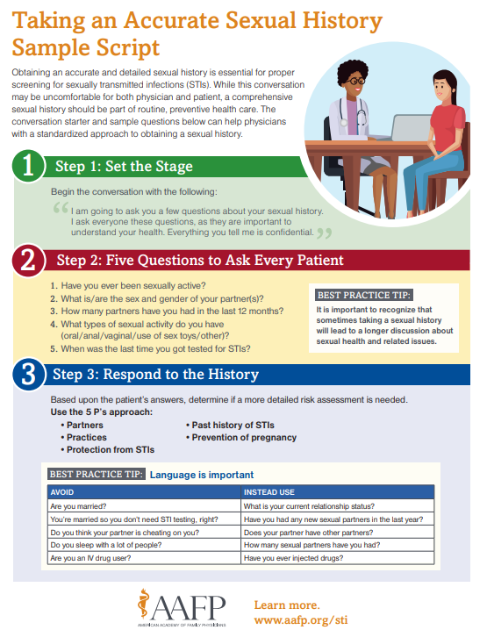
https://www.aafp.org/family-physician/patient-care/care-resources/sexually-transmitted-infections.html

Slide 75
https://www.aafp.org/family-physician/patient-care/care-resources/sexually-transmitted-infections.html

Slide 76
Adolescent Pregnancy
Compared with non-pregnant adolescents, teenage mothers are less likely to graduate from high school.
They are more likely to have low self-esteem and symptoms of depression and substance use problems.
Children of adolescent mothers are at greater risk of preterm birth, low birth weight, child abuse, neglect, poverty, and death.
As-Sanie S, Gantt A, Rosenthal MS. Pregnancy prevention in adolescents. Am Fam Physician. 2004 Oct 15;70(8):1517-24. PMID: 15526738

Slide 77
Abstinence-only Sex Education
Abstinence-only programs teach that abstinence is the only certain way to avoid pregnancy and STIs, and associated health problems; they may not teach about, endorse, or promote contraception use.
Studies of abstinence-only programs also have failed to show significant improvement in self-reported rates of intercourse or pregnancy.
As-Sanie S, Gantt A, Rosenthal MS. Pregnancy prevention in adolescents. Am Fam Physician. 2004 Oct 15;70(8):1517-24. PMID: 15526738

Slide 78
Comprehensive Sex Education
Comprehensive sex education presents abstinence as the most effective method of preventing pregnancy and STIs, but also discusses contraception as an appropriate strategy for persons who are sexually active.
28 well-designed experimental studies found that most comprehensive sex education programs were shown to significantly improve these initiation of sexual activity, number of sex partners, and the reported use of condoms and other contraceptive methods.
As-Sanie S, Gantt A, Rosenthal MS. Pregnancy prevention in adolescents. Am Fam Physician. 2004 Oct 15;70(8):1517-24. PMID: 15526738

Slide 79
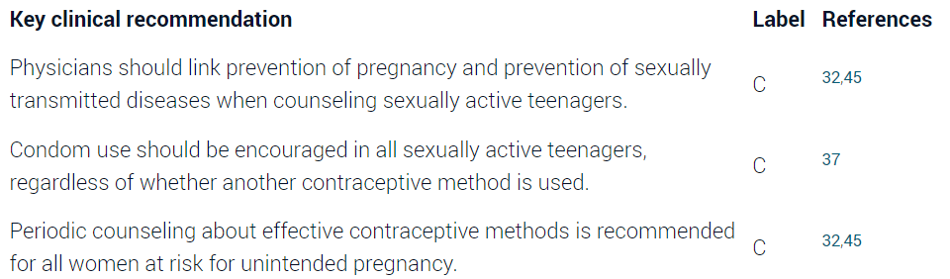
As-Sanie S, Gantt A, Rosenthal MS. Pregnancy prevention in adolescents. Am Fam Physician. 2004 Oct 15;70(8):1517-24. PMID: 15526738

Slide 80
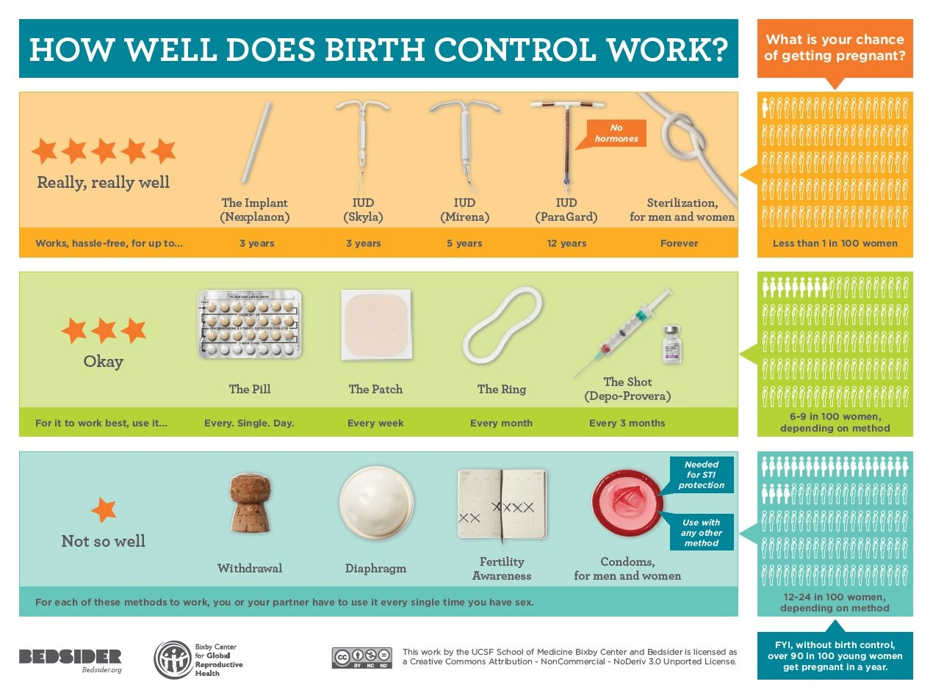

https://www.bridgercare.org/blog/bridgercares-4-most-popular-birth-control-methods

Slide 81
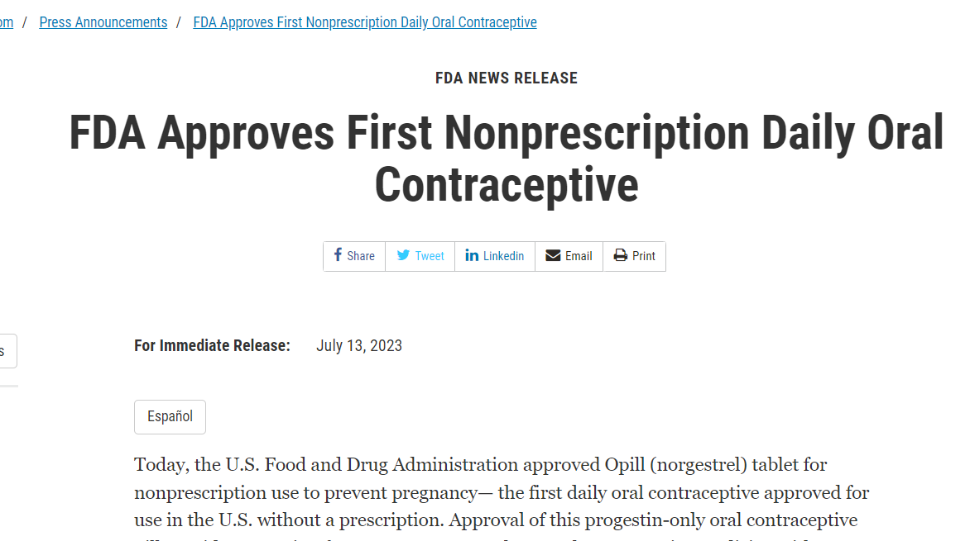
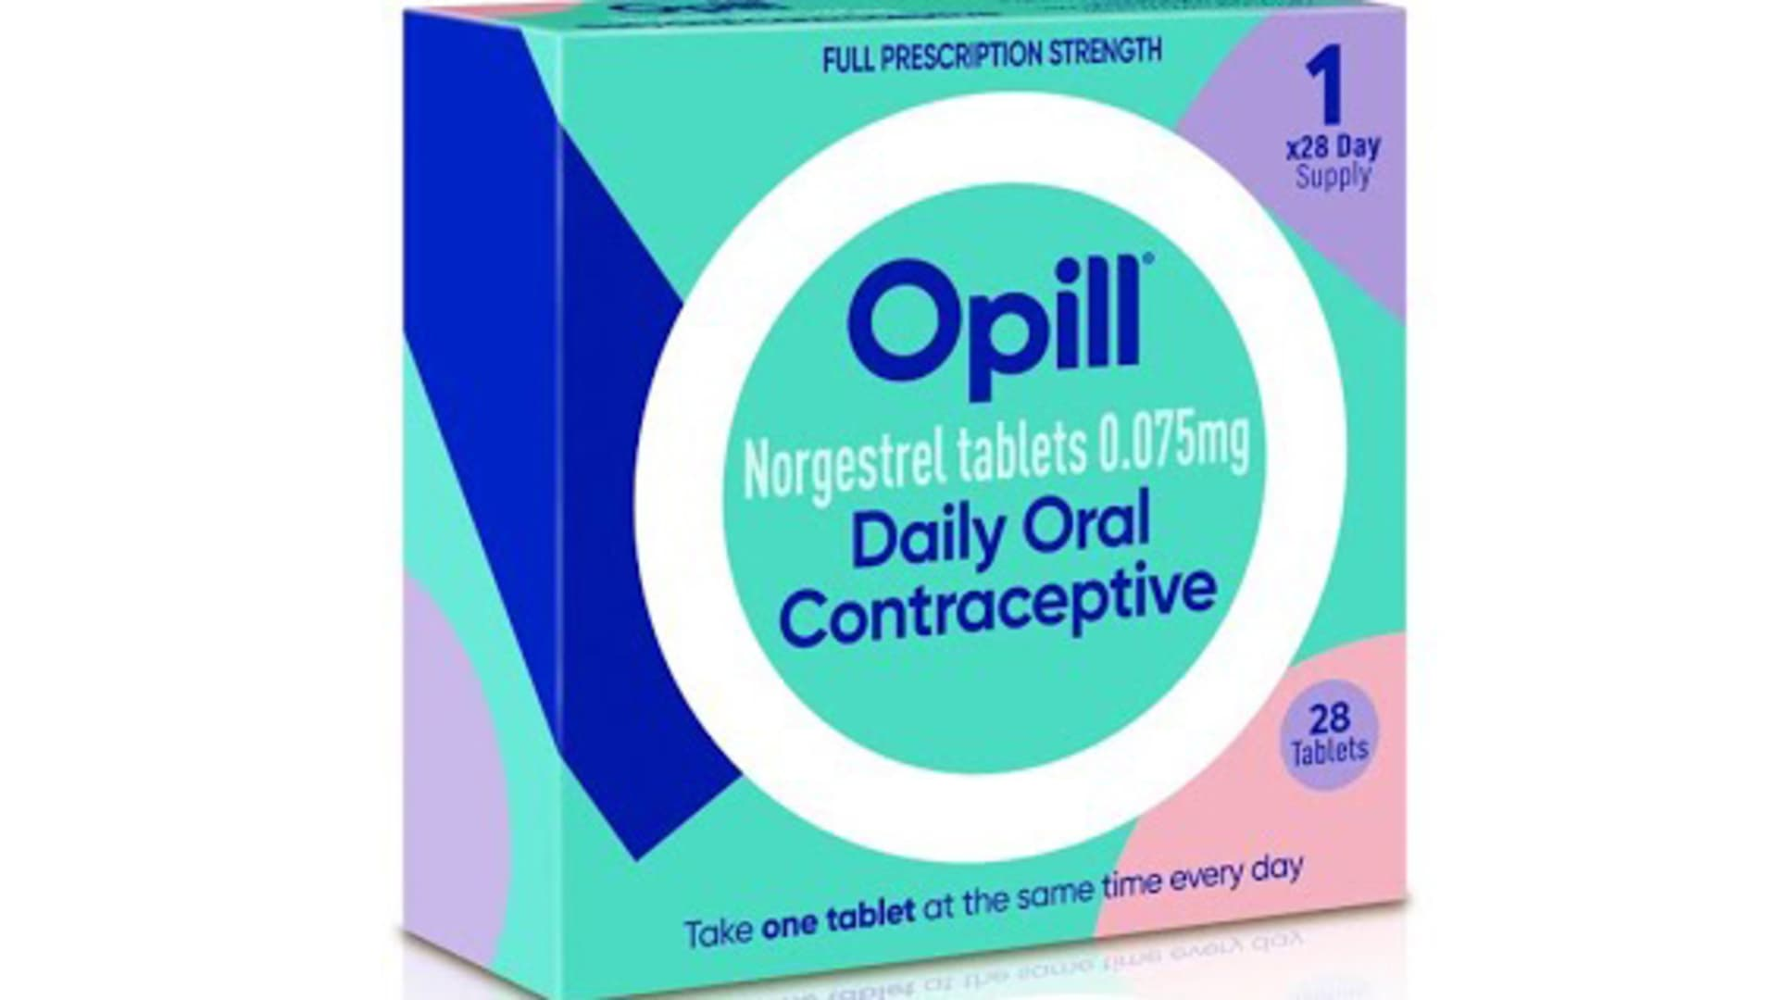
https://www.fda.gov/news-events/press-announcements/fda-approves-first-nonprescription-daily-oral-contraceptive

Slide 82
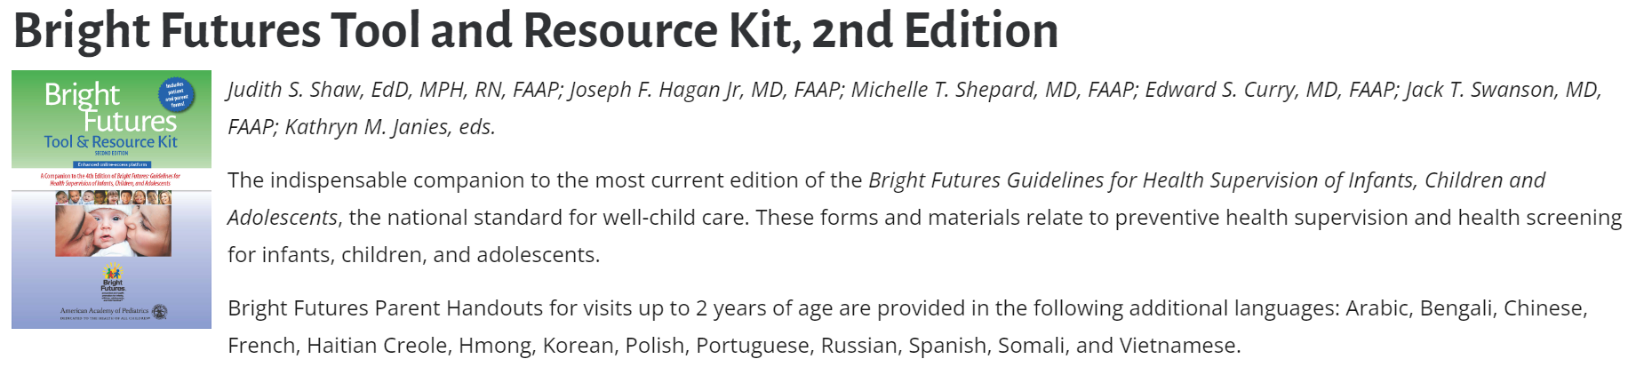
Subscription required but comprehensive:
Previsit Questionnaire (11 yo and up include patient and parent/guardian forms with option for sensitive questions)
Visit Documentation
Parent/Patient Handouts (Anticipatory guidance)
Supplemental Education Handouts
Car safety, gun safety, puberty, VIS,
Additional Resources
Links to other screening tools
https://shop.aap.org/bright-futures-tool-and-resource-kit-2nd-edition/

Slide 83
HEADSS
Home | Where do you live? Who lives with you? Do you feel safe at home? Pets? Guns?
Education | Where do you go to school? Recent Change? What do you like/not like? Safety? Grades/IEP?
Activity/Employment | What do you do for fun? Friends? Exercise? Do you feel comfortable with your body? Eating habits?
Drugs | Do you have friends who drink/smoke/do drugs? Drug use in the home? Have you ever tried …?
Suicidality | Have you ever been so sad that you have thought about hurting yourself? Cutting? Better off without you?
Sex | Have you ever dated anyone? Male, female or both? Have you had sex? Protection? Assaulted?
Katzenellenbogen, R. HEADESS: The “Review of Symstems” for Adolescents. Virtual Mentor. 2005:7(3):231-233. doi:10.1001/virtualmentor.2005.7.3cprl1-0503

Slide 84
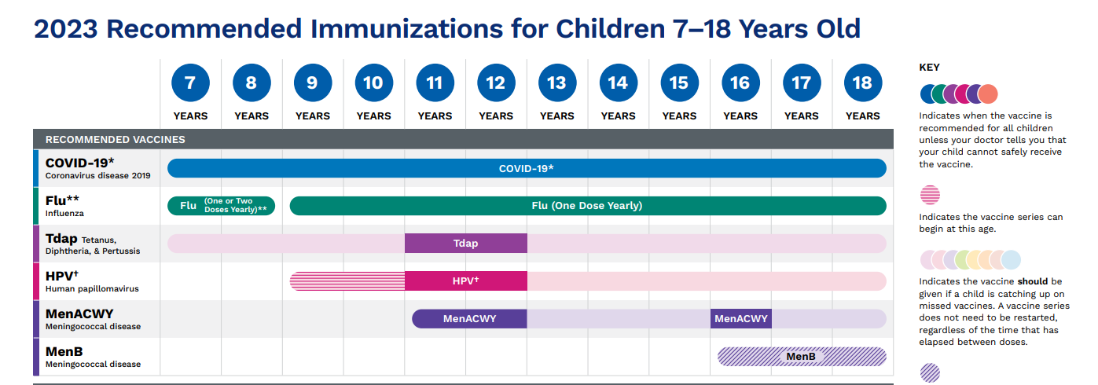
Vaccines
https://www.cdc.gov/vaccines/schedules/downloads/teen/parent-version-schedule-7-18yrs.pdf

Slide 85
NC School Requirements
Kindergarten
DTaP -
Polio – 4
Measles/Mumps – 2
Rubella – 1
HIB – 4
HBV - 3
VAR - 2
PCV – 4
7th Grade
Add Tdap – 1
MenACWY – 1
12th Grade
MenACWY – 1 (2 total)
Recommended
Covid-19
Flu (annually)
HPV (2 – 3 doses depending on age started)
Men B
https://immunization.dph.ncdhhs.gov/schools/k-12.htm

Slide 86
Consent in North Carolina
§ 90-21.5. Minor's consent sufficient for certain medical health services. (a) Subject to subsection (a1) of this section, any minor may give effective consent to a physician licensed to practice medicine in North Carolina for medical health services for the prevention, diagnosis and treatment of (i) venereal disease and other diseases reportable under G.S. 130A-135, (ii) pregnancy, (iii) abuse of controlled substances or alcohol, and (iv) emotional disturbance. This section does not authorize the inducing of an abortion, performance of a sterilization operation, or admission to a 24-hour facility licensed under Article 2 of Chapter 122C of the General Statutes except as provided in G.S. 122C-223. This section does not prohibit the admission of a minor to a treatment facility upon his own written application in an emergency situation as authorized by G.S. 122C-223.
https://www.ncleg.net/EnactedLegislation/Statutes/PDF/ByArticle/Chapter_90/Article_1A.pdf

Slide 87
Consent In North Carolina
§ 90-21.5. Minor's consent sufficient for certain medical health services.
(a1) Notwithstanding any other provision of law to the contrary, a health care provider shall obtain written consent from a parent or legal guardian prior to administering any vaccine that has been granted emergency use authorization and is not yet fully approved by the United States Food and Drug Administration to an individual under 18 years of age. (added 2021)
Controversial Vaccines that are FDA approved:
Human Papilloma Virus
Moderna Covid-19 Vaccine, Bivalent
Pfizer-BioNTech Covid-19, Bivalent
*Many adolescents want to catch up during pre-college exams – remember to ASK!!
https://www.ncleg.net/EnactedLegislation/Statutes/PDF/ByArticle/Chapter_90/Article_1A.pdf

Slide 88
Approach
Confidentiality and trust: Respecting privacy fosters open communication and trust.
Developmentally appropriate care: Tailoring healthcare to meet the unique needs and risk factors of adolescents.
Whole person approach: Addressing physical, mental, and social aspects of health.
Collaboration: Involving parents, schools, and other stakeholders in adolescent healthcare.

Slide 89
Conclusion
Adolescent medicine plays a vital role in promoting the health and well-being of young individuals.
By addressing physical, mental, and social aspects of health, we can help adolescents thrive.
Let's work together to create a supportive environment and empower adolescents to make informed choices for their health.

Slide 90
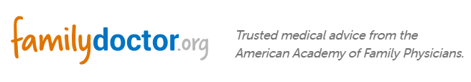

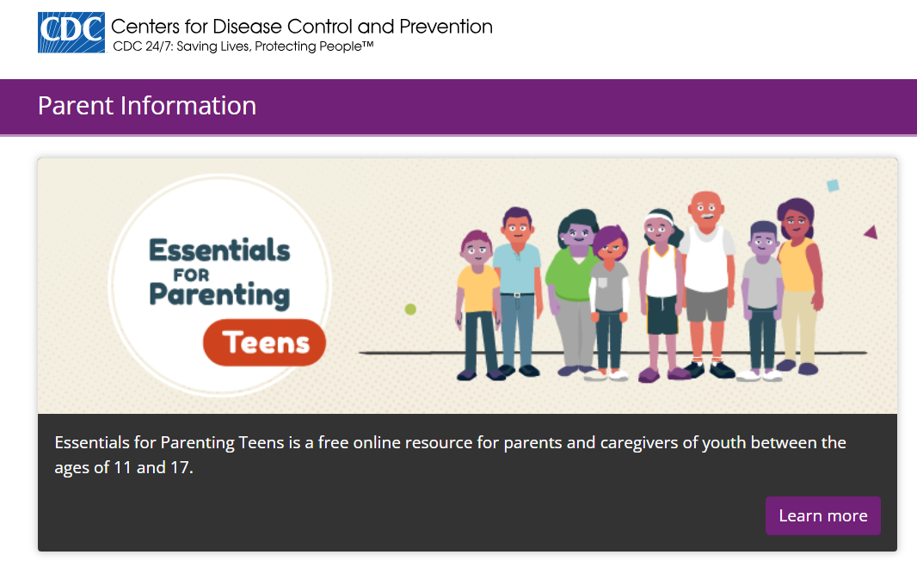
Resources for Parents
(English and Spanish)
https://familydoctor.org/
https://www.healthychildren.org/English/Pages/default.aspx
https://www.cdc.gov/parents/essentials/teens/index.html

Slide 91
Questions?

Slide 92
References
AMerriam-Webster.com/Dictionary https://www.merriam-webster.com/dictionary/adolescence#:~:text=%3A%20the%20period%20of%20life%20when,or%20process%20of%20growing%20up
World Health Organization https://www.who.int/health-topics/adolescent-health#tab=tab_2 Klein DA, Emerick JE, Sylvester JE, Vogt KS. Disorders of Puberty: An Approach to Diagnosis and Management. Am Fam Physician. 2017 Nov 1;96(9):590-599. PMID: 29094880.Christie D, Viner R. Adolescent development. BMJ. 2005 Feb 5;330(7486):301-4. doi: 10.1136/bmj.330.7486.301. PMID: 15695279; PMCID: PMC548185.Goldstick, JE, Cunningham RM, Carter PM Current Causes of Death in Children and Adolescents in the United States N Engl J Med 2022; 386:1955-1956 DOI: 10.1056/NEJMc2201761
John Gramlich https://pewrsr.ch/413hy18
https://www.aap.org/en/patient-care/gun-safety-and-injury-prevention/
Lois K. Lee, Eric W. Fleegler, Monika K. Goyal, Kiesha Fraser Doh, Danielle Laraque-Arena, Benjamin D. Hoffman, THE COUNCIL ON INJURY, VIOLENCE, AND POISON PREVENTION; Firearm-Related Injuries and Deaths in Children and Youth: Injury Prevention and Harm Reduction. Pediatrics December 2022; 150 (6): e2022060070. 10.1542/peds.2022-060070
Solnick, S.J., Hemenway, D. Unintentional firearm deaths in the United States 2005–2015. Inj. Epidemiol. 6, 42 (2019). https://doi.org/10.1186/s40621-019-0220-0
https://www.parentmap.com/article/five-easy-questions-what-you-should-ask-before-the-sleepover
Sally C Curtin, MA National Vital Statistics Reports, Vol. 69, No. 11, September 11, 2020
Youth Risk Behavior Survey 2011-2021 CDC.gov
Ruch, D; Sheftall, A, Schlagbaum, P et al Trends in Suicide Among Youth Aged 10-19 Years in the United States, 1975 to 2016 JAMA Netw Open. 2019;2(5):e193886. doi:10.1001/jamanetworkopen.2019.3886

Slide 93
Selph SS, McDonagh MS. Depression in Children and Adolescents: Evaluation and Treatment. Am Fam Physician. 2019 Nov 15;100(10):609-617. PMID: 31730312.
https://www.nimh.nih.gov/research/research-conducted-at-nimh/asq-toolkit-materials#outpatient
https://www.cdc.gov/injury/budget/policy_approaches_ACEs.html
Bryant DJ, Oo M, Damian AJ. The rise of adverse childhood experiences during the COVID-19 pandemic. Psychol Trauma. 2020 Aug;12(S1):S193-S194. doi: 10.1037/tra0000711. Epub 2020 Jun 18. PMID: 32551773.
Riddell CA, Neumann K, Santaularia NJ, Farkas K, Ahern J, Mason SM. Excess Google Searches for Child Abuse and Intimate Partner Violence During the COVID-19 Pandemic: Infoveillance Approach. J Med Internet Res. 2022 Jun 13;24(6):e36445. doi: 10.2196/36445. PMID: 35700024; PMCID: PMC9202515.
Anderson KN, Swedo EA, Trinh E, et al. Adverse Childhood Experiences During the COVID-19 Pandemic and Associations with Poor Mental Health and Suicidal Behaviors Among High School Students — Adolescent Behaviors and Experiences Survey, United States, January–June 2021. MMWR Morb Mortal Wkly Rep 2022;71:1301–1305.
https://centerforyouthwellness.org
https://www.aacap.org/AACAP/Families_and_Youth/Facts_for_Families/FFF-Guide/Children-With-Learning-Disorders-016.aspx
Curtin MJ, Willis DR, Enneking B. Specific Learning Disabilities: The Family Physician's Role. Am Fam Physician. 2019 Nov 15;100(10):628-635. PMID: 31730315.
Brook JS, Brook DW, Zhang C, Seltzer N, Finch SJ. Adolescent ADHD and adult physical and mental health, work performance, and financial stress. Pediatrics. 2013 Jan;131(1):5-13. doi: 10.1542/peds.2012-1725. Epub 2012 Dec 10. PMID: 23230074; PMCID: PMC3529955.
Biederman J, Monuteaux MC, Spencer T, Wilens TE, Faraone SV. Do stimulants protect against psychiatric disorders in youth with ADHD? A 10-year follow-up study. Pediatrics. 2009 Jul;124(1):71-8. doi: 10.1542/peds.2008-3347. PMID: 19564285; PMCID: PMC2954591.
Biederman J, Wilens T, Mick E, Spencer T, Faraone SV. Pharmacotherapy of attention-deficit/hyperactivity disorder reduces risk for substance use disorder. Pediatrics. 1999 Aug;104(2):e20. doi: 10.1542/peds.104.2.e20. PMID: 10429138.

Slide 94
Danielson ML, Bitsko RH, Ghandour RM, Holbrook JR, Kogan MD, Blumberg SJ. Prevalence of Parent-Reported ADHD Diagnosis and Associated Treatment Among U.S. Children and Adolescents, 2016. J Clin Child Adolesc Psychol. 2018 Mar-Apr;47(2):199-212. doi: 10.1080/15374416.2017.1417860. Epub 2018 Jan 24. PMID: 29363986; PMCID: PMC5834391.
Anastopoulos AD, DuPaul GJ, Weyandt LL, Morrissey-Kane E, Sommer JL, Rhoads LH, Murphy KR, Gormley MJ, Gudmundsdottir BG. Rates and Patterns of Comorbidity Among First-Year College Students With ADHD. J Clin Child Adolesc Psychol. 2018 Mar-Apr;47(2):236-247.
Mark L. Wolraich, Eugenia Chan, Tanya Froehlich, Rachel L. Lynch, Ami Bax, Susan T. Redwine, Demvihin Ihyembe, Joseph F. Hagan; ADHD Diagnosis and Treatment Guidelines: A Historical Perspective. Pediatrics October 2019; 144 (4): e20191682. 10.1542/peds.2019-1682
Mark L. Wolraich, Joseph F. Hagan, Carla Allan, Eugenia Chan, Dale Davison, Marian Earls, Steven W. Evans, Susan K. Flinn, Tanya Froehlich, Jennifer Frost, Joseph R. Holbrook, Christoph Ulrich Lehmann, Herschel Robert Lessin, Kymika Okechukwu, Karen L. Pierce, Jonathan D. Winner, William Zurhellen, SUBCOMMITTEE ON CHILDREN AND ADOLESCENTS WITH ATTENTION-DEFICIT/HYPERACTIVE DISORDER; Clinical Practice Guideline for the Diagnosis, Evaluation, and Treatment of Attention-Deficit/Hyperactivity Disorder in Children and Adolescents. Pediatrics October 2019; 144 (4): e20192528. 10.1542/peds.2019-2528
Gaba, P, Giordanengo, M, Attention-Deficit/Hyperactivity Disorder: Screening and Evaluation. American Family Physician, 2019-06-01, Volume 99, Issue 11, Pages 712-712,
Balasundaram P, Santhanam P. Eating Disorders. [Updated 2023 Mar 8]. In: StatPearls [Internet]. Treasure Island (FL): StatPearls Publishing; 2023 Jan https://www.ncbi.nlm.nih.gov/books/NBK567717
Parker MN, Lavender JM, Schvey NA, Tanofsky-Kraff M. Practical Considerations for Using the Eating Disorder Examination Interview with Adolescents. Adolesc Health Med Ther. 2023 Feb 23;14:63-85. doi: 10.2147/AHMT.S220102. PMID: 36860931; PMCID: PMC9969870.

Slide 95
Neville H. Golden, Marcie Schneider, Christine Wood, COMMITTEE ON NUTRITION, COMMITTEE ON ADOLESCENCE, SECTION ON OBESITY, Stephen Daniels, Steven Abrams, Mark Corkins, Sarah de Ferranti, Sheela N. Magge, Sarah Schwarzenberg, Paula K. Braverman, William Adelman, Elizabeth M. Alderman, Cora C. Breuner, David A. Levine, Arik V. Marcell, Rebecca O’Brien, Stephen Pont, Christopher Bolling, Stephen Cook, Lenna Liu, Robert Schwartz, Wendelin Slusser; Preventing Obesity and Eating Disorders in Adolescents. Pediatrics September 2016; 138 (3): e20161649. 10.1542/peds.2016-1649
Whitlock, Evelyn & O'Connor, Elizabeth & Williams, Selvi & Beil, Tracy & Lutz, Kevin. (2008). Effectiveness of weight management programs in children and adolescents. Evidence report/technology assessment. 170. 1-308.
https://theheartfoundation.org/2018/02/09/childhood-obesity
https://www.apa.org/topics/social-media-internet/health-advisory-adolescent-social-media-use
https://www.hhs.gov/sites/default/files/sg-youth-mental-health-social-media-advisory.pdf
Abi-Jaoude E, Naylor KT, Pignatiello A. Smartphones, social media use and youth mental health. CMAJ. 2020 Feb 10;192(6):E136-E141. doi: 10.1503/cmaj.190434. PMID: 32041697; PMCID: PMC7012622
Gwenn Schurgin O'Keeffe, Kathleen Clarke-Pearson, Council on Communications and Media; The Impact of Social Media on Children, Adolescents, and Families. Pediatrics April 2011; 127 (4): 800–804. 10.1542/peds.2011-0054
https://tdsu.org/
https://www.aap.org/en/patient-care/media-and-children/center-of-excellence-on-social-media-and-youth-mental-health/
Slekman J. Vaping: It’s all a smokescreen. Pediatric Nursing. 2019;45(1):12–15. 35.
Jenssen BP, Wilson KM. What is new in electronic-cigarettes research? Current Opinion in Pediatrics. 2019;31(2):262–266. doi: 10.1097/mop.0000000000000741.
Jones K. Salzman G. The Vaping Epidemic in Adolescents. Mo Med. 2020 Jan-Feb; 117(1): 56–58
Cullen KA, Ambrose BK, Gentzke AS, Apelberg BJ, Jamal A, King BA. Notes from the Field: Use of Electronic Cigarettes and Any Tobacco Products Among Middle and High School Students – United States, 2011-2018. MMWR Morb Mortal Wkly Rep 2018;67:1276-1277

Slide 96
The State of Underage Drinking in North Carolina, North Carolina ABC Commission, 2014, page 8
The State of Underage Drinking in North Carolina, North Carolina ABC Commission, 2015, page 10
North Carolina Youth Risk Behavior Survey, North Carolina Department of Public Instruction, Healthy Schools Initiative, 2013, page 27
Am Fam Physician. 2019;99(12). https://www.aafp.org/pubs/afp/issues/2019/0615/od1.html
National Institute on Alcohol Abuse and Alcoholism. Helping patients who drink too much: a clinician's guide; 2005. https://www.niaaa.nih.gov/guide. Accessed October 1, 2018
https://journalofethics.ama-assn.org/article/headss-review-systems-adolescents/2005-03
talkitoutnc.org
NIDA. 2021, December 15. Percentage of adolescents reporting drug use decreased significantly in 2021 as the COVID-19 pandemic endured. Retrieved from https://nida.nih.gov/news-events/news-releases/2021/12/percentage-of-adolescents-reporting-drug-use-decreased-significantly-in-2021-as-the-covid-19-pandemic-endured on 2023, June 24
Skinner, H; The drug abuse screening test, Addictive Behaviors, Volume 7, Issue 4, 1982, Pages 363-371 https://doi.org/10.1016/0306-4603(82)90005-3.
Yudko E, Lozhkina O, Fouts A, A comprehensive review of the psychometric properties of the Drug Abuse Screening Test, Journal of Substance Abuse Treatment, Volume 32, Issue 2, 2007,Pages 189-198, https://doi.org/10.1016/j.jsat.2006.08.002.
Klein DA, Valerio CR, Cofield ZN. Sexually Transmitted Infections: Updated Guideline From the CDC. Am Fam Physician. 2022 May 1;105(5):553-557. PMID: 35559622
https://www.aafp.org/family-physician/patient-care/care-resources/sexually-transmitted-infections.html
As-Sanie S, Gantt A, Rosenthal MS. Pregnancy prevention in adolescents. Am Fam Physician. 2004 Oct 15;70(8):1517-24. PMID: 15526738

Slide 97
https://www.bridgercare.org/blog/bridgercares-4-most-popular-birth-control-methods
https://www.fda.gov/news-events/press-announcements/fda-approves-first-nonprescription-daily-oral-contraceptive
https://shop.aap.org/bright-futures-tool-and-resource-kit-2nd-edition/
Katzenellenbogen, R. HEADESS: The “Review of Symstems” for Adolescents. Virtual Mentor. 2005:7(3):231-233. doi:10.1001/virtualmentor.2005.7.3cprl1-0503
https://www.cdc.gov/vaccines/schedules/downloads/teen/parent-version-schedule-7-18yrs.pdf
https://www.ncleg.net/EnactedLegislation/Statutes/PDF/ByArticle/Chapter_90/Article_1A.pdf
https://familydoctor.org/
https://www.healthychildren.org/English/Pages/default.aspx
https://www.cdc.gov/parents/index.html

Slide 98


